Slide 1
CISY114 – Week 4
Authoring Tools & Audio

Slide 2
Quick Review (1/2)
Images are stored as bitmaps (individual pixels) or vectors (mathematically defined lines, drawn by the computer).
Color is stored by numbers.
  Binary: 11111111 11111111 11111111
  Hexidecimal: #FFFFFF.
  Decimal: 255,255,255
The size of the numbers is the bit depth. The higher the bit depth, the more colors we can represent, but the larger the file size.
Transparency is called alpha. (GIF,PNG)

Slide 3
Quick Review (2/2)
Since bitmaps are huge. To save space we use different forms of compression.
  Lossy vs lossless compression.
  Lossless techniques:
    Run-Length Encoding (“Tile Counting”), Lempel-Ziv-Welch (“Dictionary”), color palette, general compression.
    PNG, TIFF, GIF (<256 colors), & native file formats
  Lossy techniques:
    Interpolation (“pattern matching”), reduced color palette.
    JPEG, PNG-8, GIF

Slide 4
Any Questions?
Now in the winter of our discontent…

Slide 5
Authoring Systems
Vaughan’s “Helpful Ways to Get Started” advice on page 229
Types of Authoring Tools:
  Card- or Page-Based
  Icon- or Object-based
  Timeline Based

Slide 6
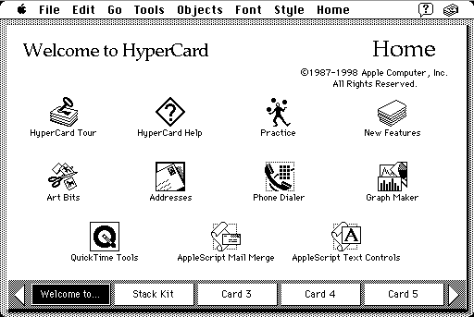
Card-/Page-Based
The first tool: Hypercard (for the original Macintosh and Apple IIGS).

Slide 7
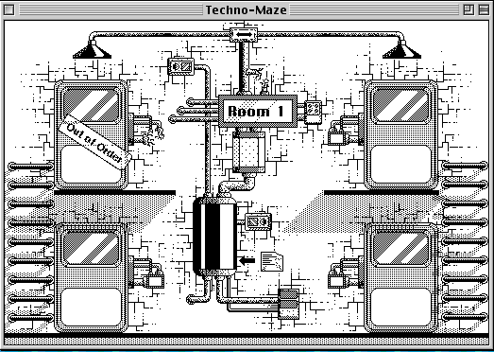

Slide 8
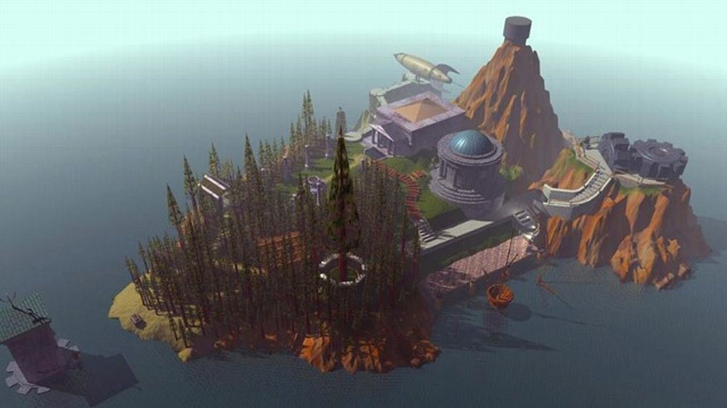

Slide 9
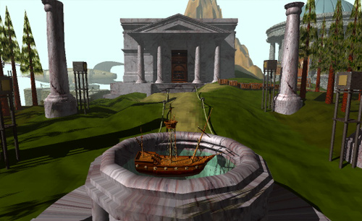

Slide 10
Card-/Page-Based
Today: Powerpoint. ☺
Advantages:
  Easy to use.
  Intuitive as slides.
  Quick to build.
Disadvantages:
  Rarely stand-alone.
  Limited to the card/page paradigm.

Slide 11
Icon-/Object-Based
Used to be popular, but have all but disappeared.
The two most popular tools in their day:
  Macromedia Authorware (deceased)
  IconAuthor (deceased)
Quick to build, but very limited.

Slide 12
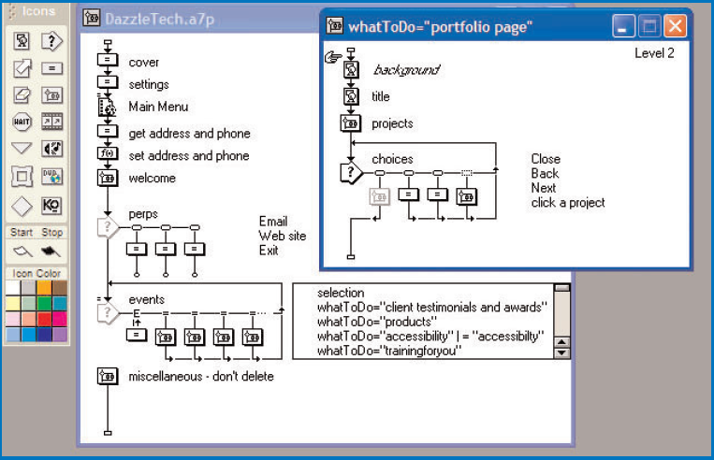

Slide 13
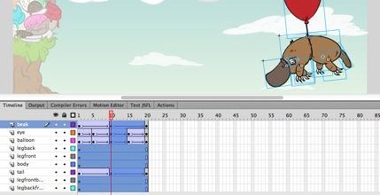
Timeline-Based
Elements and events are manipulated on a timeline. (Adobe Flash only contender.)

Slide 14
Timeline-Based
Advantages:
  Control and animation of elements.
  Extensive scripting capabilities.
  Cross-platform.
Disadvantages:
  HOGS System resources...
  High learning curve.
  On its way out.

Slide 15
Any Questions?
Awake! Awake! Ask thyself:

Slide 16
Audio

Slide 17
What IS Sound?
Close your eyes…
Listen…
Listen…
Listen…

Slide 18
So…. Sound, then. ☺
What is sound?

Slide 19
So…. Sound, then. ☺
What is sound?
  Vibrations through a medium (air, water, etc.), heard by our ears and interpreted in our brains.

Slide 20
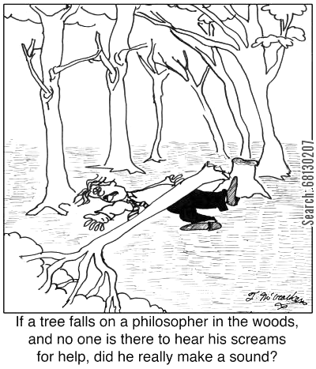

Slide 21
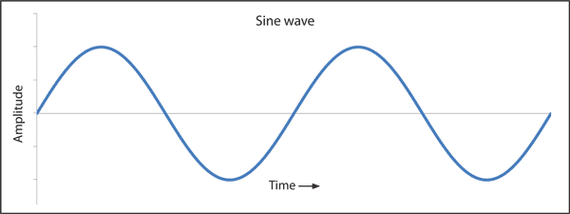
So…. Sound, then. ☺
What is sound?
  Vibrations through a medium (air, water, etc.), heard by our ears and interpreted in our brains.
  We *like* to think of them as “waves” but it’s a bit more complicated than that.

Slide 22
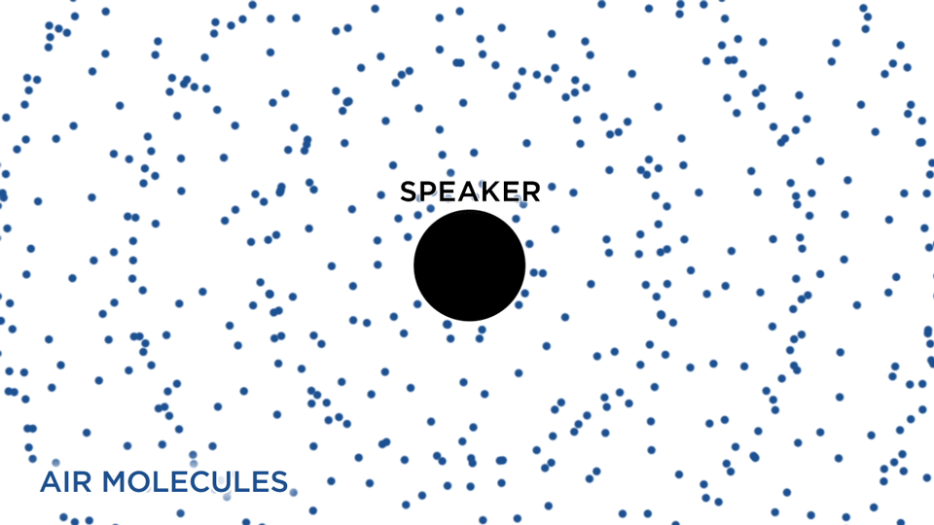
Npr.org

Slide 23
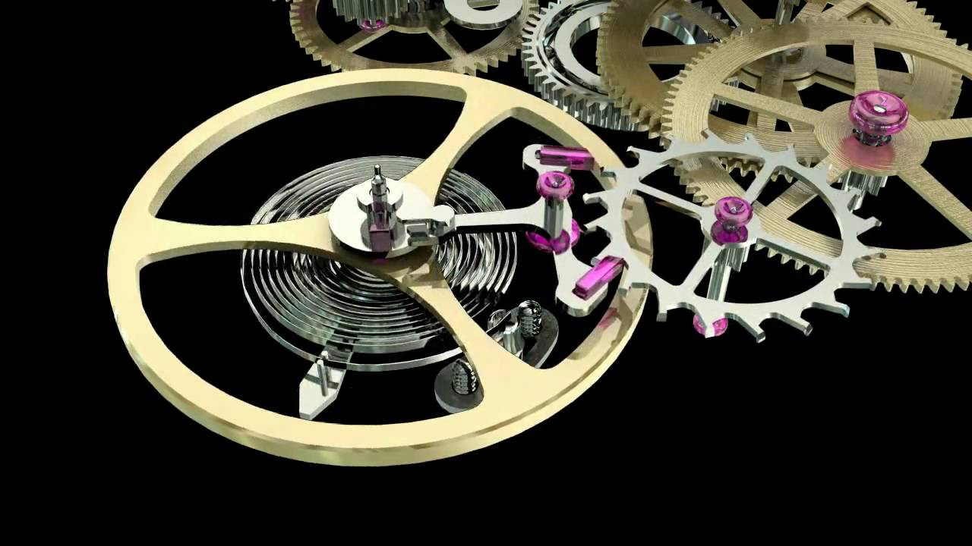

Slide 24
How do we measure sound?
Several metrics:
  The Magnitude level in Decibels (dB).
    Named after Alexander Bell, and are 1/10th units.
    Decibels are LOGARITHMIC and RELATIVE.
  The Frequency in Hertz (Hz).
    Named after Heinrich Hertz, who proved electromagnetic waves.
    1 Hz is one wave per second.

Slide 25
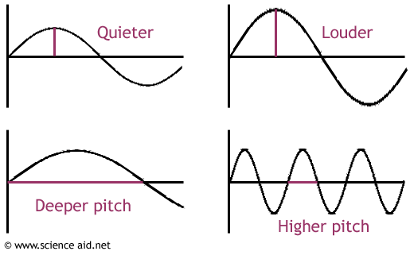

Slide 26
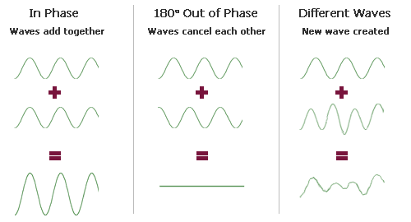

Slide 27
What Can We Hear?
Human beings can only hear between
20 Hz to 20 KHz and are
most sensitive to 2 KHz – 5 KHz.
Our relative hearing range is from 0 dB (i.e. what we can just perceive – remember dB are relative) to about 130 dB (the “threshold of pain”).

Slide 28
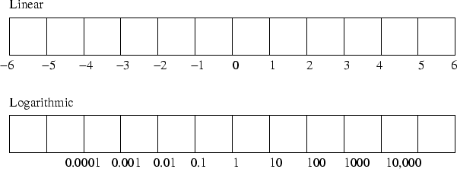
Bels Are Logarithmic

Slide 29
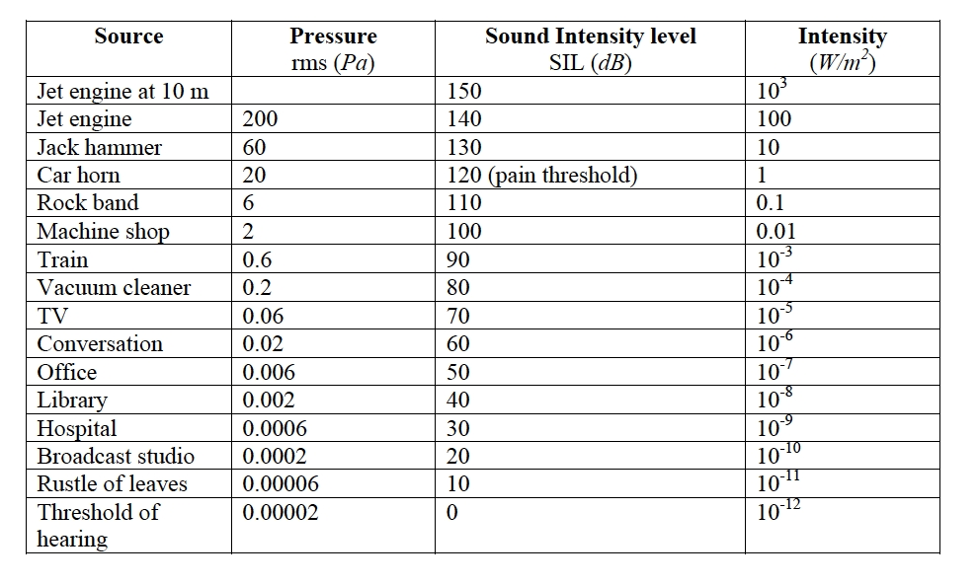

Slide 30
So How Do We Quantize It?
We need to choose a way to sample it that we can fit into a computer.

Slide 31
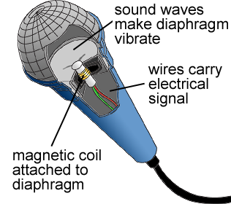
Concord.org

Slide 32
So How Do We Quantize It?
We need to choose a way to sample it that we can fit into a computer.
We need to choose two things:
  A sampling rate (in Hz) – How often we measure.
  A bit depth (in bits) – How accurately we measure.

Slide 33
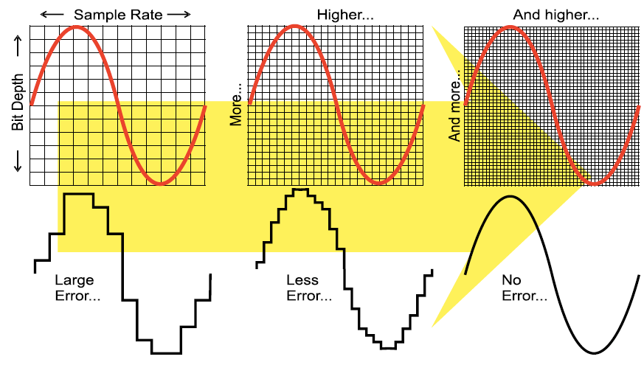
Not possible. ☺
This would be an
analog signal then!

Slide 34
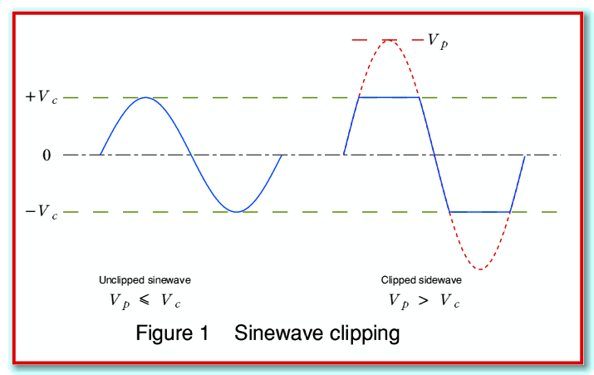
Normalization vs Clipping

Slide 35
Appropriate Sampling Rate
What happens if your sampling rate is 10 KHz and you’re trying to record a 10 KHz sound?

Slide 36
Appropriate Sampling Rate
What happens if your sampling rate is 10 KHz and you’re trying to record a 10 KHz sound?
Generally 44.1 KHz is considered “optimal” for the human ear.

Slide 37
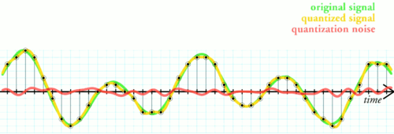
Quantizing introduces noise…

Slide 38
Let’s hear it…. (demo)

Slide 39
Mono or Stereo?
Human beings are bi-aural creatures. (Some argue tri-aural.)
Mono audio recordings only record one waveform.
Stereo record two, one for each ear.
Using fades between them, they can simulate 3 dimensions of sound.

Slide 40
Big Honking File Sizes
Audio recordings eat up a LOT of disk space.
Let’s do a calculation:
  60 seconds of audio
  At 44.1 KHz
  In 16 bits of depth
  In stereo
And the answer is: ?

Slide 41
Big Honking File Sizes
Audio recordings eat up a LOT of disk space.
And the answer is:
  (44.1 x 1000) Hz x 16 bits x 2 channels
  = 1,411,200 bits/sec. or 1.4112 megabits/sec.
  (bitrate)
  x 60 sec = 84,672,000 bits total.
  (232.8 tons of pennies)
  84,672,000 ÷ 8 bits ÷ 1000 ÷ 1000 = ~10.58 MB

Slide 42
We Need Compression!
What can we do to reduce file size?

Slide 43
We Need Compression!
What can we do to reduce file size/bit rate?
  Reduce sampling rate.
  Reduce bit depth.
    Chop off what we can’t hear. (MP3)
  Reduce length of file.
  Reduce channels (stereo -> mono).
    Selectively (like MP3) based on loudness.
  Generic file compression tricks. (zip)
A particular implementation of quantization and compression is called a codec (compressor-decompressor).

Slide 44
So As Promised…
Gregorian chant manuscripts as the first documented case of audio compression.

Slide 45
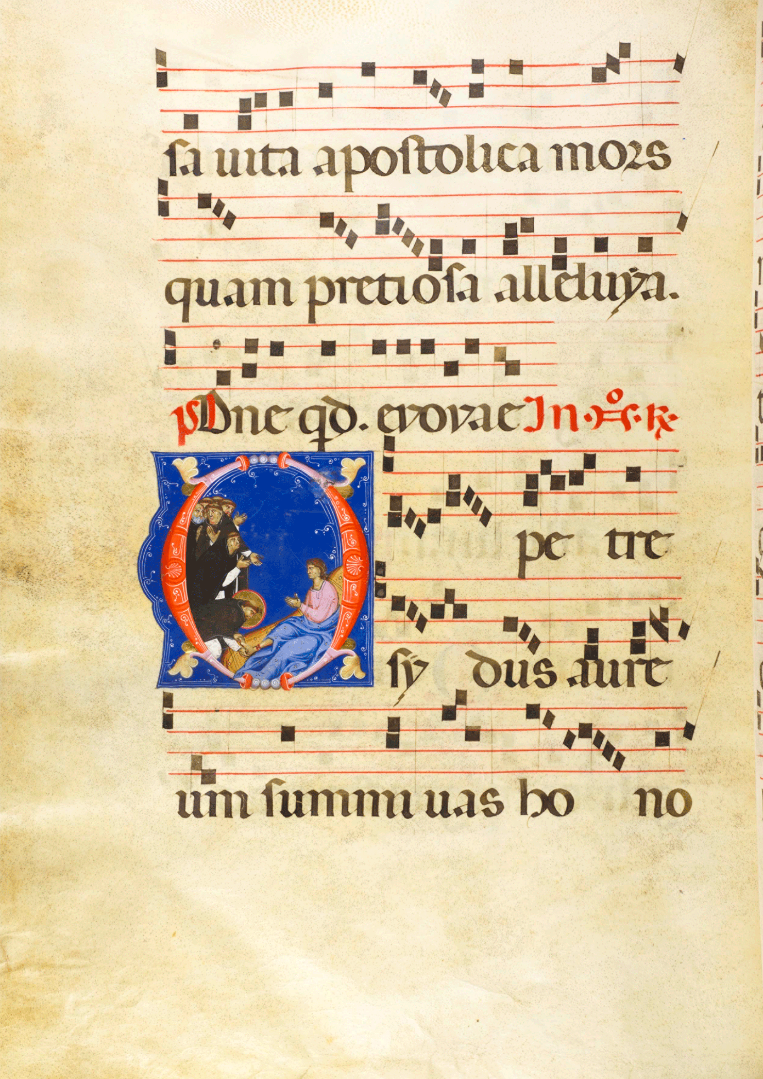

Slide 46
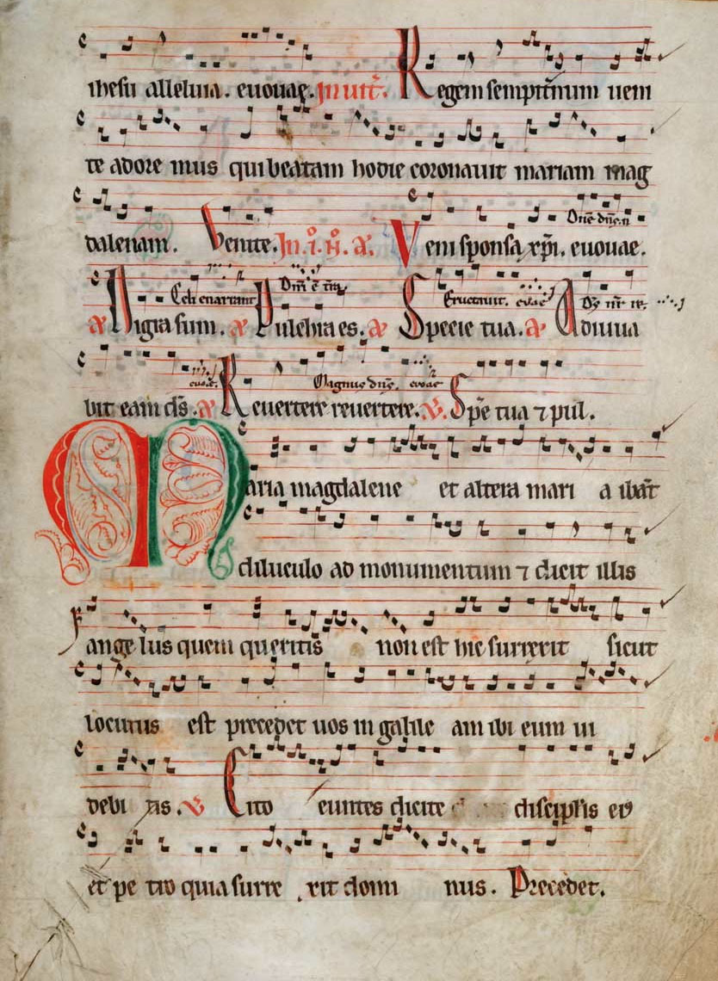

Slide 47
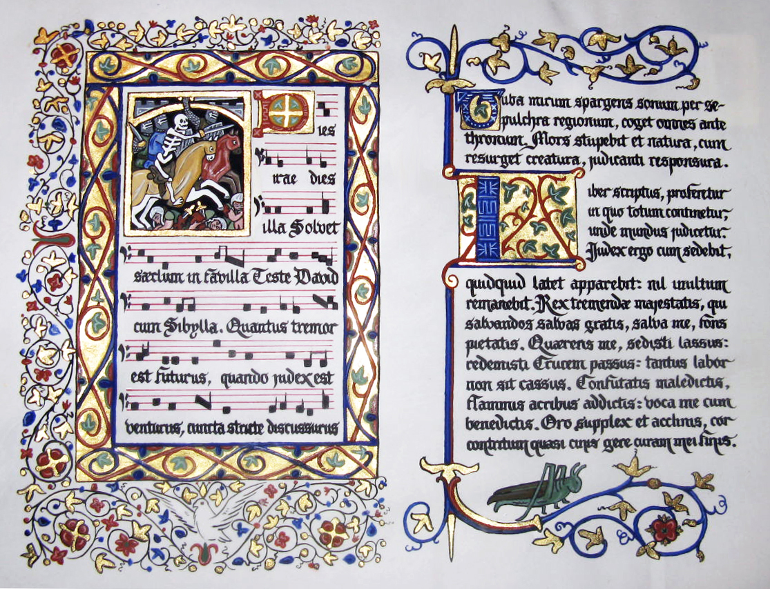

Slide 49
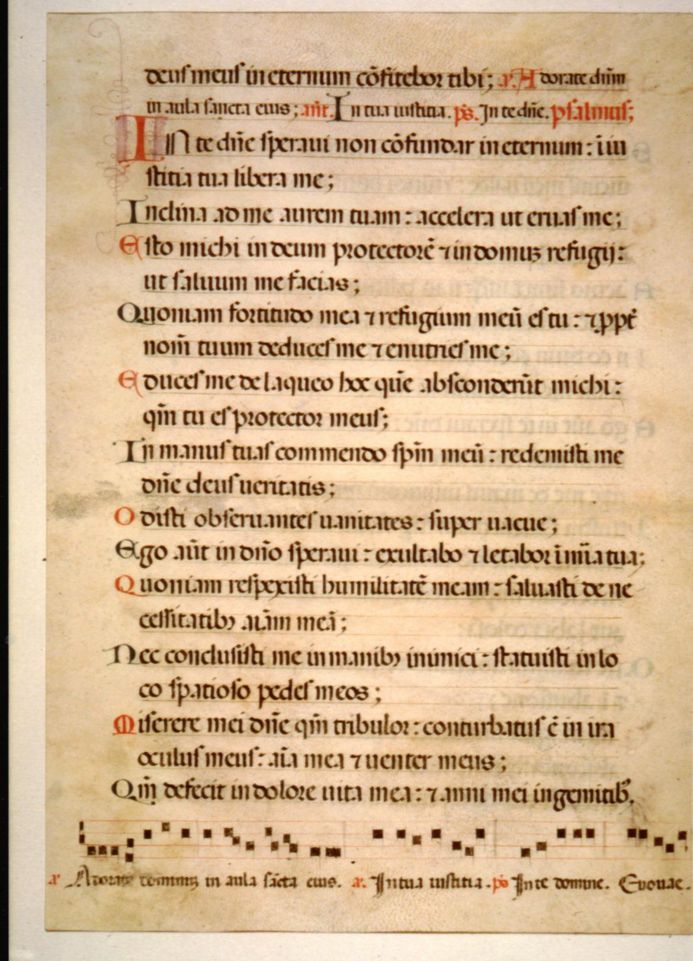

Slide 51
Are there any questions?
Awaken! And ask!

Slide 52
Be Back By….

