Slide 1
CISY114 Week 7
Designing & Producing
User Psychology

Slide 2
Let’s Talk About the Midterm
& Project 1
The Midterm is on March 15th (after we get back from Spring Break).
The Midterm Review has been posted to the Group Docs.

Slide 3
Let’s Talk About the Midterm
& Project 1
Project 1 is due on March 24th.
Project 1 Information has been posted to the Group Docs.
Links to UX Deliverables and User Personas are on the Schedule.

Slide 4
ARE THERE ANY QUESTIONS?
Spring Break Approacheth! But first…

Slide 5
Structure & Navigation
There are several navigation structures that your can use in a multimedia presentation:
  Linear
  Hierarchical
  Nonlinear
  Composite

Slide 6
Linear Navigation

Slide 7
Hierarchical Navigation
Level 1
Level 2
Level 3

Slide 8
Non-Linear Navigation

Slide 9
Composite Navigation

Slide 10
Visual Design Principles
Contrast
Repetition
Alignment
Proximity & Grouping
(We will be re-visiting these in a few weeks, too, but they’re on the Midterm.)

Slide 11
Contrast
Choosing colors and differing attributes to draw attention and distinction between different elements on the screen.

Slide 12
Contrast
Poor contrast because of bad color choices.
Better contrast because of good color choices.
Use a color wheel to find complimentary colors.
http://www.sessions.edu/color-calculator

Slide 13
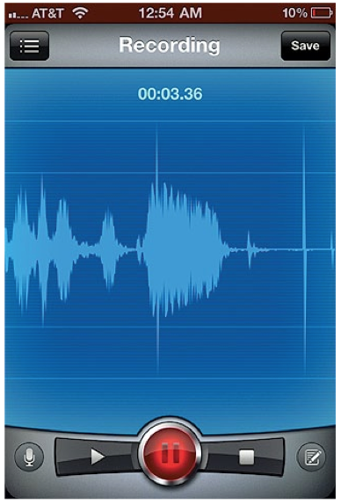
Contrast

Slide 14
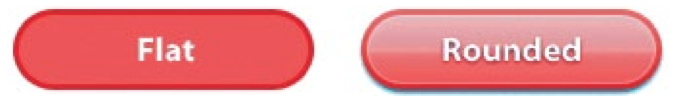
Other types of Contrast
Visual Affordances
  Cues given to the user when they begin to interact which indicate what they can do.

Slide 15
Repetition
Re-using elements or layouts in a manner that is intuitive.
A user should be able to rely upon the same functionality.

Slide 16
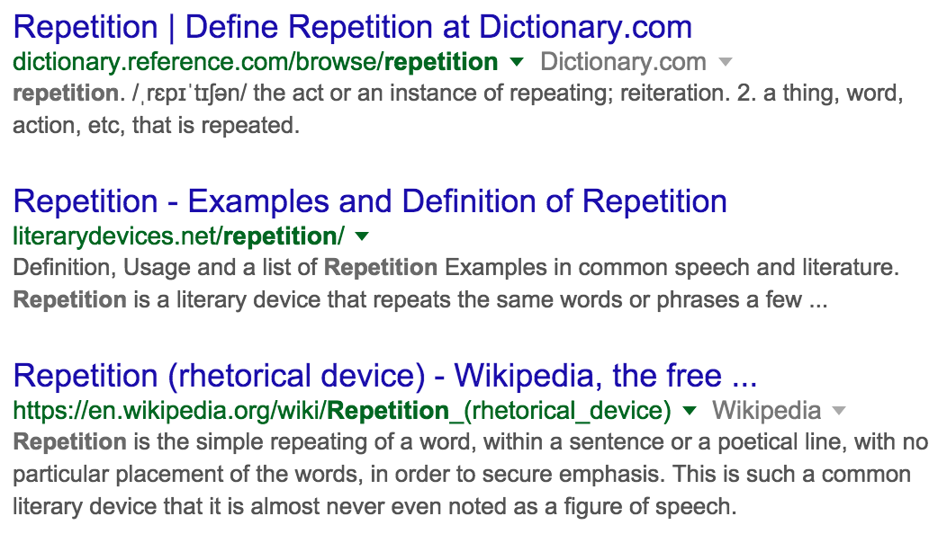
Repetition Repetition Repetition

Slide 17
Repetition
Do not re-define terms and icons!
For example, “Back” should have a defined action in navigation.
  Move one slide back in a linear progression.
  Move up one level.
  Go backwards in whatever path the user takes.
  Don’t mix and match!

Slide 18
Alignment
Making sure elements are regularly placed relative to each other.

Slide 19
Alignment

Slide 20
Alignment

Slide 21
Proximity & Grouping
Clustering related elements together so that it is obvious they function together.
This also depends upon the delivery method!

Slide 22
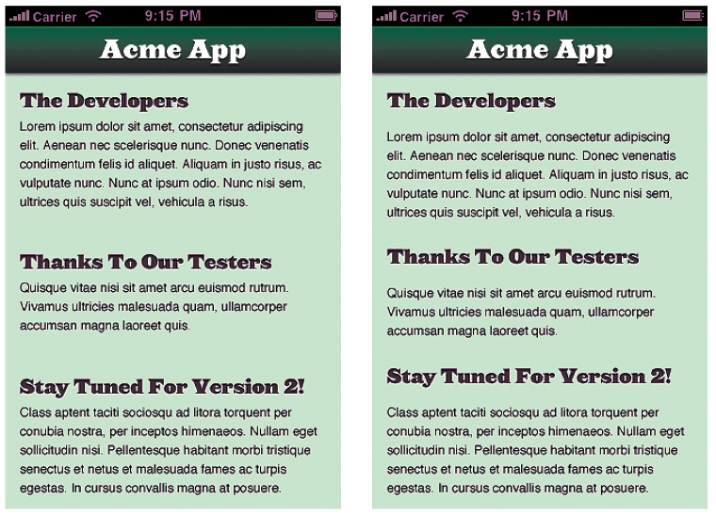
Proximity & Grouping

Slide 23
Putting It All Together
For your Projects you will need to keep all of these in mind.
Your set of design choices (layout, color, and “feel”) makes up your “brand identity.”
http://www.logodesignlove.com/brand-identity-style-guides ← Keep in mind for your Considerations document!

Slide 24
ARE THERE ANY QUESTIONS?
Navigate to question mode and ask…

Slide 25
The Psychology of Web Design
Susan Weinschenk talks about how humans are social animals.
  How we interact online follows rules for social interactions.
  “If the website is not responsive or takes too long to load, it is like the person we are speaking to is not looking at us or is ignoring us. If the website asks for personal information too soon in the flow of the interaction, it’s like someone getting too personal.” (p255)

Slide 26
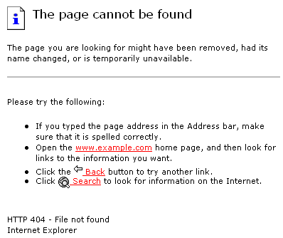
Example: The 404 Page
It’s like someone stood you up. CUE RAGE!!!

Slide 27
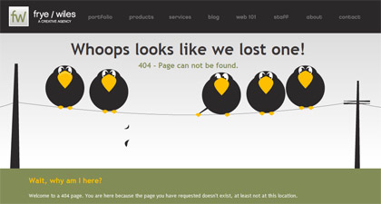
Defusing the 404:
Cracking a joke.

Slide 28
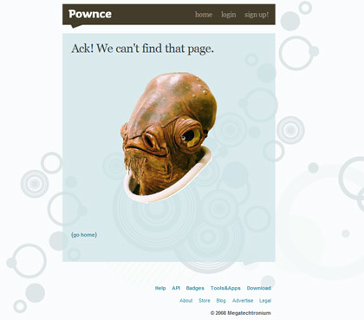
Defusing the 404:
Cracking a joke.

Slide 29
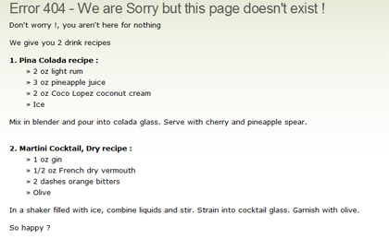
Defusing the 404:
Cracking a joke.

Slide 30
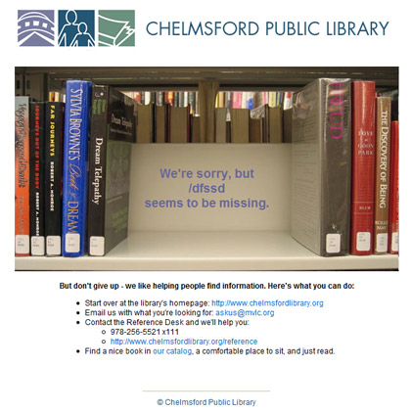
Defusing the 404:
Cracking a joke.

Slide 31
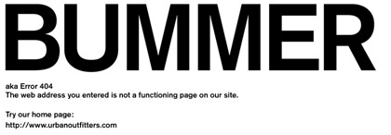
Defusing the 404:
Cracking a joke.
It’s like someone saying “I’m sorry.”

Slide 32
“Old Brain” & Distractions
Think of it as your brain’s reflexes.
Getting someone’s attention with multimedia, most effectively, is an effort at tripping one of those reflexes to get them looking in the right place, and then engage a user with relevant content.
Works the same with interface elements, etc. (Animations that catch the eye.)
I call this “brain hacking.”

Slide 33


Slide 34
⇒You’re looking about here.
That’s where the Lion’s eyes were.
You’ve been brain hacked.

Slide 35
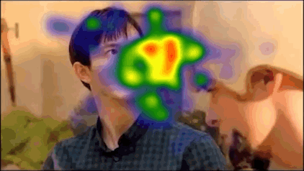
Eye Tracking
We have a good idea of where people look without even realizing it:
Notes:
There are some differences between men and women. There are more… “sexy” examples. But google those on your own time. Delete your browser history.

Slide 36
Getting Attention Summary:
Use something reflexive to gain attention.
  Faces.
  Indications of motion.
  Etc.
Immediately engage your user with content.
  A story or other means to keep their attention.
  Engage past the reflexes.

Slide 37
Ambiguous Situations
The Latane and Darlane Experiment.
  One of my favorites!
Subjects given a test to take in a room where smoke would come in through the vent.
  The more people in the room who acted as if it was normal, the more likely they were to act as if it was normal. fnord
There is a sense of Social Inertia.
Notes:
START THE STOP WATCH

Slide 38
Ambiguous Situations:
We, as social animals, also look to others for cues in unfamiliar or ambiguous situations.
  Reviews and recommendations are a big factor.
  I call it “looking for authentication.”
  Let’s see how it works!

Slide 39
Ambiguous Situations:
Also tied in with the Paradox of Choice.
  (Weinschenk doesn’t go into this, but it’s an important principle.)
  Wife: “Go get some extra virgin olive oil.”
  Me: “Well, which do you prefer?”
  Local Supermarket vs. Whole Foods

Slide 40


Extra Virgin Olive Oil

Slide 41
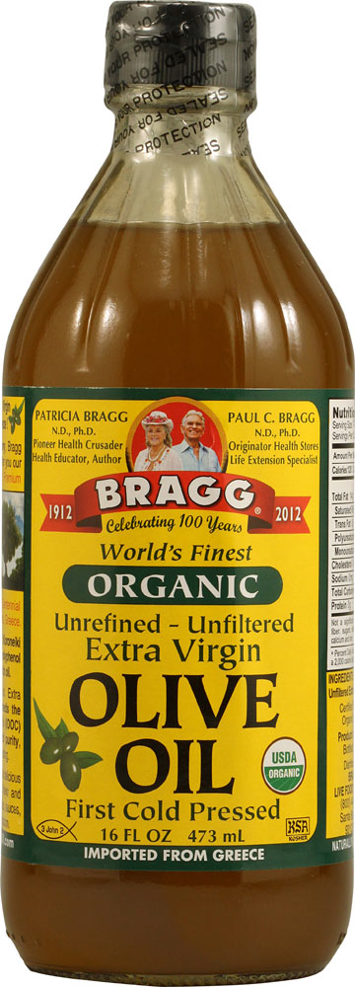
Extra Virgin Olive Oil

Slide 42
Extra Virgin Olive Oil
The time you take to choose is greater and your satisfaction with your choice is less.

Slide 43
Extra Virgin Olive Oil

Slide 44

Extra Virgin Olive Oil
Notes:
You’re going to have to justify your decision.

Slide 45
Extra Virgin Olive Oil
Fewer, good choices, better reaction time, higher satisfaction.

Slide 46
Personal Example
Vending at events with my family company:
When I offered 6-8 different types of pocket watches, the majority of conversations were long and about “which one is best?”
When they were pared down to 3-4 types, sales and satisfaction went up and conversations were about what they liked about them.

Slide 47
Attention to Detail (Professionalism)
If your interface does not look professional, people will not think it is professional. LOL.
“Dress to impress.”
Don’t be sloppy.

Slide 48
Attention to Detail
(Professionalism)
If your interface does not look professional, users will not think it is professional.
Remember the saying, “Dress to impress.”
Refrain from being sloppy.

Slide 49
Motivations
The “Goal Gradient Effect.”
  Ever notice why some websites have “levels” you can achieve for participating?
  Progress motivates.
  Achievement enforces a break (unless the next goal is really cool or interesting).

Slide 50
“People are inherently lazy.”
Satisfy + Suffice = Satisfice
  Thanks, Herbert Simon. :-P
I disagree.
  It’s not a matter of “laziness” (that’s a misnomer).
  EULAS.
  It’s a matter of maximizing satisfaction and minimizing stressors.
  “The perfect is the enemy of the good.”
  Look back at our olive oil example and the Paradox of Choice.
  Thanks, Barry Schwartz. ☺
Notes:
I’m not throwing Simon under the bus or anything.

Slide 51
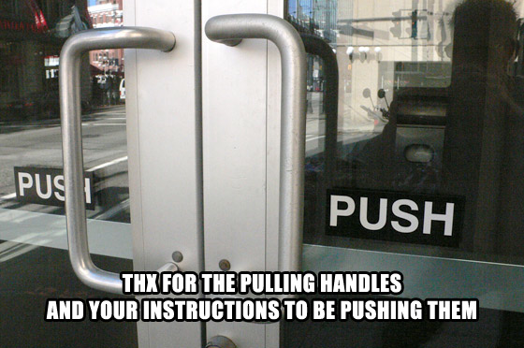
Mental vs. Conceptual Models

Slide 52
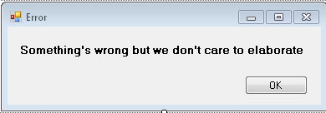
Misakes
Anticipate your users.
Test out the pitfalls.
Make sure error messages are easy to read and are actionable.
  “Blank field error.” VS. “Please fill this field out.”
Notes:
She doesn’t use the term “actionable.”

Slide 53
Looking But Not Seeing
The “Monkey Business Illusion,” video by Daniel Simmons (one of the authors of The Invisible Gorilla).https://www.youtube.com/watch?v=IGQmdoK_ZfY
Apollo Robins https://www.ted.com/talks/apollo_robbins_the_art_of_misdirection
Some of the same principles of magic tricks.

Slide 54
Conclusion:
If you are aware of these phenomena, you’ll be able to make more effective design decisions.
  Anticipate your users, catch their eye, and engage them; even when they make mistakes.
  Avoid ambiguous situations & present curated choices.
  Be professional, present intuitive ways to interact, & motivate your users to do so.

Slide 55
ARE THERE ANY QUESTIONS?
Check that everything you came with is in your pockets and ask…

