Slide 1
CISY114 Week 5
Sketching, Wireframing, Prototyping & Animation

Slide 2
Sketching, Wireframing, Prototyping
Today we are re-visiting the ITERATIVE DESIGN PROCESS.

Slide 3
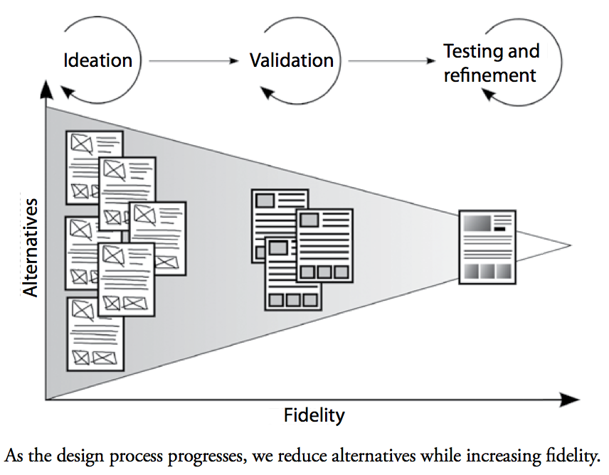
“Ideation” -- *snicker* maybe if you’re an Imagineer…

Slide 4
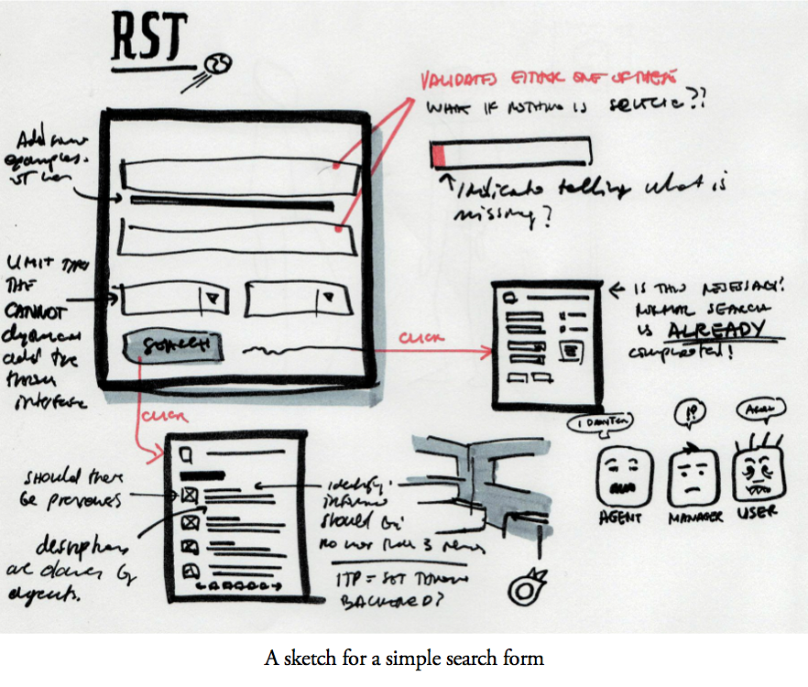
Sketching Your Ideas

Slide 5
Different Sketching Strategies
Brainstorming
Brainwriting
Thesaurus Browsing
Mind-mapping
Gap Filling
Boxing Gloves (worst name ever)
Sketchboarding
Storyboarding
I’ll add: Proof-Of Concept
Gyahhh! So many… make it stop…

Slide 6
Wireframing
Wireframing is the process of taking your sketches and blocking them out (think like actors on a stage).
It shows the STRUCTURE, ORGANIZATION, and ACTIONS of all elements, but not details.
At this point you check to see if everything is up to spec.
Lo-fi --->High-fi Wireframes.

Slide 7
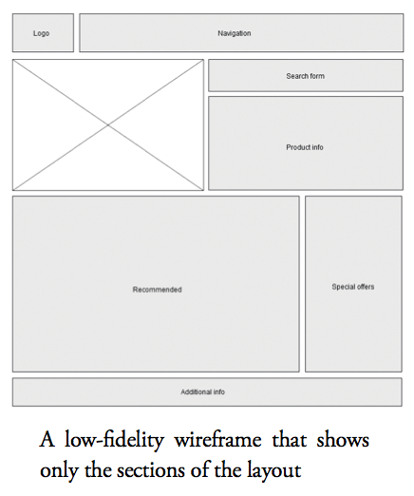
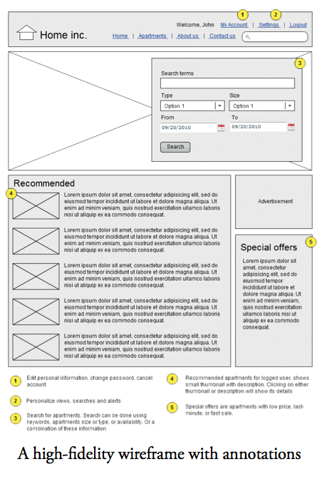
Lo-Fi vs High-Fi

Slide 8
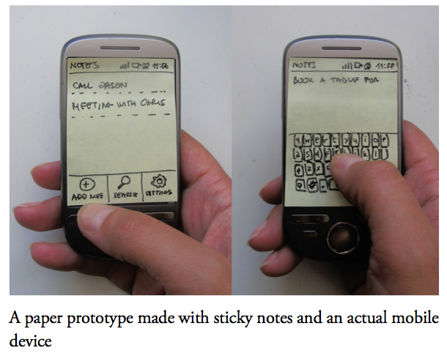
Prototyping
Prototyping takes the wireframes and implements them into something tangible and testable.
We will be seeing some prototypes closer to the Lab portion of the class.

Slide 9
Iterative Testing
You know the drill from here. ☺

Slide 10
ARE THERE ANY QUESTIONS?
Designer Daleks say “ITERATE! ITERATE!” and ask…

Slide 11
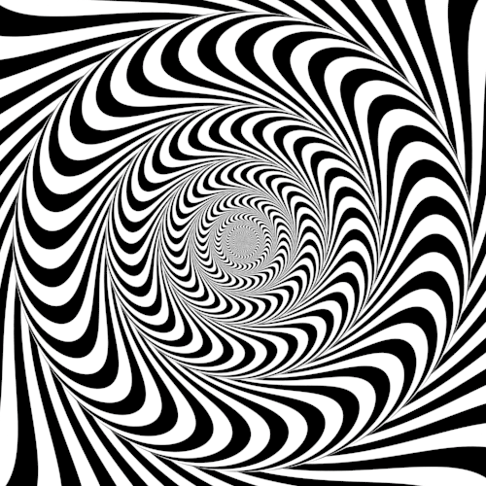
ANIMATION!

Slide 12
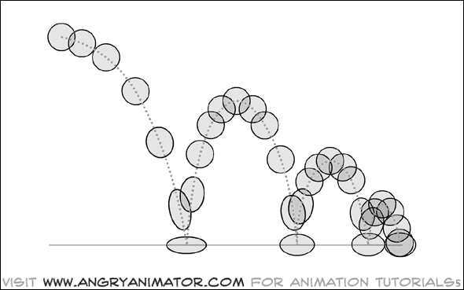
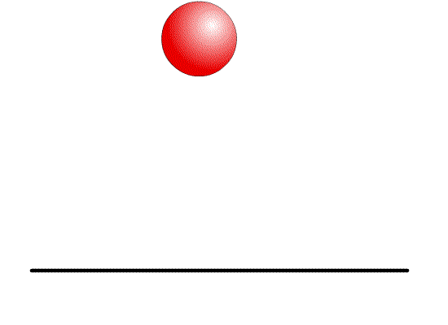
What IS Animation?
It exploits a biological phenomenon known as PERSISTENCE OF VISION to express motion.
A series of images are presented in rapid succession, and our brains fill in the gaps.
36 separate images.

Slide 13
Persistence of Vision
This phenomenon is also the basis for most illusions and magic tricks. (Anyone have a quarter I can borrow?)

Slide 14
Basic Animation
Translation – Moving an image incrementally without changing it. (Path animation is common.)
Rotation – Turning an object around an axis.
Scaling– Stretching or squashing something.

Slide 15
More Advanced 2D Animation
Cel animation
Hand-drawn keyframes that are tweened.
Multiple layers are then composited.
Pretty much every one of your favorite childhood animated movies.
Hullabaloo example: https://www.youtube.com/watch?v=DxoNwcI8A2c

Slide 16
Vector Animation
What most Flash animations are.
The control points of a vector image are changed over time to create the motion.

Slide 18
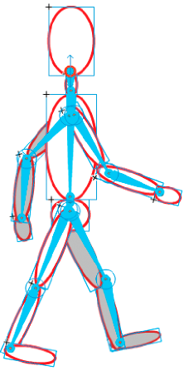
Inverse Kinematics
Sets up a character with a rig made of bones.
Animation involves changing the positions of those bones over time.

Slide 19
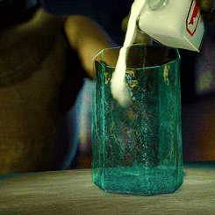
3D Animation
Instead of drawing 2D images, 3D images are rendered frame-by-frame within the computer.
Interpolations can be calculated in novel ways.

Slide 20
Or disturbing ways…
Fallen Art – We need to poll the class first. https://www.youtube.com/watch?v=OATWewCATN0

Slide 21
A Special Treat
Let’s watch some scenes from the Beauty and the Beast Work-in-Progress Edition.
Keep an eye out for keyframing, tweening, 3d, compositing

Slide 22
ARE THERE ANY QUESTIONS?
Tale as old as time, tune as old as song….

Slide 23
Be Back By:

