Slide 1
Understanding Multimedia on a college level
By Evin White

Slide 2
Multimedia
The 5 building blocks
Is a combination of
Text
Images
Sound
Animation
And Video

Slide 3
Interactive Multimedia
Are the same 5 elements combined in such a creative way, that a viewer or user will experience heightened excitement or gratification due to the hands-on experience.
The main goal is to get across an overall message to a viewer or audience. These elements combined can do extraordinary things emotionally for a project and the viewer.
When designing multimedia, as the designer you weave these many elements together into a complex tapestry of sights and sounds. Choosing the best way to give the viewer control over their experience is a challenge, but very rewarding.

Slide 4
Text
Are letters and symbols we use to communicate
Text lives all around us! TV, books, posters, computers, phones ect… You may also refer to them as words on a medium. It's prevalence prevents us from realizing it's importance in conveying information and providing easy to use navigation. Also, it is important to remember that text has technical concerns as well.
Once upon a time…

Slide 5
When using text as navigation, it is important to consider your audience. Choose words that will clearly indicate where links lead and use those same terms as the headings for the screens they lead to.
For example, the buttons on this page. The one on the left is to go to the previous page. The arrow on the right is to go to the next page and the icon of the house is to go to the home (or main) page.
Reserachers have shown that when reading on screen your reading screen is slower than off of paper. It is important to write concisely when developing screen based media. Emphasize breifness and clarity

Slide 6
ASCII
To a computer, text is a series of numeric codes. The two major encoding schemes are ASCII and Unicode. ASCII was developed before Unicode and is only suitable for display characters in English and some Western languages. Unicode is the new dominant form and allows typefaces to encode characters from every language on earth.
ASCII (American Standard Code for Information Interchange was created
before Unicode. ASCII code numbers match up with a letter it represents from the
english alphabet. It does this because this was the system used before. The digital
age began. The computer needed something to display.

Slide 7
Unicode
The original version accommodated up to 65,000 characters which didn’t just include the English language but characters from all known languages and alphabets in the world.
Type is rendered by individual fonts that are on a computer. In order for your audience to be able to see the typeface you have chose you must either get permission to embed the typeface in your product, license the typeface for use or convert elements of your text to pixels, rendering it as an image.

Slide 8
Text
The typewriter is what most people used years ago when they needed to apply text to paper.
They have now been replaced by computers. They support word processing programs such as Microsoft Word, Note Pad, Text Edit and Pages. All of them will come with standard typefaces (fonts) that users can use to type letters, e-mails, statuses on social media or text messages etc… These typefaces can be changed to aid the clarity of the message being relayed to the viewer.
Text can be handwritten also. Many typeface designers draw their lettering by hand. Some are very elegant using serifs (the little tails on the ends of the letters) ,some are simple san serifs (letters without the little tails at the ends of the letters) and some are decorative. There are also many kinds of pens and markers that can achieve a variety hand drawn letters.

Slide 9
Typographical Bon Jovi poster series
Designed by Evin White

Slide 13
Ever sent a text message?
To:
M
a
c
k
m
k
L
!
send
A
B
C
D
E
F
G
H
I
J
K
L
M
!
@

Slide 14
Images
can be photograph like bitmaps, vector-drawn graphics, 3D renderings, buttons to click and windows of motion video.
Bitmaps are a matrix of the individual pixels that form an image.
Vector is a drawn line that is described by the location of it’s two endpoints
Vector-drawn graphic is an image created from vector objects
Images are used as visual aids to communicate a message most of the time.
Designers use images on websites, ads and posters
Photographers use images as an art form based on perspective

Slide 15
A common maxim holds that "an image is worth a thousand words." A properly composed image can convey strong emotion and resonate with your audience. It is important to use images wisely. Be honest with yourself and your audience about the degree to which the images are manipulated to get the desired effect. Also remember that almost every non-background element that is seen, including navigation buttons, icons, widgets and indicators, and gradients within these elements, in addition to your content can be an image.

Slide 16
Images
There are several computer programs that allow anyone from a beginner to a professional, manipulate (edit) images in any way. The most popular would be Adobe Photoshop , Bridge or Premiere. Others are more for viewing purposes like, Preview and Picassa.
Vector drawn images can be created in Photoshop or Illustrator.

Slide 17
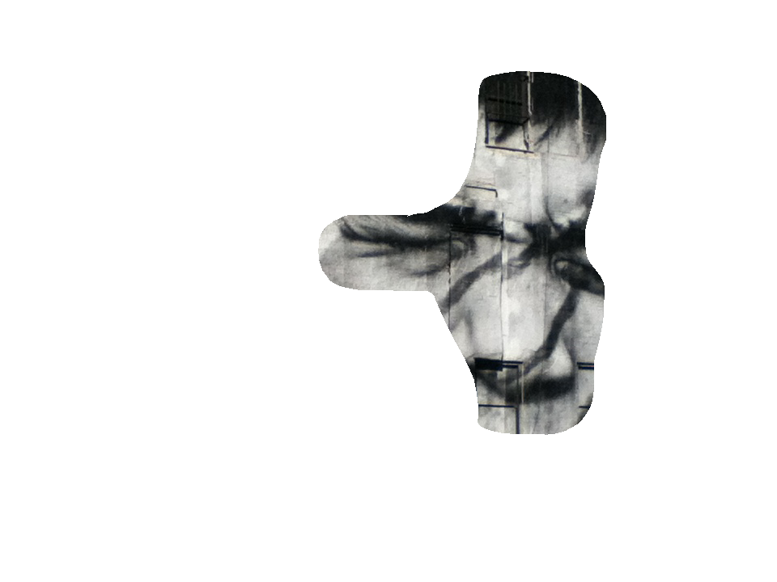
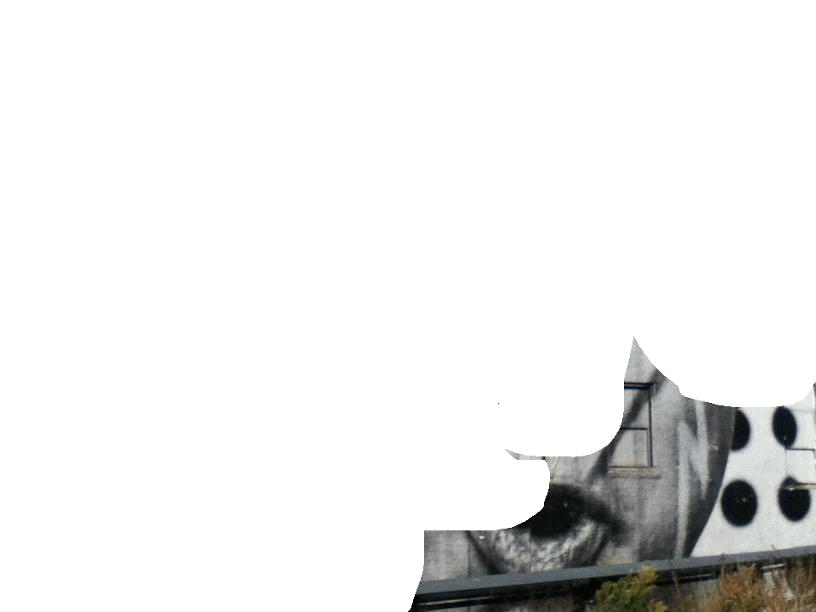
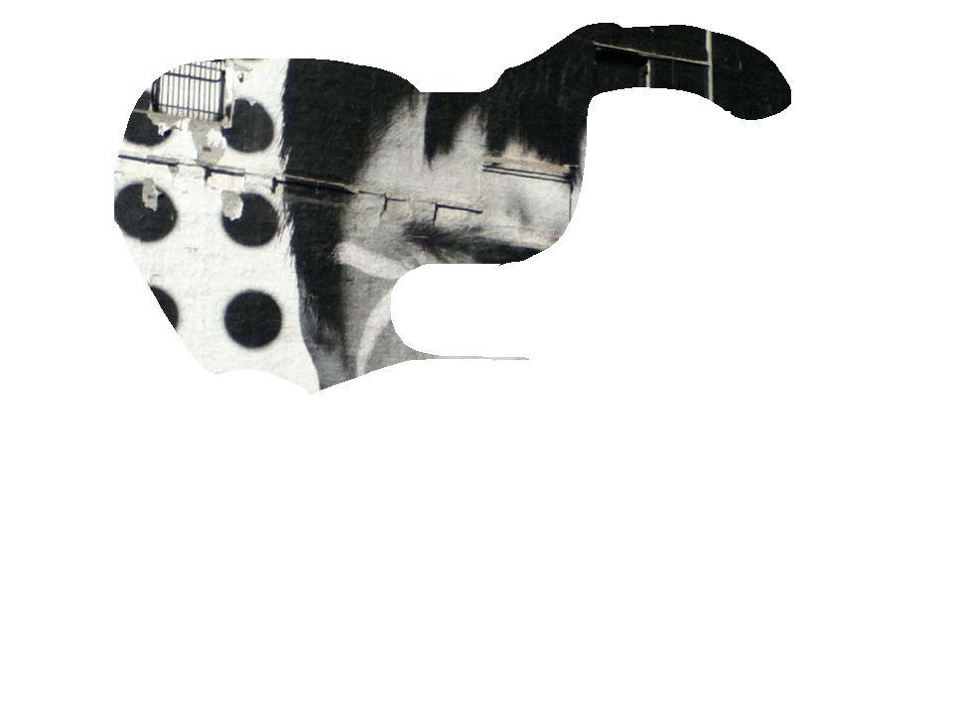

Slide 24
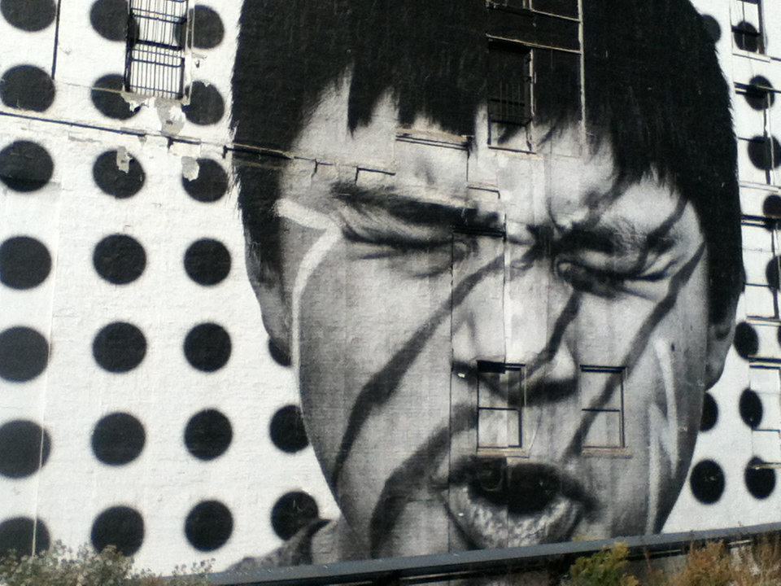
Photo credit to Evin White

Slide 25
Audio
sound is meaningful speech in any language (from a whisper to a scream). It could be music, sound effects or someone speaking.
Sound was born when radio was born. During a tour in NYC at NBC studios. The guide gave us the history of how NBC started on radio. When the baseball games were on they used props and tools to add excitement for the listeners!
Now we can accomplish those sounds and even create our own songs and music, right on our computers. Programs like Garageband, Mixmeister and Pro tools are used by beginners and industry professionals to accomplish wonderful sounds and beautiful music.
They also use studio equipment like microphones and sound booths to achieve clarity.

Slide 26
Audio is one of two senses that we can most easily manipulate with multimedia, the first being sight. It is a very sensual form of media. Used properly it can do tasks as varied as indicating a button has been pressed, to draw attention to a state change, to provide a human connection via soothing voice over or to set an emotional tone with suspenseful or triumphant music. Technically the challenge for audio is to limit the file size while maintaining fidelity of the sound wave. In a project where there are many channels of overlapping audio, an additional challenge is in ensuring that the resulting mix blends properly so that the computer can render the sounds

Slide 27
Audio
1
2
3
Linked audio file is an original work done by Evin White

Slide 28
Animation
makes static presentations come alive !
The process of creating exhilarating animations is a very difficult, tedious and time- consuming process but very rewarding when you see the end result.
Popular Disney movies like Beauty and the Beast, The Lion King, The Little Mermaid and Dumbo, were animated.
Creating animations isn’t simple. There are many steps a creative team take to create an animated movie. Storyboards are drawn, rough animations (sketches), tweening (finer sketches or animation clean up), compositing (putting the sketches into the computer) and 3D.
For simple animations at home, try making a flipbook! Or if you want a challenge, play around with Adobe After Effects, photoshop or PowerPoint.

Slide 29
Animation can be challenging to consider when developing multimedia. Yes, it is the medium in which Pixar and Dreamworks perform their magic, but animation is more than rendered characters. For a computer interface, animation can show that the system is loading or ready for input. It can provide a visual cue between screen changes. It can provide a hint by casting a glow on a navigation element. The key with animation is to exercise restraint. Subtle is almost always better than flamboyant.

Slide 30
This animation is an original work done by Evin White

Slide 31
This animation is an original work done by Evin White

Slide 32
Video
Is the most powerful and engaging of all the multimedia venues. It brings computer users closer to reality. For example, most people will feel heightened excitement watching a video of a vacation because they can connect a memory or emotion to the experience.
If your creative, you can do some pretty amazing things with video. One of my favorite illusionists to watch on Youtube is Zach King! He may spark some ideas for you. If you aren’t creative and you enjoy watching videos, still check out Zach’s page. It will guarantee a smile on your face every time!
https://www.youtube.com/user/ZachKingVine
There are computer programs like Imovie, Windows Movie Maker or Video Star that can help you create videos. Using a camcorder or any device that has a record feature will allow you to record a video of your own.

Slide 33
Video production is a field unto itself. Its use in professional and personal communication has exploded in recent years. Most computer systems ship with video cameras built in to the monitor bezels and all modern smartphones include video recording capability. Popular websites like YouTube and Vimeo have democratized the video distribution process, allowing amateur video producers to share their efforts with the world. The technical challenge with video is the sheer amount of data that is necessary to render video smoothly. The challenge of the technical multimedia producer is to maintain the highest clarity with the lowest data rate possible for the delivery system. To accomplish this it is necessary to render the video in different compressed formats and to test which give the best throughput while maintaining a smooth framerate.

Slide 34
Video
All music and production are original works done by Evin White

Slide 35
All music and production are original works done by Evin White

Slide 36
All these elements can really give a “WOW” factor when used appropriately. Try creating a campaign or video that uses these elements and see who you can wow with the interactivity of your project.

Slide 37
Vaughn, Tay. Multimedia: Making It Work, Ninth Edition. USA: Cenveo Publishing Services, 2014. Print
Zach King. “Zach King’s Vine Videos.” Youtube.com. https://www.youtube.com/user/ZachKingVine

