Slide 1
Multimedia Presentation
By Laila Ghali

Slide 2
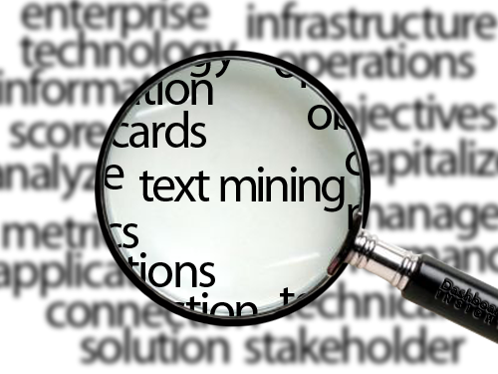
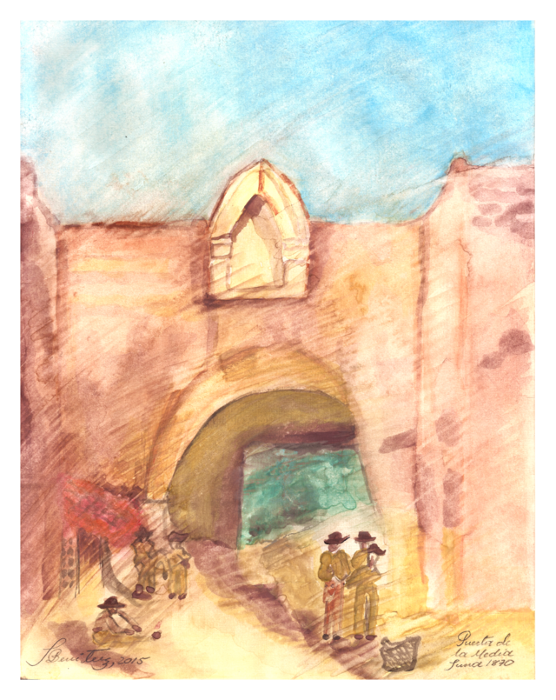
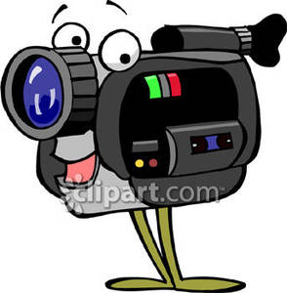
The Five parts of Multimedia
Animation
Multimedia
Text
Pictures
Sound
Video

Slide 3
Multimedia is the combination of multiple forms of media. This includes text, pictures, sound, video, etc. For example, a presentation involving audio and video clips would be considered a "multimedia presentation." Software that involves animations, sound, and text is called "multimedia software." CDs and DVDs are considered to be "multimedia formats"
What is Multimedia?

Slide 4
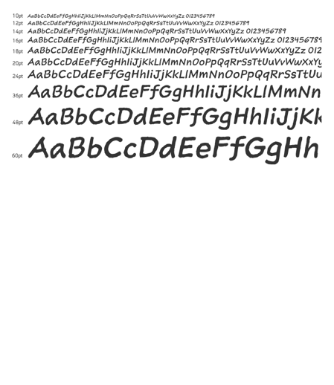
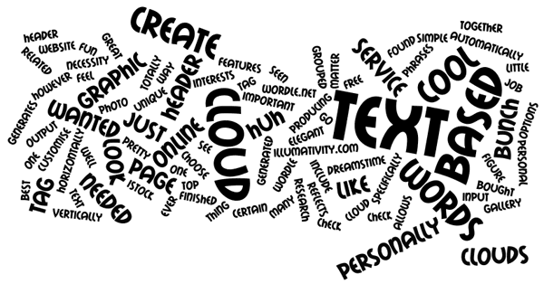
Text
Text is used a lot in computers. Because we use text all the time in computers we often forget how important is it in multimedia. Text helps in finding information and makes it easy to use navigation. Also, it is important to remember that text has technical trouble too.
When using text for directions. Choose words that will clearly show where links takes and use those same terms as the headings for the screens they lead to.

Slide 5
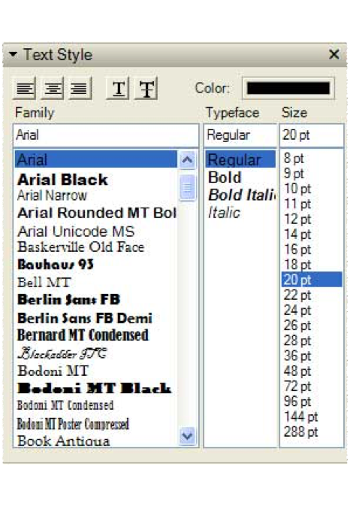
When you’re reading a text on a computer, you’re reading it slower than off of paper. It is important to write concisely when developing screen based media. Emphasize brevity and clarity.
When a computer reads text, it changes it into numbers to understand it, because computer can only read numbers. The two ways for a computer to this, is using ASCII and Unicode. ASCII was made before Unicode and is only used to show writing in English and some Western languages. Unicode is used for every language on earth.
Typeface includes different types, sizes, and styles.

Slide 6
Text as Multimedia Elements
Back to the Five parts of multimedia

Slide 7
Sound
Sound is one of two senses that we can play with in multimedia, the first being sight. It is a very exciting part of media. Used in the right way it can do different jobs like showing a button has been pressed, to point out a change, to give a connection to people through relaxing voice or giving an emotional tone with music.

Slide 8
The application of multimedia might need the use of sound effect, music, and speech.
There is two types of sound or audio: Analog and digital
Analog is the original sound signal
Digital is the sampling of the original

Slide 9
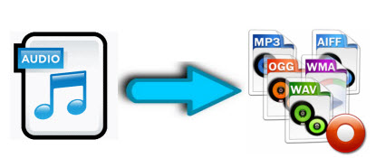
The hard part in working with sound is to make the file size smaller without changing the sound wave. In a project where there are a lot of mixed sounds, another thing is to make sure that all the sounds are well mixed so that the computer can give us the sounds.
Back to the Five parts of multimedia

Slide 10
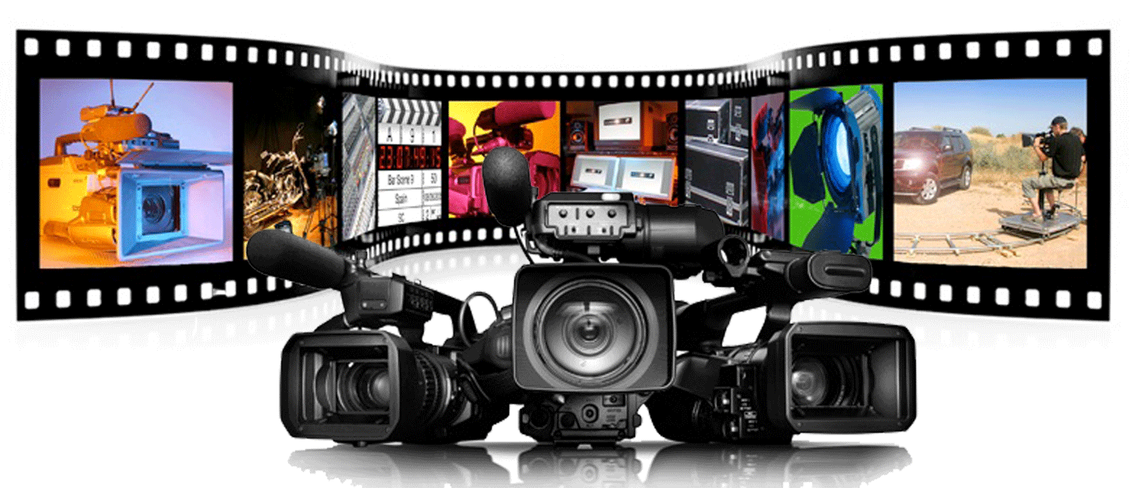
Video
Video is being used in many areas, specially in the past few years. Most computers have video in them and all new smartphones with video recording. Famous websites like YouTube and vine gave the chance to new video makers/ producers to share their efforts with the world.

Slide 11
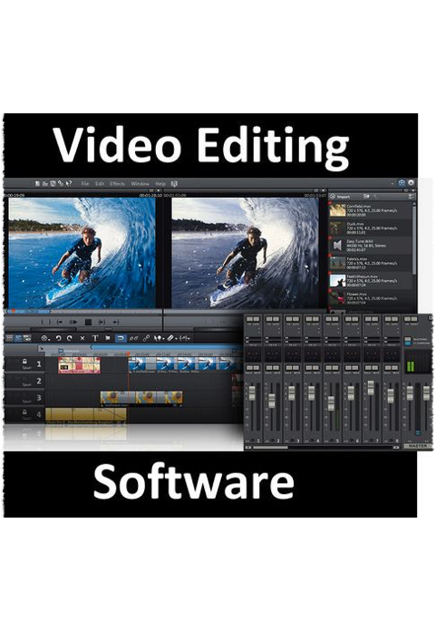
The challenge with video is the big amount of information that is necessary to make a good one. The hard part is to keep the video clear using a minimum amount of that information for the delivery system.
To make this this happen, we have to make the video in different shortened formats and to find which give the best result while keeping a clear pictures from beginning of the video to end.
Click here for an Example

Slide 12
Taking a video that was originally 23 minutes long. Using a video edited “ Movie Maker ” created a 1:38 seconds short movie
Back to the Five parts of multimedia

Slide 13
Picture
A well, clear made picture can send strong emotion and resonate with your audience. It is important to use images wisely. Be honest with yourself and your audience about the degree to which the images are manipulated to get the desired effect.
Also remember that almost every non-background element that is seen, including navigation buttons, icons, widgets and indicators, and gradients within these elements, in addition to your content can be an image.

Slide 14
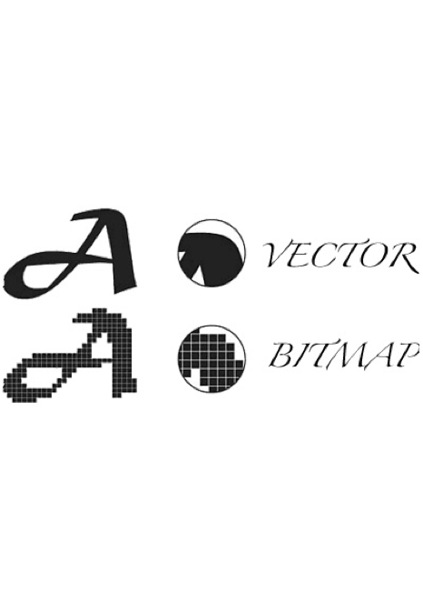
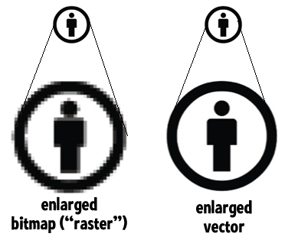
First, we need to know the different between the two types of pictures that the computer gives, bitmaps and vector drawings.
Bitmaps are very small squares called pixels, making one big picture. They need a big space to save the picture information. As the size of the pictures gets bigger so does the room is takes in the computer.
Vector the image using points, lines and shapes to be drawn. These images can change from very tiny pictures to big poster on the wall and commercial on the street without losing the clarity of the image.

Slide 15
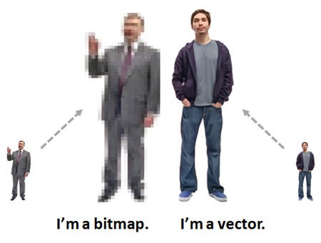
Back to the Five parts of multimedia

Slide 16
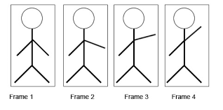
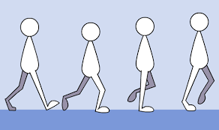
Animation
Animation is one of the hardest parts of multimedia. Using programs like Pixar and DreamWorks to make the magic, but animation is more than completed characters.

Slide 17
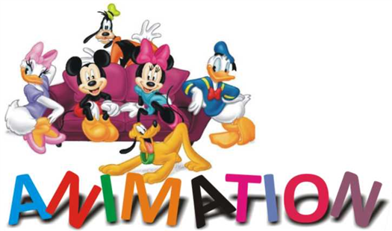
.
The key with animation is to exercise restraint. Subtle is almost always better than flamboyant.
For a computer, animation can show that a website or anything click on is loading or ready to open. It can provide a visual cue between screen changes. It can provide a hint by casting a glow on a navigation element

Slide 18
Animation
Click here for an Example

Slide 19
Example
Back to the Five parts of multimedia

Slide 20
References
Animation Explanation. By Wanton. Dir. Aluri. Perf. Warrior Cats. YouTube, 8 Feb. 2012. Web. 30 Mar.2015
https://www.youtube.com/results?search_query=animation+explanation
Text as Multimedia. Dir. Lofty Sublime. 2012. YouTube.
https://www.youtube.com/watch?v=_3P-47g-t6o
https://archive.org/details/InternetArchive35mmStockFootageSampleReel
Orion 8, 27 July 2009, Icon sound loudspeaker, Orion 8, 29, july,2009, http://commons.wikimedia.org/wiki/File:Icon_sound_loudspeaker.svg
Inteloutside2, 11 January 2008 ,Orangebox animation liten, Inteloutside2, 12 January 2008, http://commons.wikimedia.org/wiki/File:Orangebox_animation_liten.gif
Julio Benitez Martinez, 22 March 2015, Puerta de La Media Luna, Cartagena de Idias, 1870, Colombia, Julio Benitez Martinez, 25 march 2015, http://commons.wikimedia.org/wiki/File:Puerta_de_La_Media_Luna,_Cartagena_de_Idias,_1870,_Colombia.tif
Google, 19 August 2014, Emoji u1f3a7, Ebraminio, 20 August 2014, http://commons.wikimedia.org/wiki/File:Emoji_u1f3a7.svg

