Slide 1
CISY 114: Week 4
“The Mailbag”
And Participation

Slide 2
Participation Questions:
Correct Answers:
“Animal Crackers” (4)
Metaphor (3)
Other (1)
Incorrect Answers:
“Harry” (7)
No Answer (4)

Slide 4
Questions:
When it comes to bit depth, more specifically to color, does 24 bit color information exceed the human eye's ability to perceive color?

Slide 5
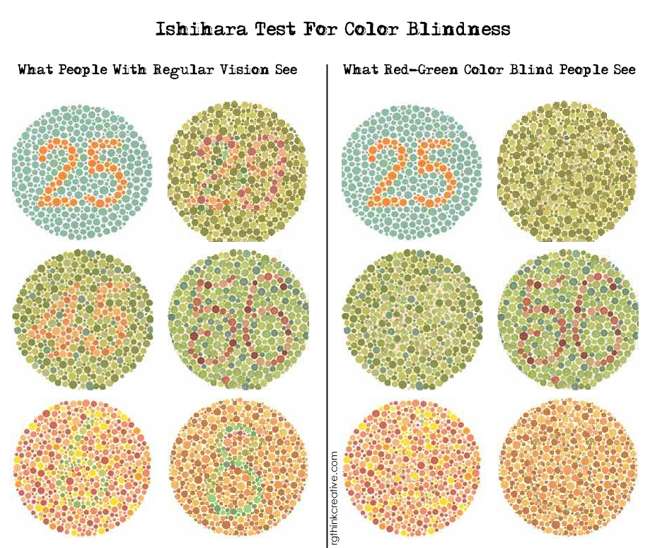
Color Blindness

Slide 6
Tetrachromacy
Meet Concetta Antico
Where most humans have 3 types of “cone” cells in our eyes (for red, green, and blue) she has four.
It’s a sex-linked trait (only women can have it; sorry guys).

Slide 7
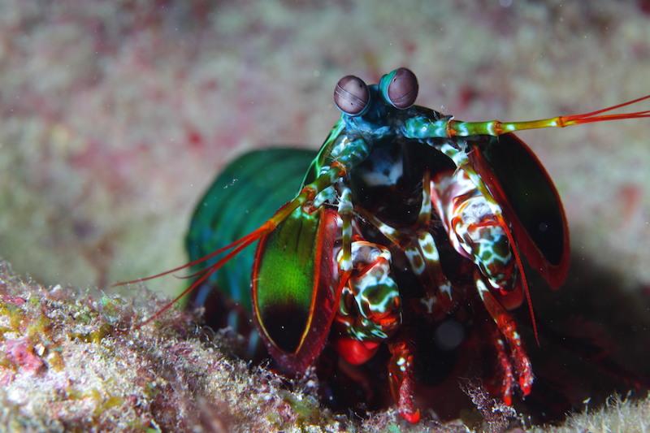
Polychromacy
Meet The Mantis Shrimp
Mantis shrimp have 16 (!!!) types of cones.
Imagine that, silly humans.

Slide 8
Questions:
When it comes to bit depth, more specifically to color, does 24 bit color information exceed the human eye's ability to perceive color?
“IT DEPENDS”

Slide 9
Questions:
[The] section about the hexadecimal counting system from your video was a bit confusing.

Slide 10
Questions:
I found the typography chapter very interesting but after awhile it was a little bit like information overload for me. I would like to go over that some more.

Slide 11
Long Story Short (TL;DR):
Typography on the web is a fickle thing.
Even if you’re using the same font it may display differently between browsers, or even between the same browser on different systems.
Be sure to use readable type that “degrades” well when viewed on other systems.

