Slide 1
CISY114 Week 7
Designing & Producing User Psychology

Slide 2
Structure & Navigation
There are several navigation structures that your can use in a multimedia presentation:
Linear
Hierarchical
Nonlinear
Composite

Slide 3
Linear Navigation

Slide 4
Hierarchical Navigation
Level 1
Level 2
Level 3

Slide 5
Non-Linear Navigation

Slide 6
Composite Navigation

Slide 7
Visual Design Principles
Contrast
Repetition
Alignment
Proximity & Grouping
(We will be re-visiting these in a few weeks, too, but they’re on the Midterm.)

Slide 8
Contrast
Choosing colors and differing attributes to draw attention and distinction between different elements on the screen.

Slide 9
Contrast
Poor contrast because of bad color choices.
Better contrast because of good color choices.
Use a color wheel to find complimentary colors. http://www.sessions.edu/color-calculator

Slide 10
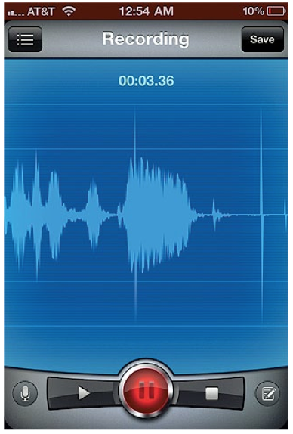
Contrast

Slide 11
Other types of Contrast
Visual Affordances
Cues given to the user when they begin to interact which indicate what they can do.

Slide 12
Repetition
Re-using elements or layouts in a manner that is intuitive.
A user should be able to rely upon the same functionality.

Slide 13
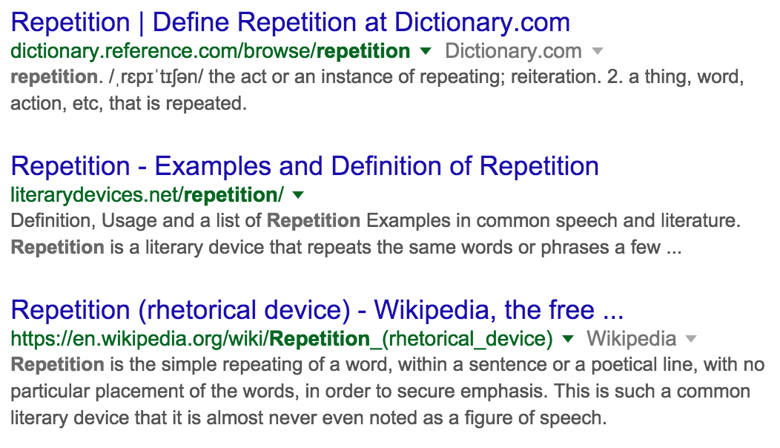
Repetition Repetition Repetition

Slide 14
Repetition
Do not re-define terms and icons!
For example, “Back” should have a defined action in navigation.
Move one slide back in a linear progression.
Move up one level.
Go backwards in whatever path the user takes.
Don’t mix and match!

Slide 15
Alignment
Making sure elements are regularly placed relative to each other.

Slide 16
Alignment

Slide 17
Alignment

Slide 18
Proximity & Grouping
Clustering related elements together so that it is obvious they function together.
This also depends upon the delivery method!

Slide 19
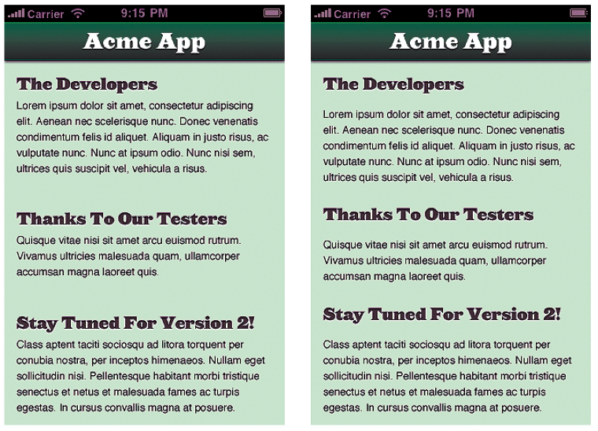
Proximity & Grouping

Slide 20
Putting It All Together
For your Projects you will need to keep all of these in mind.
Your set of design choices (layout, color, and “feel”) makes up your “brand identity.”
http://www.logodesignlove.com/brand-identity-style-guides ← Keep in mind for your Considerations document!

Slide 21
ARE THERE ANY QUESTIONS?
Navigate to question mode and ask…

Slide 22
The Psychology of Web Design
Susan Weinschenk talks about how humans are social animals.
How we interact online follows rules for social interactions.
“If the website is not responsive or takes too long to load, it is like the person we are speaking to is not looking at us or is ignoring us. If the website asks for personal information too soon in the flow of the interaction, it’s like someone getting too personal.” (p255)

Slide 23
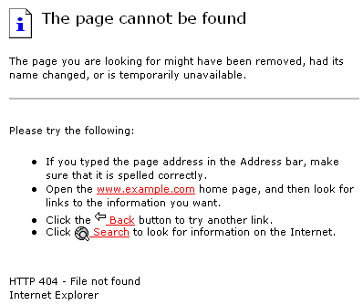
Example: The 404 Page
It’s like someone stood you up. CUE RAGE!!!

Slide 24
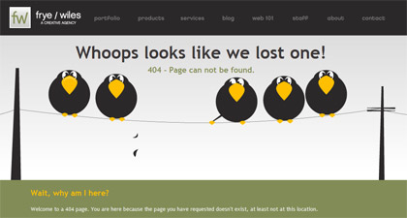
Defusing the 404: Cracking a joke.

Slide 25
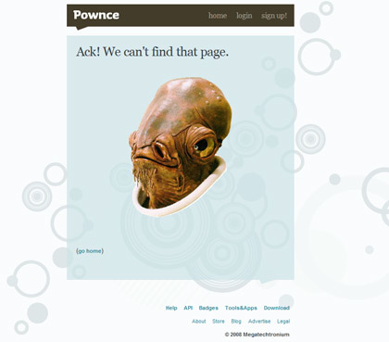
Defusing the 404: Cracking a joke.

Slide 26
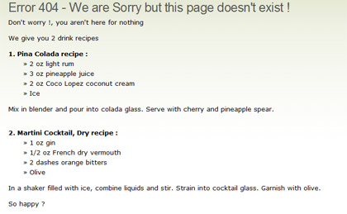
Defusing the 404: Cracking a joke.

Slide 27
Defusing the 404: Cracking a joke.

Slide 28
Defusing the 404: Cracking a joke.
It’s like someone saying “I’m sorry.”

Slide 29
“Old Brain” & Distractions
Think of it as your brain’s reflexes.
Getting someone’s attention with multimedia, most effectively, is an effort at tripping one of those reflexes to get them looking in the right place, and then engage a user with relevant content.
Works the same with interface elements, etc. (Animations that catch the eye.)
I call this “brain hacking.”

Slide 31
⇒You’re looking about here.
That’s where the Lion’s eyes were. You’ve been brain hacked.

Slide 32
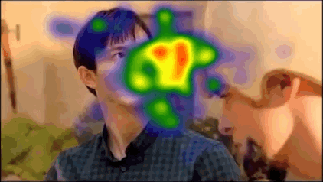
Eye Tracking
We have a good idea of where people look without even realizing it:
Notes:
There are some differences between men and women. There are more… “sexy” examples. But google those on your own time. Delete your browser history.

Slide 33
Getting Attention Summary:
Use something reflexive to gain attention.
Faces.
Indications of motion.
Etc.
Immediately engage your user with content.
A story or other means to keep their attention.
Engage past the reflexes.

Slide 34
Ambiguous Situations
The Latane and Darlane Experiment.
One of my favorites!
Subjects given a test to take in a room where smoke would come in through the vent.
The more people in the room who acted as if it was normal, the more likely they were to act as if it was normal. fnord
There is a sense of Social Inertia.
Notes:
START THE STOP WATCH

Slide 35
Ambiguous Situations:
We, as social animals, also look to others for cues in unfamiliar or ambiguous situations.
Reviews and recommendations are a big factor.
I call it “looking for authentication.”
Let’s see how it works!

Slide 36
Ambiguous Situations:
Also tied in with the Paradox of Choice.
(She doesn’t go into this.)
“Go get some extra virgin olive oil.”
“Well, which do you prefer?”
Local Supermarket vs. Whole Foods

Slide 37
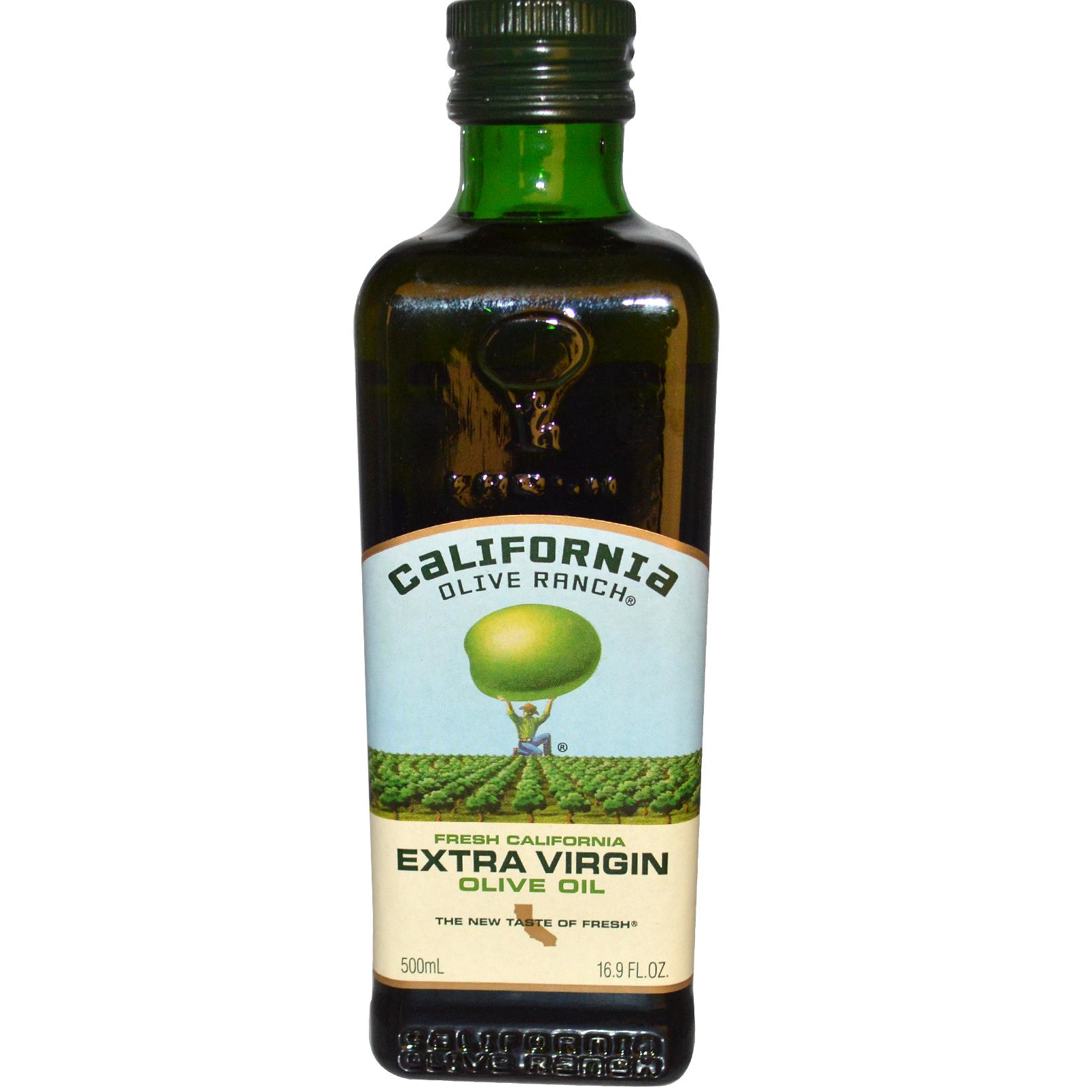
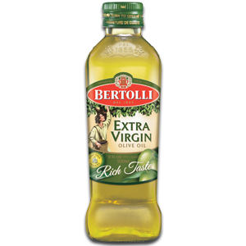
Extra Virgin Olive Oil

Slide 38
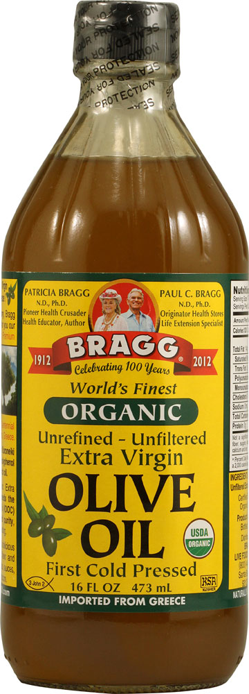
Extra Virgin Olive Oil

Slide 39
Extra Virgin Olive Oil
The time you take to choose is greater and your satisfaction with your choice is less.

Slide 40
Extra Virgin Olive Oil

Slide 41
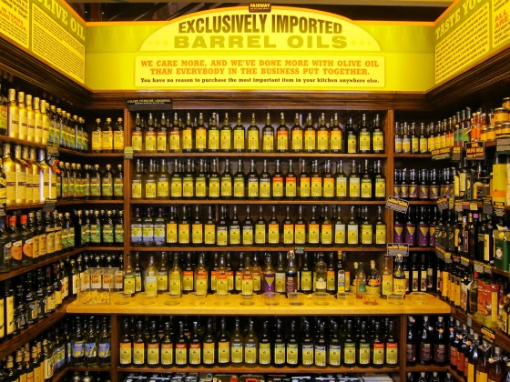
Extra Virgin Olive Oil
Notes:
You’re going to have to justify your decision.

Slide 42
Extra Virgin Olive Oil
Fewer, good choices, better reaction time, higher satisfaction.

Slide 43
Personal Example
Vending at events with my family company:
When I offered 6-8 different types of pocket watches, the majority of conversations were long and about “which one is best?”
When they were pared down to 3-4 types, sales and satisfaction went up and conversations were about what they liked about them.

Slide 44
Attention to Detail (Professionalism)
If your interface does not look professional, people will not think it is professional. LOL.
“Dress to impress.”
Don’t be sloppy.

Slide 45
Attention to Detail (Professionalism)
If your interface does not look professional, users will not think it is professional.
Remember the saying, “Dress to impress.”
Refrain from being sloppy.

Slide 46
Motivations
The “Goal Gradient Effect.”
Ever notice why some websites have “levels” you can achieve for participating?
Progress motivates.
Achievement enforces a break (unless the next goal is really cool or interesting).

Slide 47
“People are inherently lazy.”
Satisfy + Suffice = Satisfice
Thanks, Herbert Simon. :-P
I disagree.
It’s not a matter of “laziness” (that’s a misnomer).
EULAS.
It’s a matter of maximizing satisfaction and minimizing stressors.
“The perfect is the enemy of the good.”
Look back at our olive oil example and the Paradox of Choice.
Thanks, Barry Schwartz. ☺
Notes:
I’m not throwing Simon under the bus or anything.

Slide 48
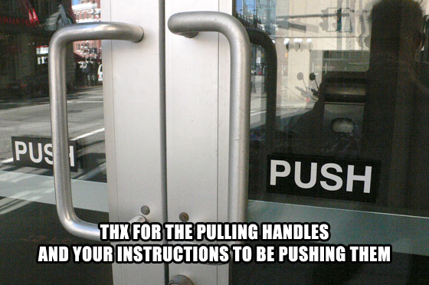
Mental vs. Conceptual Models

Slide 49
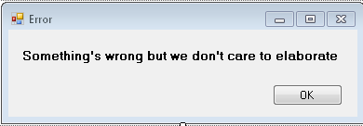
Misakes
Anticipate your users.
Test out the pitfalls.
Make sure error messages are easy to read and are actionable.
“Blank field error.” VS. “Please fill this field out.”
Notes:
She doesn’t use the term “actionable.”

Slide 50
Looking But Not Seeing
The “Monkey Business Illusion,” video by Daniel Simmons (one of the authors of The Invisible Gorilla).https://www.youtube.com/watch?v=IGQmdoK_ZfY
Some of the same principles of magic tricks.

Slide 51
Conclusion:
If you are aware of these phenomena, you’ll be able to make more effective design decisions.

