Slide 1
CISY114 Week 3
Hardware & Software
Images

Slide 2
Hardware & Software
Let us begin!

Slide 3
Windows vs. Macintosh
Most of this is largely historical.
The Mac vs PC wars have settled into their respective camps (all run x86).
The biggest difference between Macs & PCs today is hardware in/dependence.

Slide 4
Networking & Data Storage
Since this is largely reference material, let’s go over these together in the book quickly.
Refer back to these when the need arises.

Slide 5
Input Devices
Today you need to worry most about:
Keyboard & Mouse/Touchpad
Keystrokes.
Point and click.
Left/right/center click.
Scroll “wheel.”
Touchscreens
Taps and gestures.

Slide 6
Are there any questions?
WAKE UP!!!! And ask:

Slide 7
Images! – We shall discuss:
Different things and ways to quantize them.
Vector vs Bitmap
Color – Bit depth and palette (not pilates).
(Sorry, we have to go over hexidecimal again.)
Compression
Lossy vs Lossless
The “weight” of files.

Slide 8
How Do We Represent Images?
Remember, the computer does not have any actual images inside it. (Images are ANALOG.)
How do we quantize an image to fit into a digital space?

Slide 9
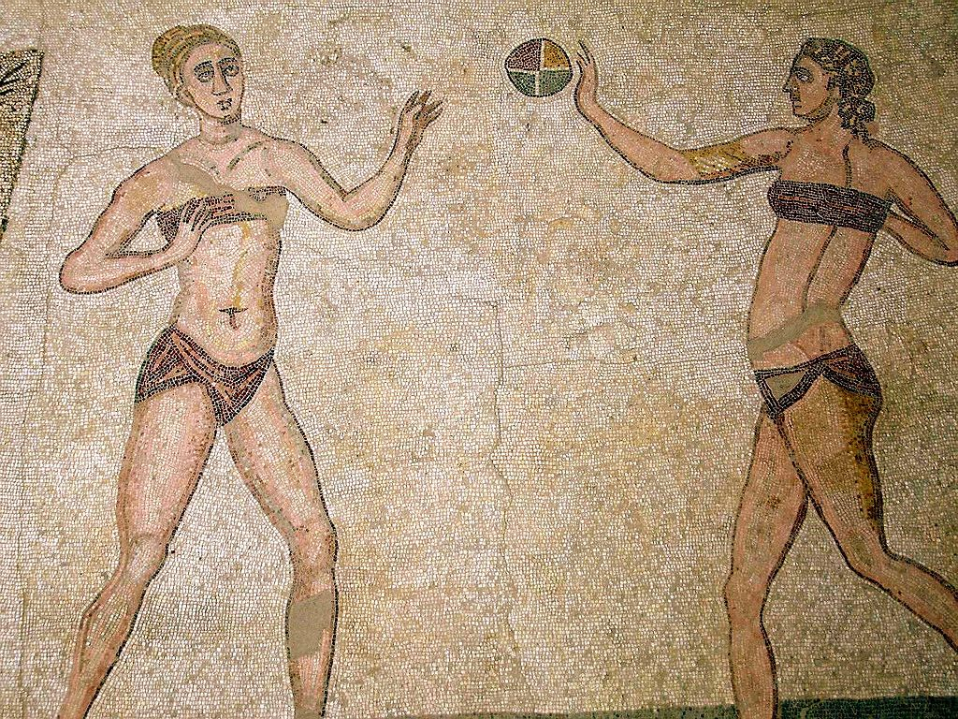
Bitmap
A BITMAP image is like a giant mosaic where each tile (pixel) has its own color.

Slide 11
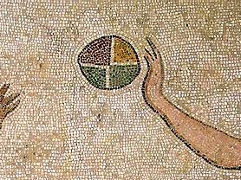

Slide 12
Bitmap
Made of pixels.
Width and height are the “resolution.”
(“Pixel density” has to do with PPI or “pixels per inch.”)
Each pixel on the grid uses a number to represent a color.
The larger the range of the number, the more colors one can represent.
The number of bits dedicated to those numbers determines its “bit depth.”

Slide 13
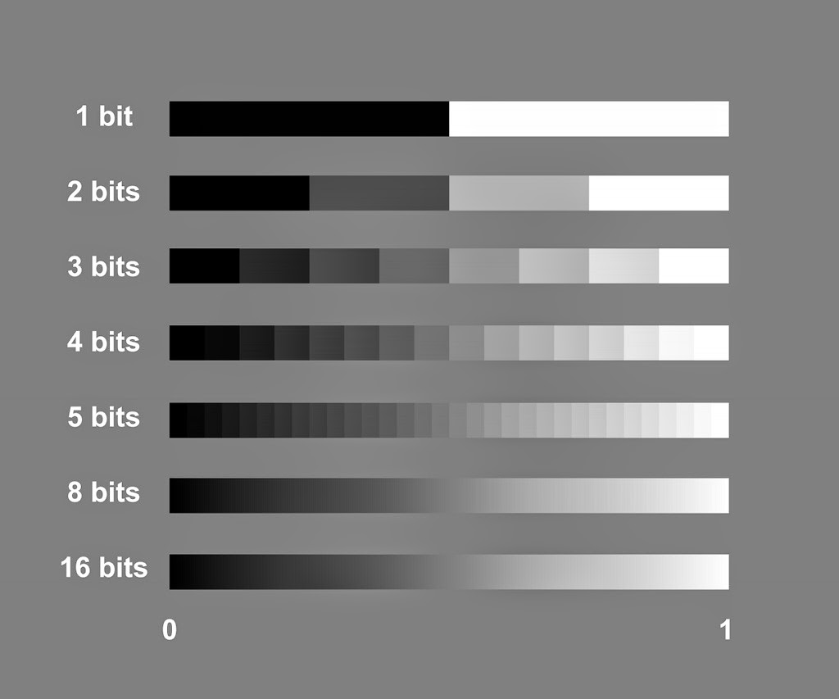
Bit Depth Illustrated

Slide 14
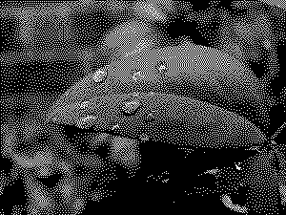

Slide 15
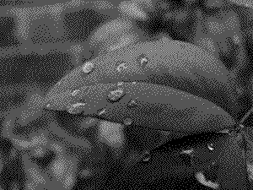

Slide 16
Storing COLOR

Slide 17
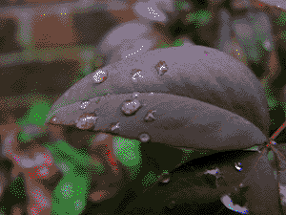

Slide 18
Let’s take a closer look at DITHERING…

Slide 19
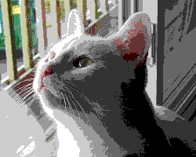
Dithering

Slide 20
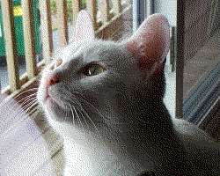
Dithering

Slide 21
Storing More COLOR
When bit depth gets bit enough, we can actually divvy up the bits to represent different colors.
8-bit color does it this way:
000 000 00
8 levels
8 levels
4 levels
8 x 8 x 4 = 256 combinations

Slide 22
256 Colors

Slide 23
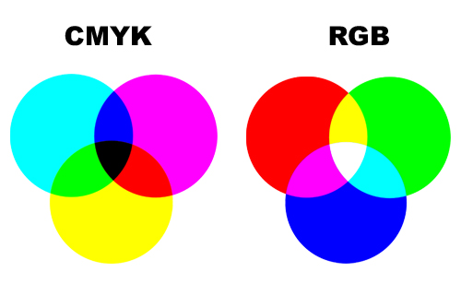
Additive vs Subtractive Color
What you learned
in grade school.
What computers
use.
You’ll also see “HSV” color, but this is a bonus.

Slide 24
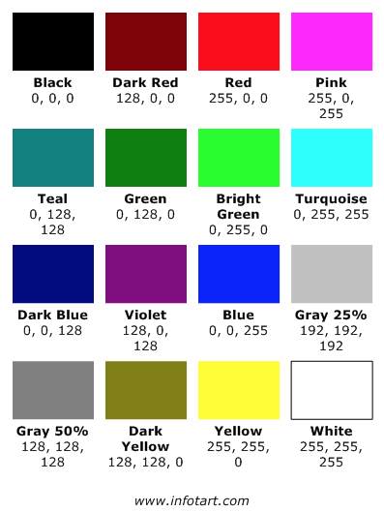
Color Combinations in RGB

Slide 25
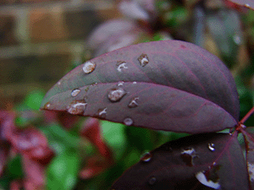

Slide 26
Storing More COLOR
With 24-bit color, we get 8 bits (a whole byte) for each color channel:
00000000 00000000 00000000
256 levels
256 levels
256 levels
256 x 256 x 256
= 16,777,216 combinations
“Millions of Colors” or “True Color”

Slide 27
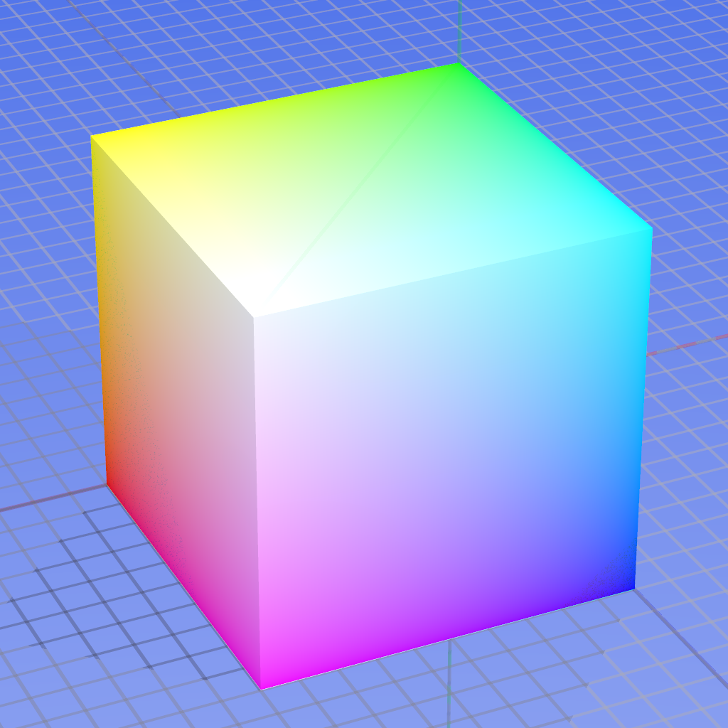

Slide 29
No advantage for more colors
…assuming average eyesight.
What are the limitations of our own eyes?

Slide 30
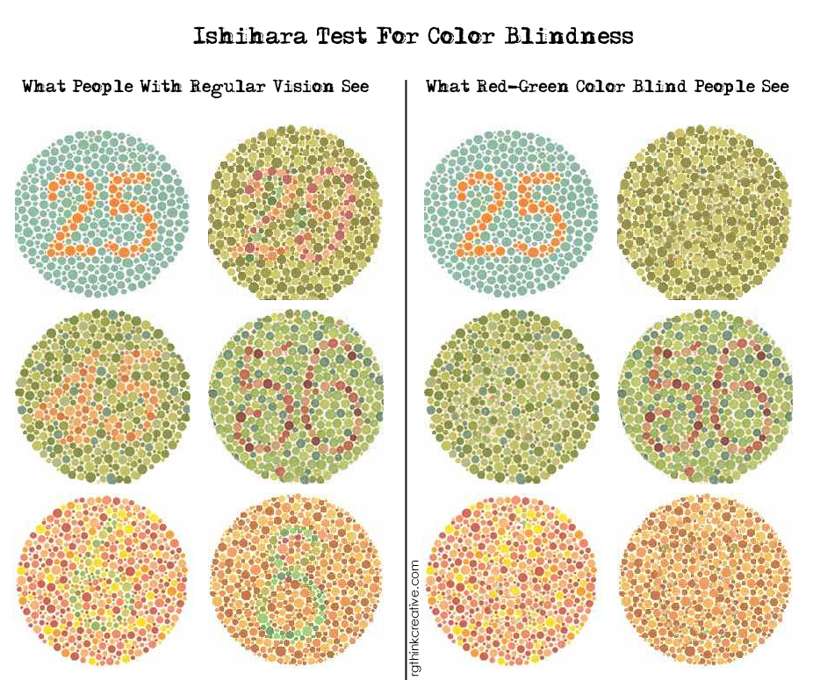
Color Blindness

Slide 31
Tetrachromacy
Meet Concetta Antico
Where most humans have 3 types of “cone” cells in our eyes (for red, green, and blue) she has four.
It’s a sex-linked trait (only women can have it; sorry guys).

Slide 32
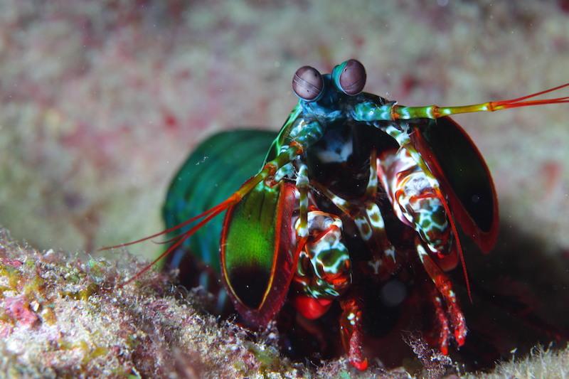
Polychromacy
Meet The Mantis Shrimp
Mantis shrimp have 16 (!!!) types of cones.
Imagine that, silly humans.

Slide 33
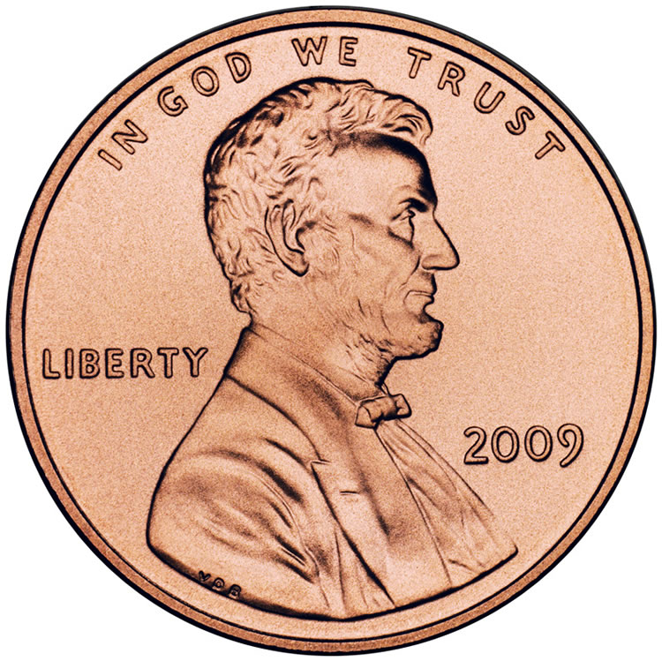
If Bits Were Pennies
If a bit weighed as much as penny (2.5 g)…
How much does a 20x20 pixel 1 bit image weigh?
How much does a 20x20 pixel 8 bit image weigh?
How much does a 20x20 pixel 16 bit image weigh?

Slide 34
Vector
A VECTOR image is defined mathematically and the computer chooses how to color the pixels.
Like in LAB 1! ☺

Slide 35
Vector
A VECTOR image is defined mathematically and the computer chooses how to color the pixels.
No pixels.

Slide 37
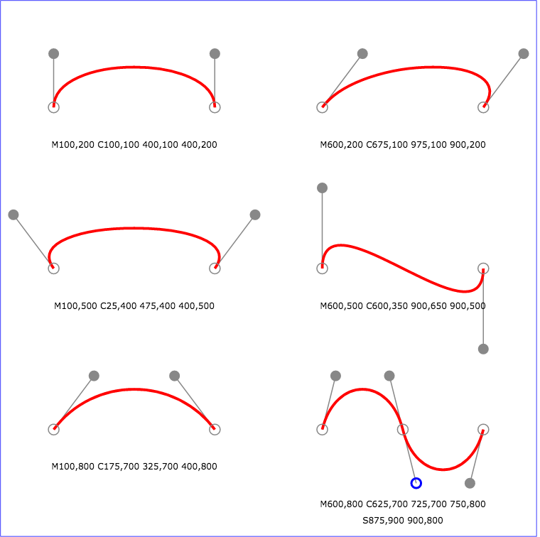
Bezier Curves
http://www.w3.org/TR/SVG/images/paths/cubic02.svg

Slide 38
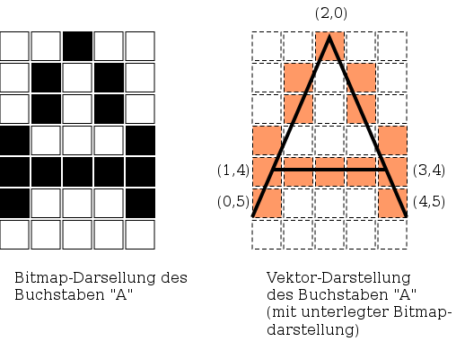
Bitmap vs. Vector
https://upload.wikimedia.org/wikipedia/commons/thumb/e/e8/Bitmap_vs_vector.svg/508px-Bitmap_vs_vector.svg.png

Slide 39
Transparency
Transparency in images is called ALPHA.
GIF has a 1-bit transparency channel (it’s either on or off).
PNG has a 7-bit transparency channel (128 different levels).
Vector images like SVG store transparency as a decimal value between 0 and 1.

Slide 40
Think of the Pennies!

Slide 41
How do we SAVE pennies?

Slide 42
Image Compression
Different methods to represent the same image with less data.
Lossy vs Lossless
Symmetrical vs Asymmetrical

Slide 45
Lossless vs Lossy
Lossless Compression reproduces the exact same image down to the pixel.
PNG, GIF, TIFF, Native Formats
Lossy Compression reproduces a reasonable simulacrum thereof.
JPEG, GIF, DjVu

Slide 46
Lossless Compression
Run Length Encoding (RLE) or “Tile Counting”
Lempel-Ziv-Welch Encoding (LZW)
Limited color palette. (GIF & PNG)
Generic file compression hocus-pocus (zip, etc.)
A combination thereof.

Slide 47
Run Length Encoding (RLE)
0,0,0,0,0,0,0,0,
0,0,1,0,0,1,0,0,
0,0,0,0,0,0,0,0,
0,0,0,0,0,0,0,0,
0,1,0,0,0,0,1,0,
0,0,1,0,0,1,0,0,
0,0,0,1,1,0,0,0,
0,0,0,0,0,0,0,0.

Slide 48
Run Length Encoding (RLE)
10,1,2,1,19,1,4,
1,3,1,2,1,5,2,11.

Slide 49
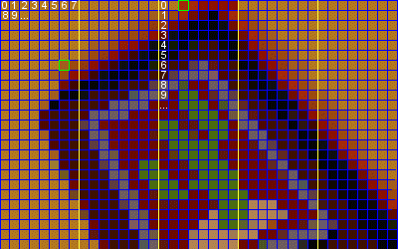
Run Length Encoding (RLE)

Slide 50
LZW Encoding
A type of RLE where bigger “chunks” are saved as a dictionary.
Encode: THISISTHETHESIS (“this is the thesis”)
1 = THE (or 3E – see below, chunk the chunks)
2 = SIS
3 = TH
4 = I
342112 vs THISISTHETHESIS (about 50% shorter)

Slide 51
Limiting Color Palettes
[namespace] | [colorspace]
0000 | 000000000000000000000000
Use a larger bit depth for each color, but limit the total number of colors.
Effectively give each larger color a smaller name to store and reference.
The AWESOMENESS of Mark J. Ferrari:
http://www.effectgames.com/effect/article-Old_School_Color_Cycling_with_HTML5.html

Slide 52
Lossy Compression
Forcibly limit color palette (heavy dithering).
Interpolation -- Use a patterning system to make something “good enough” (JPEG).

Slide 53
Forcibly Limit the Color Palette

Slide 54
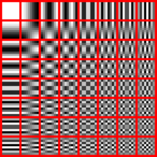
Interpolation

Slide 55
Interpolation via Patterning

Slide 56
Symmetrical vs Asymmetrical
If it’s SYMMETRICAL it takes as much time to encode/store it as it takes to decode/display.
If it’s ASYMMETRICAL, one takes more time or resources than the other.
(Think: Where does one spend their pennies?)

Slide 57
Symmetrical vs Asymmetrical
Bitmaps tend to be heavy on storage and light on display.
Vectors tend to be light on storage and heavy on display.
JPEGs tend to be heavy on encoding, but quick on decoding.
PNGS tend to be symmetrical with encoding and decoding.

Slide 58
ARE THERE ANY QUESTIONS?
Yawn stretch and ask:

