Slide 1
CISY114 Week 3
Hardware & Software
Images

Slide 2
Hardware & Software
Let us begin!

Slide 3
Windows vs. Macintosh
Most of this is largely historical.
The Mac vs PC wars have settled into their respective camps (all run x86).
The biggest difference between Macs & PCs today is hardware in/dependence.

Slide 4
Networking & Data Storage
Since this is largely reference material, let’s go over these together in the book quickly.
Refer back to these when the need arises.

Slide 5
Input Devices

Slide 6
Are there any questions?
WAKE UP!!!! And ask:

Slide 7
Images! – We shall discuss:
Different things and ways to quantize them.
Vector vs Bitmap
Color – Bit depth and palette (not pilates).
(Sorry, we have to go over hexidecimal again.)
Compression
Lossy vs Lossless
The “weight” of files.

Slide 8
How Do We Represent Images?
Remember, the computer does not have any actual images inside it. (Images are ANALOG.)
How do we quantize an image to fit into a digital space?

Slide 9
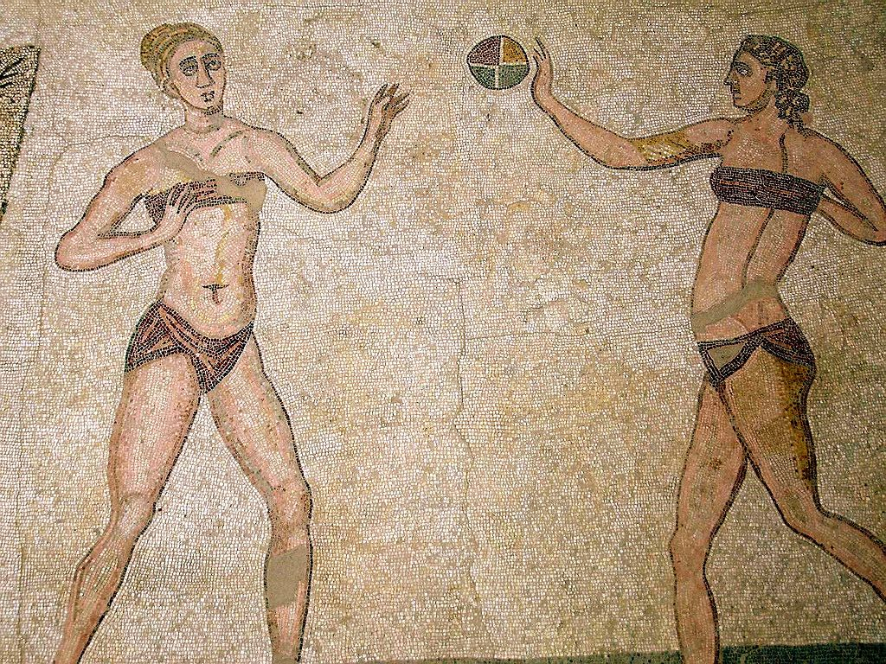
Bitmap
A BITMAP image is like a giant mosaic where each tile (pixel) has its own color.

Slide 11
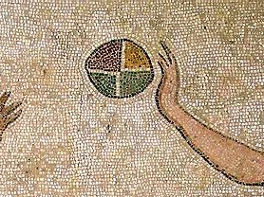

Slide 12
Bitmap
Made of pixels.
Width and height are the “resolution.”
Each pixel on the grid uses a number to represent a color.
The larger the range of the number, the more colors one can represent.
The number of bits dedicated to those numbers determines its “bit depth.”

Slide 13
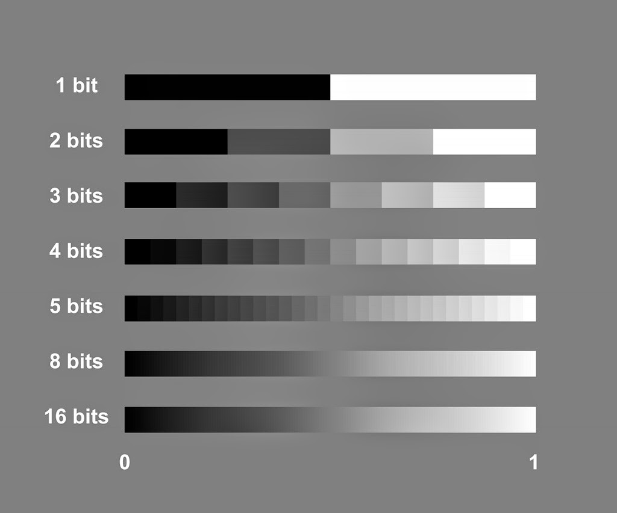
Bit Depth Illustrated

Slide 14
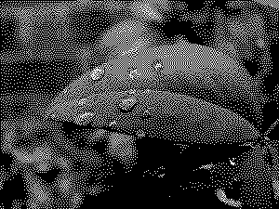

Slide 15
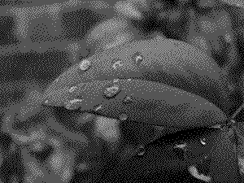

Slide 16
Storing COLOR

Slide 18
“DITHERING”

Slide 19
Storing More COLOR
When bit depth gets bit enough, we can actually divvy up the bits to represent different colors.
8-bit color does it this way:
000 000 00

Slide 20
256 Colors

Slide 21
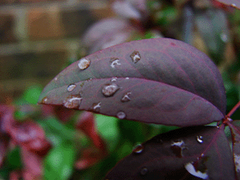

Slide 22
Storing More COLOR
With 24-bit color, we get 8 bits (a whole byte) for each color channel:
00000000 00000000 00000000

Slide 23
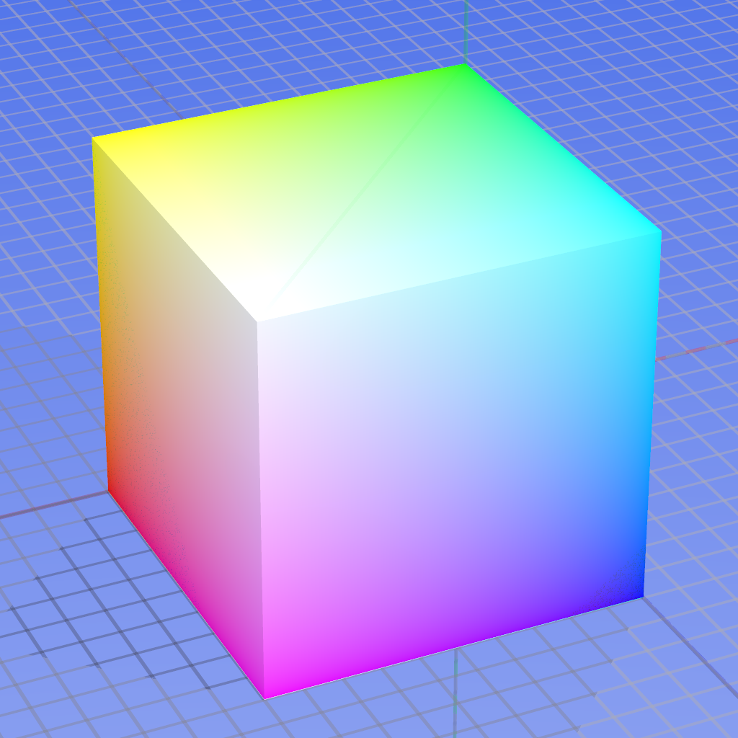

Slide 25
The limitations of our own eyes.

Slide 26
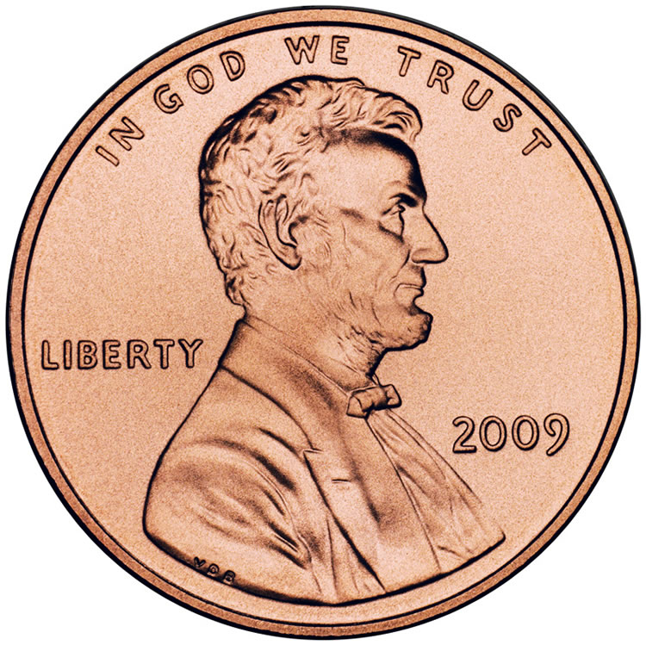
If Bits Were Pennies
If a bit weighed as much as penny (2.5 g)…
How much does a 20x20 pixel 1 bit image weigh?
How much does a 20x20 pixel 8 bit image weigh?
How much does a 20x20 pixel 16 bit image weigh?

Slide 27
Vector
A VECTOR image is defined mathematically and the computer chooses how to color the pixels.
Like in LAB 1! ☺

Slide 28
Vector
A VECTOR image is defined mathematically and the computer chooses how to color the pixels.
No pixels.

Slide 30
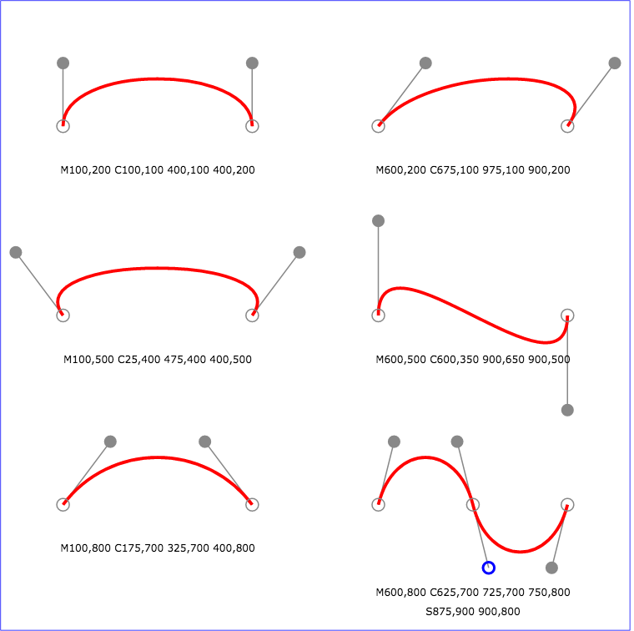
Bezier Curves
http://www.w3.org/TR/SVG/images/paths/cubic02.svg

Slide 31
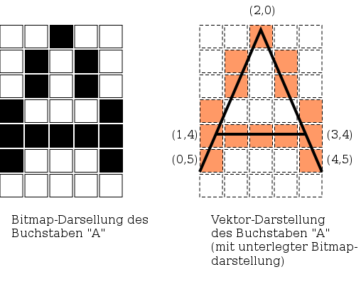
Bitmap vs. Vector
https://upload.wikimedia.org/wikipedia/commons/thumb/e/e8/Bitmap_vs_vector.svg/508px-Bitmap_vs_vector.svg.png

Slide 32
Think of the Pennies!

Slide 33
How do we SAVE pennies?

Slide 34
Image Compression
Different methods to represent the same image with less data.
Lossy vs Lossless
Symmetrical vs Asymmetrical

Slide 37
Lossless vs Lossy
Lossless Compression reproduces the exact same image down to the pixel.
PNG, GIF, TIFF, Native Formats
Lossy Compression reproduces a reasonable simulacrum thereof.
JPEG, GIF, DjVu

Slide 38
Lossless Compression
“Tile Counting”
Limited color palette. (GIF & PNG)
Generic file compression hocus-pocus (zip, etc.)
A combination thereof.

Slide 39
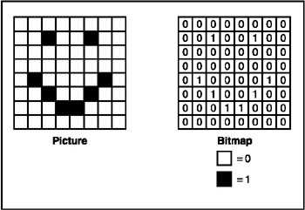
“Tile Counting”

Slide 40
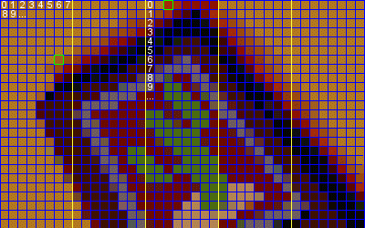
“Tile Counting”

Slide 41
Limiting Color Palettes
Use a larger bit depth for each color, but limit the total number of colors.
Effectively give each larger color a smaller call name to reference.
The AWESOMENESS of Mark J. Ferrari:
http://www.effectgames.com/effect/article-Old_School_Color_Cycling_with_HTML5.html

Slide 42
Lossy Compression
Forcibly limit color palette (heavy dithering).
Use a patterning system to make something “good enough” (JPEG).

Slide 43
Forcibly Limit the Color Palette

Slide 44
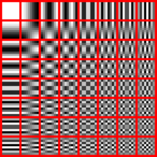
Patterning

Slide 45
Patterning

Slide 46
Symmetrical vs Asymmetrical
If it’s SYMMETRICAL it takes as much time to encode it as it takes to decode it.
If it’s ASYMMETRICAL, one takes more time than the other.
Ex: JPEG is far more asymmetrical than PNG.
Ex: A high-res JPEG is more asymmetrical than a low-res JPEG.

Slide 47
ARE THERE ANY QUESTIONS?
Yawn stretch and ask:

