Slide 1
CISY114 Week 2
Process & Intangibles Typography & Text

Slide 2
Quick Review
Analog vs Digital
Quantization
Binary, Decimal, & Hexidecimal

Slide 3
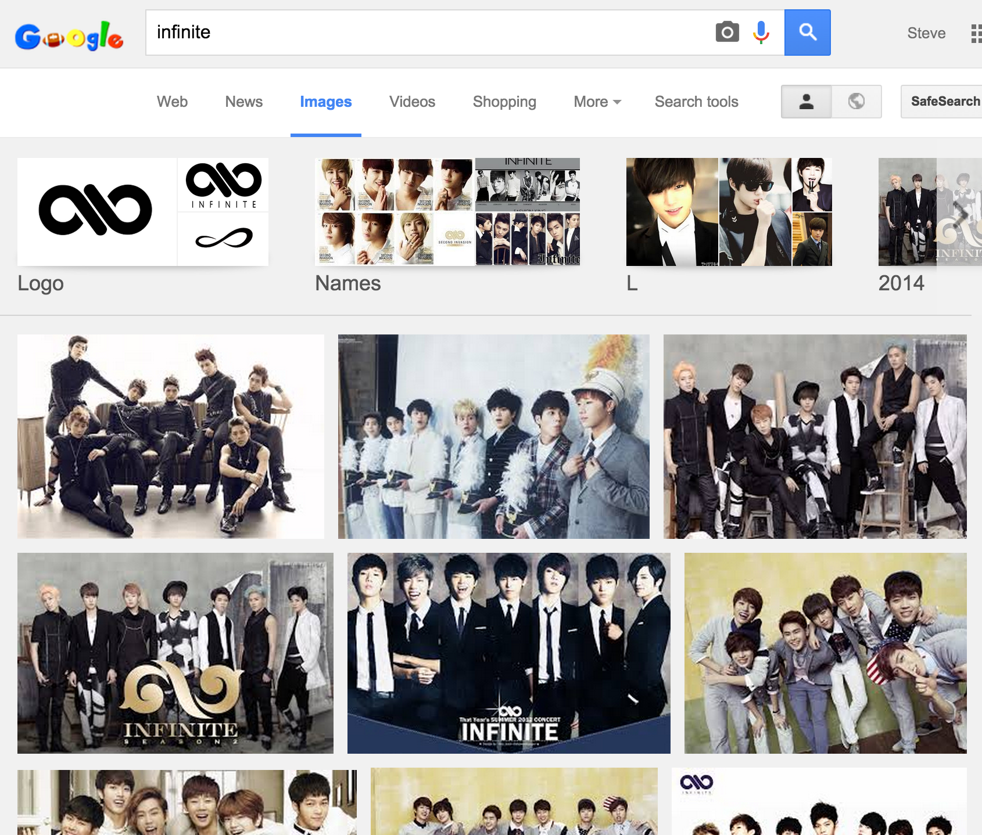

Slide 4
Zeno’s Paradox as a Metaphor
(Draw it here, Steve.)

Slide 5
Quantization
(Also draw it here, Steve.)

Slide 6
Binary, Decimal, & Hexidecimal
Decimal – 0123456789
Binary – 01
Hexidecimal – 0123456789ABCDEF
Four Binary digits are equivalent to one Hexidecimal digit.

Slide 7
Binary, Decimal, Hexidecimal
Dec Bin Hex
Dec Bin Hex
0 0000 0
1 0001 1
2 0010 2
3 0011 3
4 0100 4
5 0101 5
6 0110 6
7 0111 7
8 1000 8
9 1001 9
10 1010 A
11 1011 B
12 1100 C
13 1101 D
14 1110 E
15 1111 F

Slide 8
Are there any questions?
Now comes the time we face our fears and ask:

Slide 9
The Stages of Multimedia Design
Planning & Costing
Making a specification or “spec.”
Aesthetics, “look and feel”
Proof of concept & prototyping (your notepads)
Designing & Producing
This is where the magic happens.™
Testing
Going back a step: “Iterative Design”
Delivering
Follow-up: “Iterative Design never ends.”

Slide 10
The Untouchables Intangibles

Slide 11
The Intangibles
The Human Factor
Creativity
Organization
Communication
These three things are SKILLS.
All three of these add up to Teamwork.

Slide 12
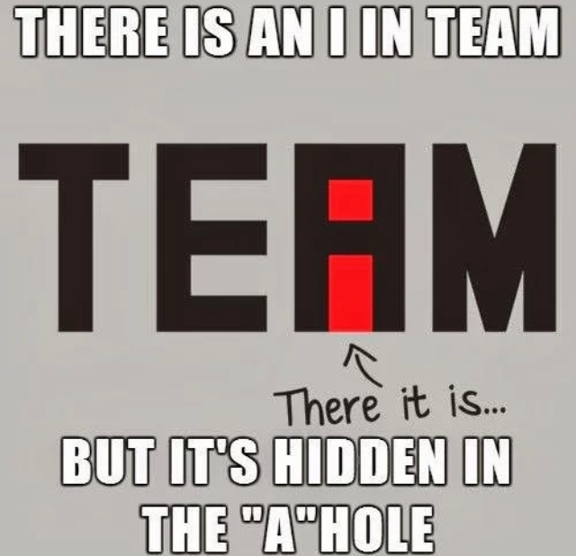
The Intangibles

Slide 13
Project 1
The Project 1 information will be posted to the Group BuddyDrive next week.
You’re going to want to look over it carefully and begin the Planning phase.

Slide 14
Are there Any Questions?
With our brains swelling with new information, we must ask:

Slide 15
Web Typography
The written word from paper to screen.

Slide 16
Writing Media
Remember from our first lecture:
First written on stone.
Then written with a pen (oscraca, papyrus, vellum, paper).
Then printed with a press.
Finally, up on our screens.
The different processes had different requirements.

Slide 17
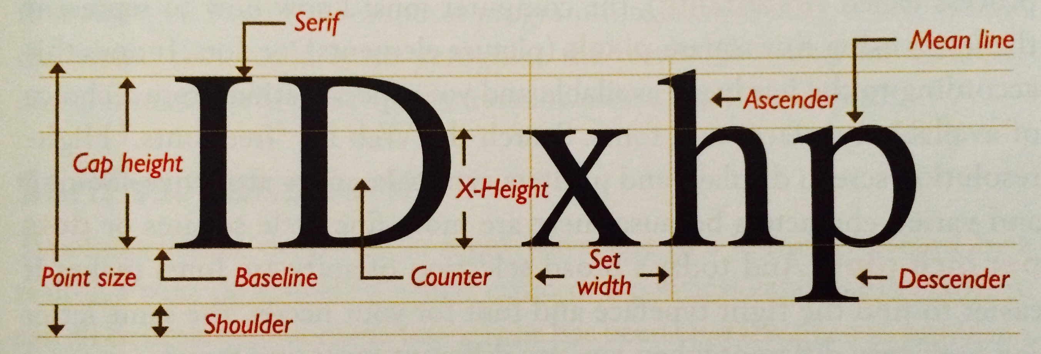
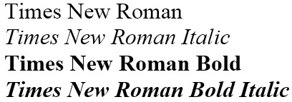
Modern Typography Jargon (p23)

Slide 18
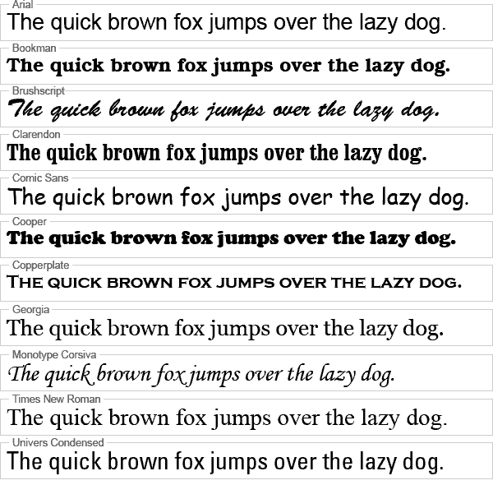
Notes:
Pangrams

Slide 19
Classes of Fonts
Serif – Times New Roman
Sans (Serif) - Arial
Monospace - Courier
Modern - Georgia
Oldstyle - Baskerville
Script - Brush Script
Slab – Wide Latin
Decorative – Curlz MT

Slide 20
Serif vs Sans Serif
“They shot the serif. It was grotesk.”

Slide 21
Ligatures
The purpose of ligatures is to make reading easier. The most common in English are:
fl fi ff ft ti
Examples: http://www.will-harris.com/ligatures.htm

Slide 22
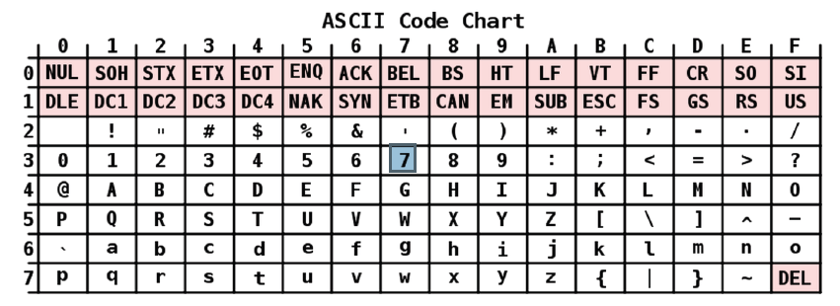
Text on a Computer Quantized into character tables.

Slide 23
Unicode
For more than just the English alphabet, Unicode was invented to give a number to each and every character or “glyph” in every script used by mankind.
However… there are some problems…

Slide 24
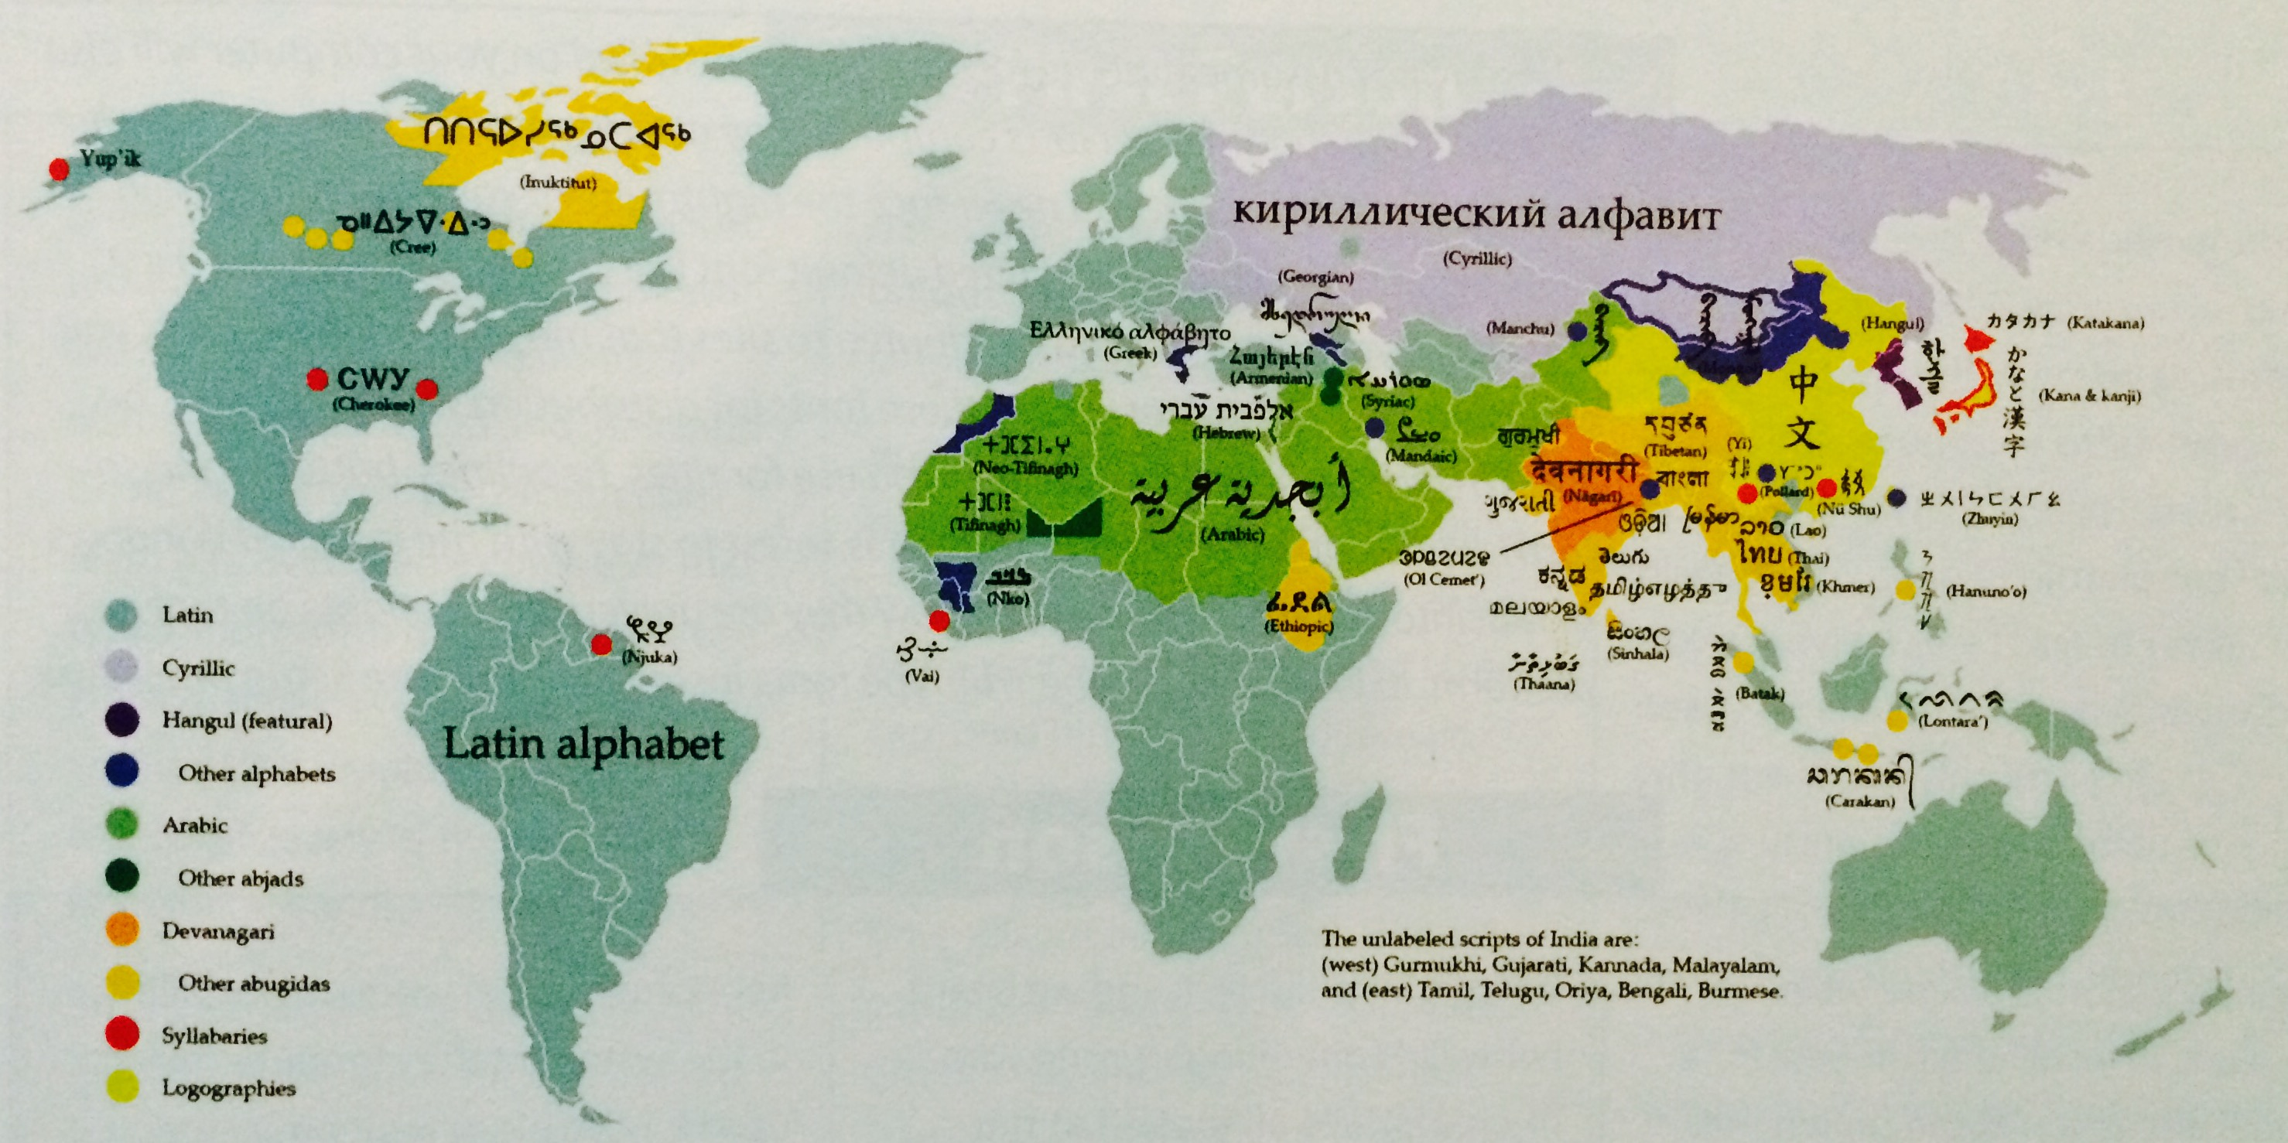
Vaughan page 47

Slide 25
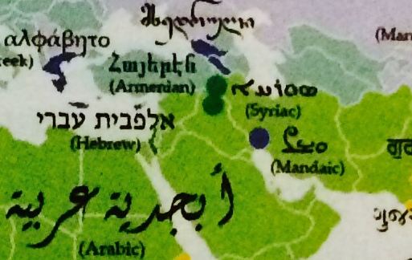

Slide 26
The Unicordinator
http://unicodinator.com/
A good visualization of all of the different Unicode “blocks.”

Slide 27
But how do we draw it on a screen?
Now we’ve quantized their representations in the computer’s memory. How do we do we present them to the user?
We need to turn symbols into pixels.
Two types of fonts:
Bitmap – largely depreciated today
Vector

Slide 28
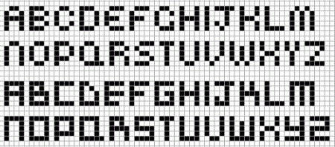
Quantizing Fonts to the Screen
We will be going over this in-depth next week.

Slide 29
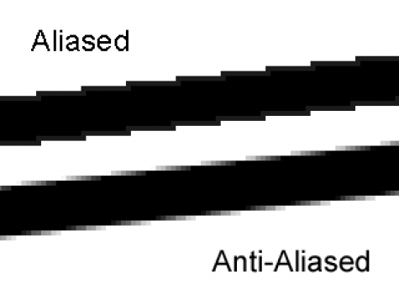
Antialiasing
http://i.stack.imgur.com/pA7uy.png

Slide 30
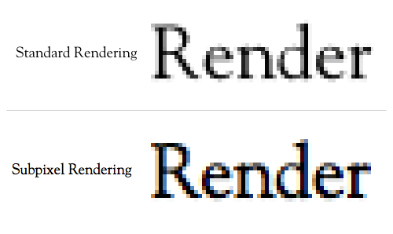
Sub-Pixel Antialiasing
http://media.mediatemple.netdna-cdn.com/wp-content/uploads/images/anti-aliasing/subpixel-side-by-side.gif

Slide 31
Text in Digital Multimedia
Choosing Fonts
Aesthetics for the project, laid down in the Planning Stage.
Platform differences & graceful degrading.
Less is more. “Minimalism.”
Serifs or no Serifs – the dawn of the e-Ink and “retina” displays.

Slide 32
Text in Digital Multimedia
Your audience’s attention span.
The way we read has changed dramatically.
Above the fold. Small chunks.
http://www.theguardian.com/world/interactive/2013/feb/12/state-of-the-union-reading-level
Animating text. (Subtle to obvious.)
Text as cues. Labels must call the user to action.
Symbols vs. text. (Think about the save icon.)
Hypertext (the founding principle of HTML)

Slide 33
ARE THERE ANY QUESTIONS?
It’s time to wake up and ask:

Slide 34
Lab Time!
Take a break, and be back here by:

Slide 35
Writing Demonstration

Slide 36
Lab #2 – Articulating Fonts
Lab 2 Instructions should be posted on the Group now… (or I should probably get to that…)

