Slide 1
CISY114 Week 2
Process & Intangibles Typography & Text

Slide 2
Quick Review
Analog vs Digital
Quantization
Binary, Decimal, & Hexidecimal

Slide 3
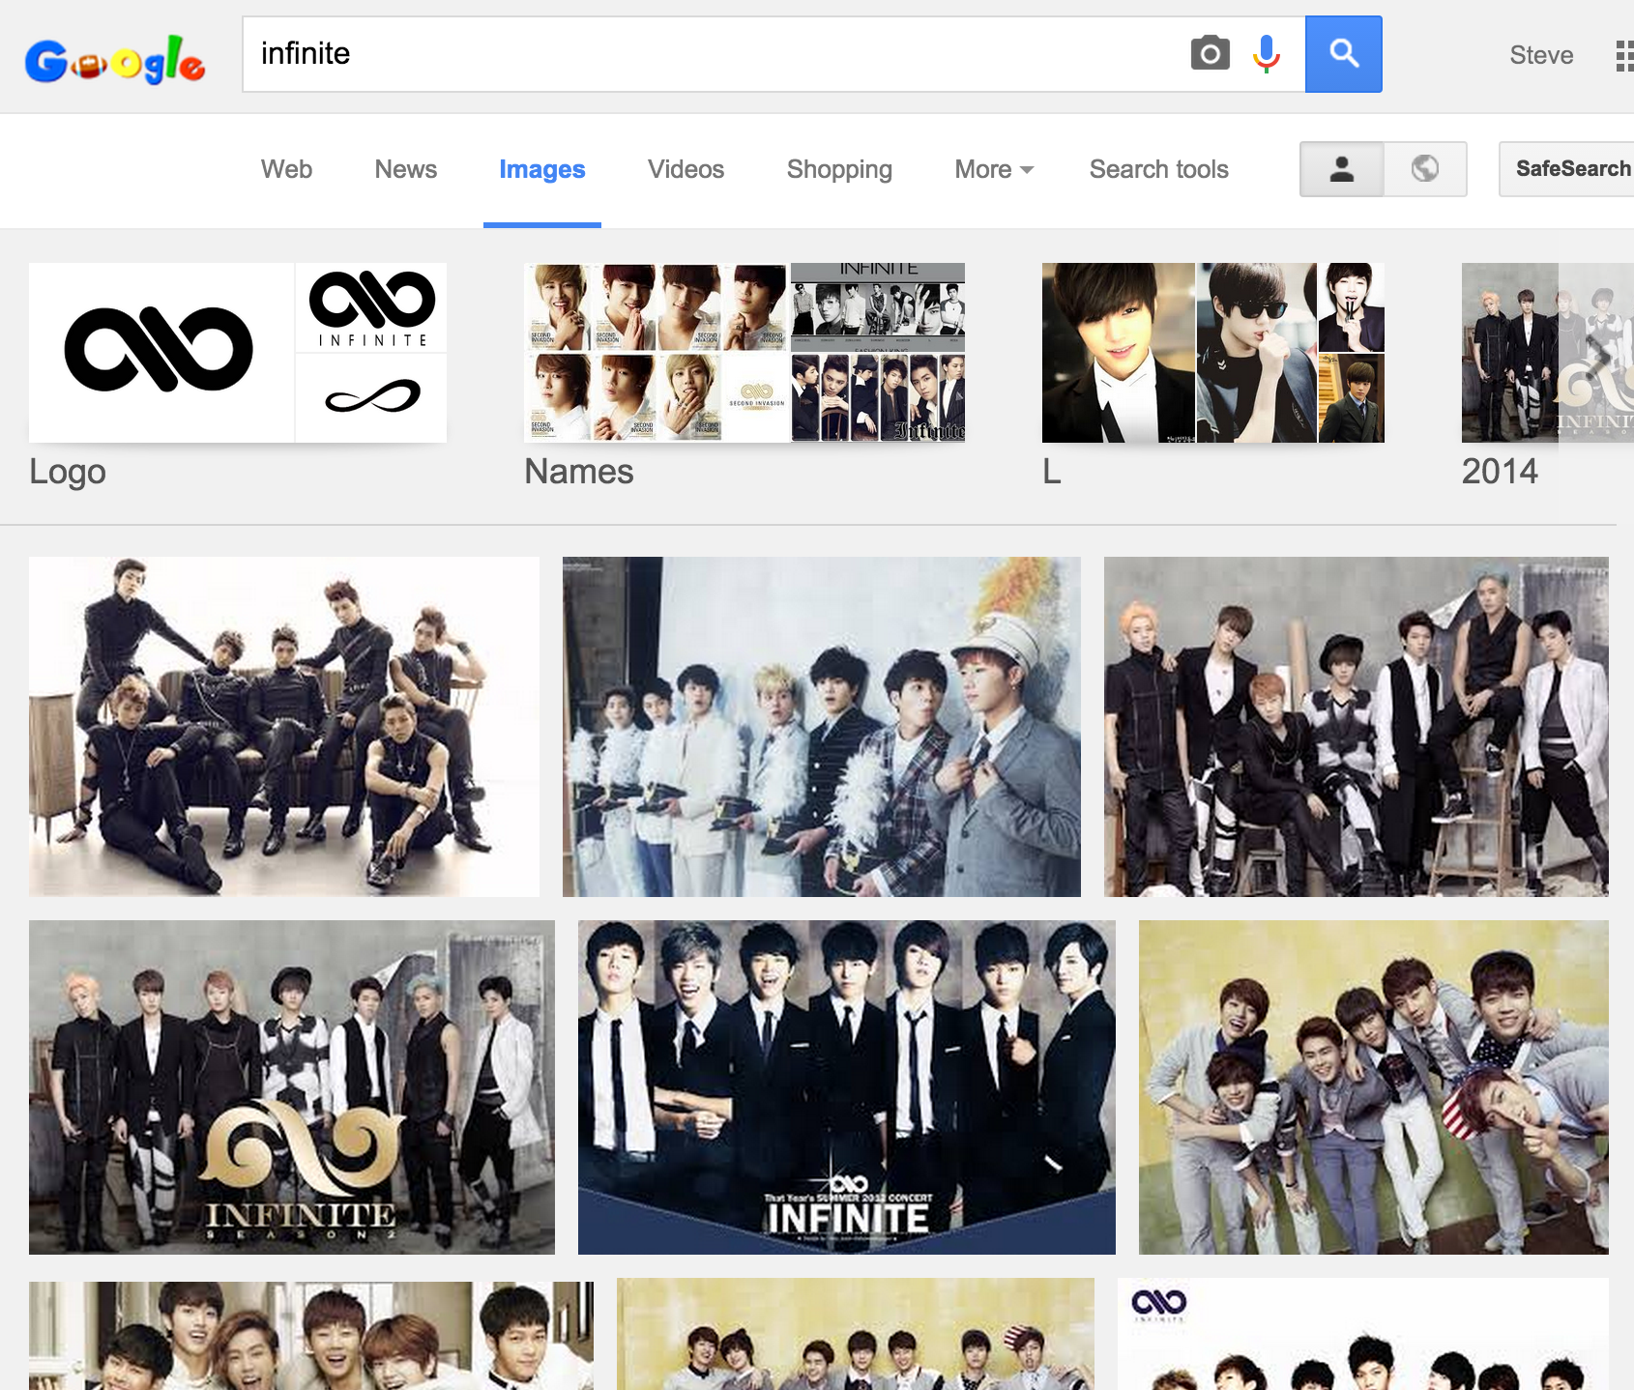

Slide 4
Zeno’s Paradox as a Metaphor
(Draw it here, Steve.)

Slide 5
Quantization
(Also draw it here, Steve.)

Slide 6
Binary, Decimal, & Hexidecimal
Decimal – 0123456789
Binary – 01
Hexidecimal – 0123456789ABCDEF
Four Binary digits are equivalent to one Hexidecimal digit.

Slide 7
Are there any questions?
Now comes the time we face our fears and ask:

Slide 8
The Stages of Multimedia Design
Planning & Costing
Making a specification or “spec.”
Aesthetics, “look and feel”
Proof of concept & prototyping (your notepads)
Designing & Producing
This is where the magic happens.™
Testing
Going back a step: “Iterative Design”
Delivering
Follow-up: “Iterative Design never ends.”

Slide 9
The Untouchables Intangibles

Slide 10
The Intangibles
The Human Factor
Creativity
Organization
Communication
These three things are SKILLS.
All three of these add up to Teamwork.

Slide 11
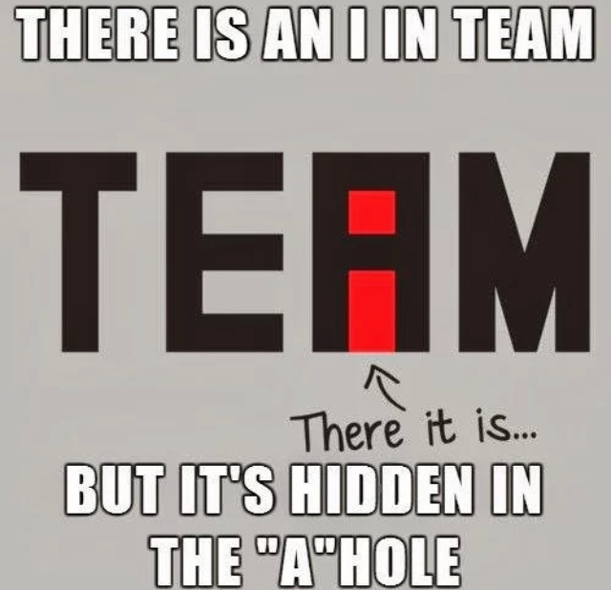
The Intangibles

Slide 12
Project 1
The Project 1 information will be posted to the Group BuddyDrive next week.
You’re going to want to look over it carefully and begin the Planning phase.

Slide 13
Are there Any Questions?
With our brains swelling with new information, we must ask:

Slide 14
Web Typography
The written word from paper to screen.

Slide 15
Writing Media
Remember from our first lecture:
First written on stone.
Then written with a pen (oscraca, papyrus, vellum, paper).
Then printed with a press.
Finally, up on our screens.
The different processes had different requirements.

Slide 16
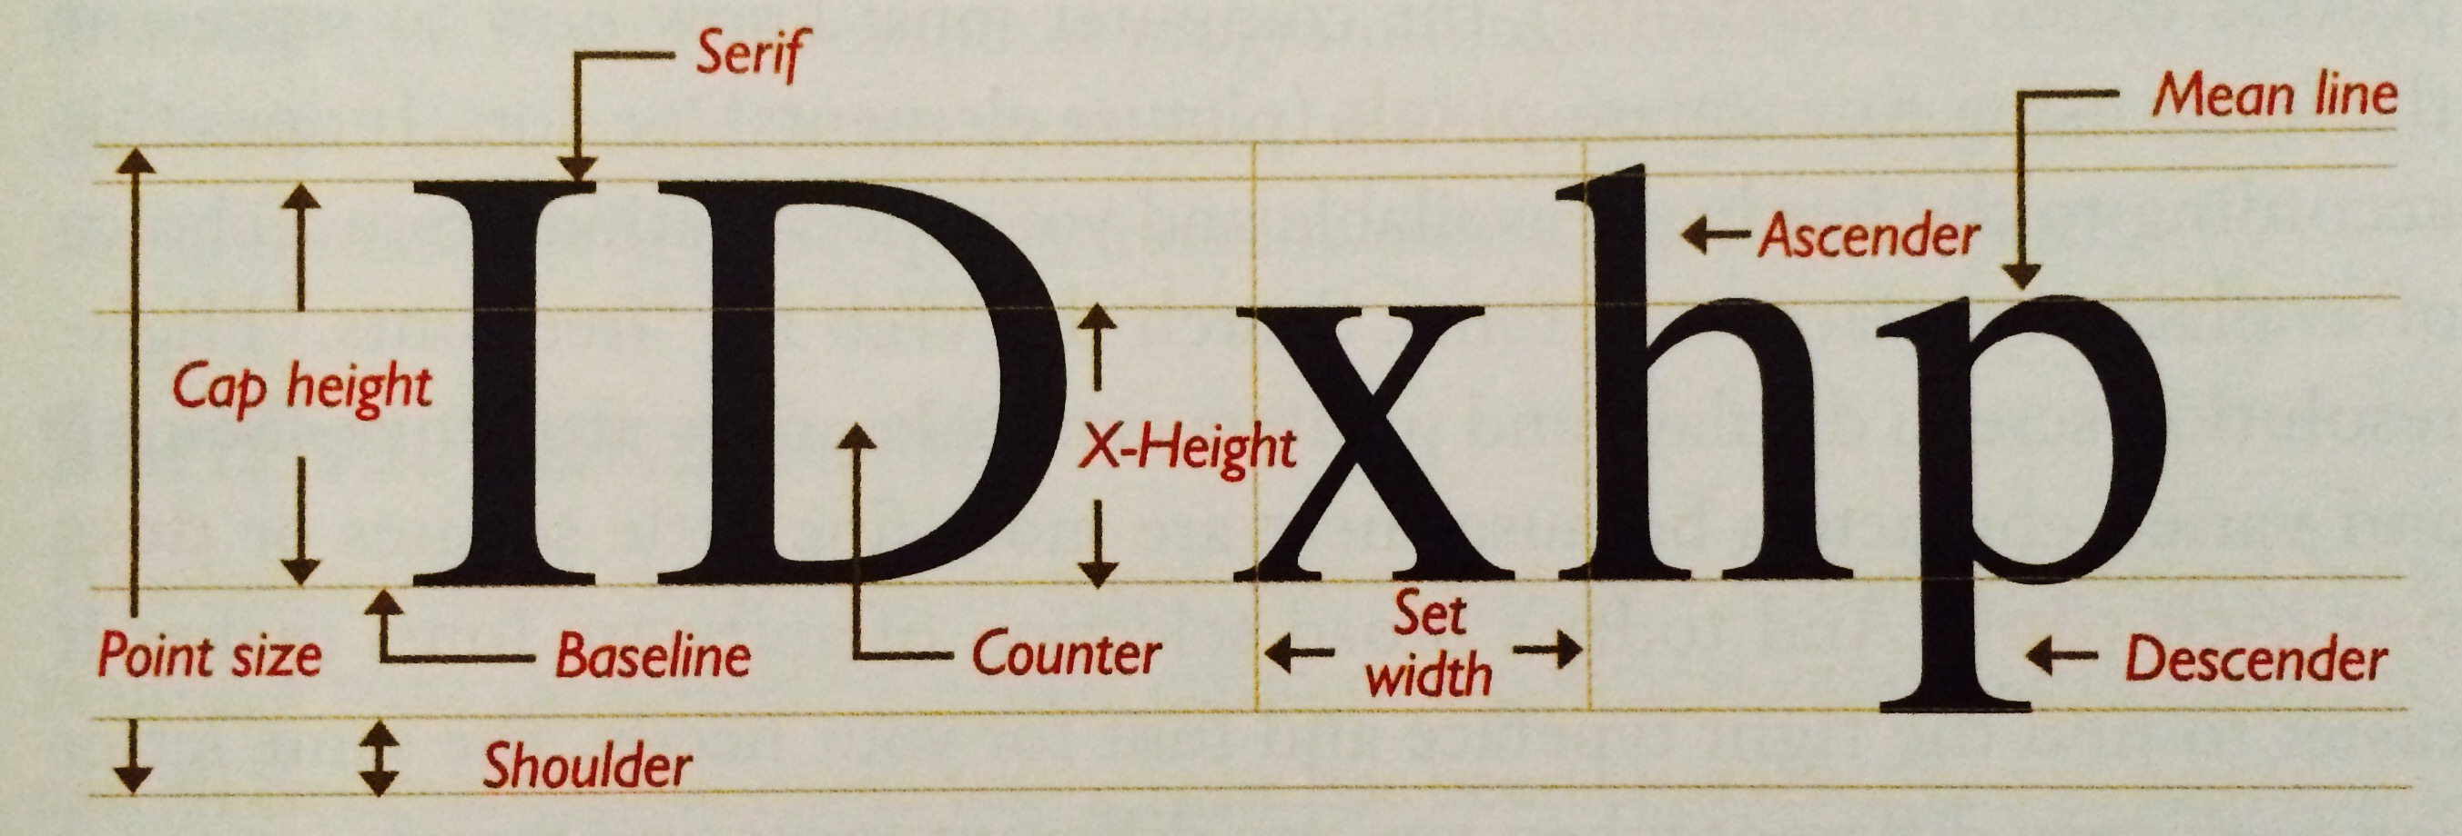
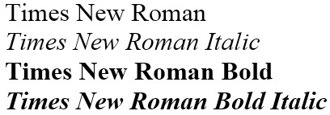
Modern Typography Jargon (p23)

Slide 17
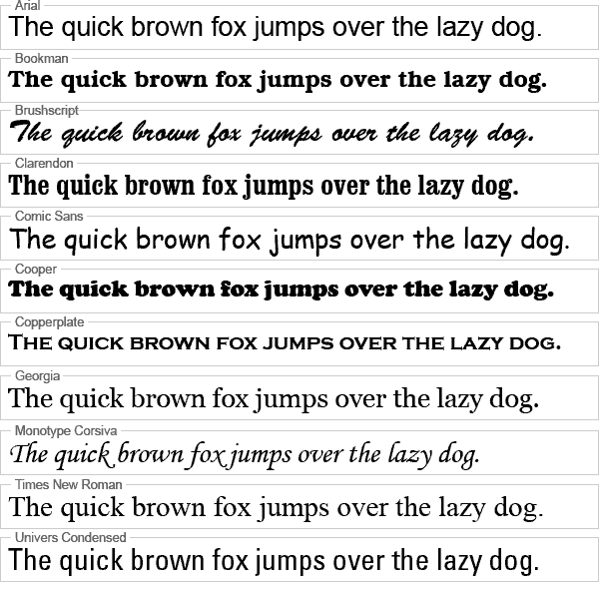
Notes:
Pangrams

Slide 18
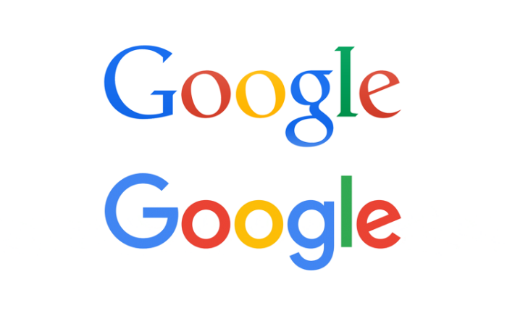
Serif vs Sans Serif
“They shot the serif. It was grotesk.”

Slide 19
Ligatures
The purpose of ligatures is to make reading easier. The most common in English are:
fl fi ff ft ti
Examples: http://www.will-harris.com/ligatures.htm

Slide 20
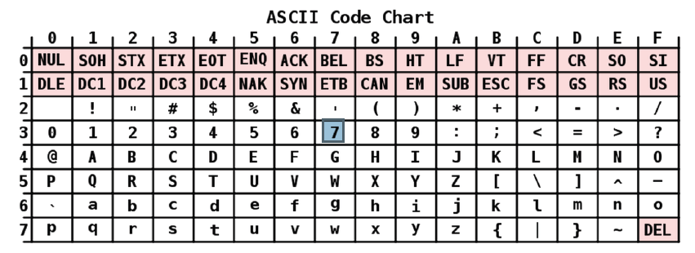
Text on a Computer Quantized into character tables.

Slide 21
Unicode
For more than just the English alphabet, Unicode was invented to give a number to each and every character or “glyph” in every script used by mankind.
However… there are some problems…

Slide 22
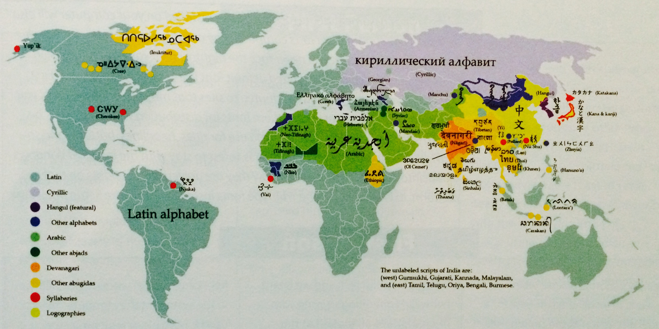
Vaughan page 47

Slide 23
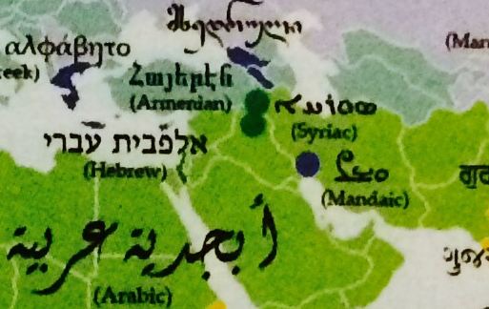

Slide 24
But how do we draw it on a screen?
Now we’ve quantized their representations in the computer’s memory. How do we do we present them to the user?
Two types of fonts:
Bitmap – largely depreciated today
Vector

Slide 25
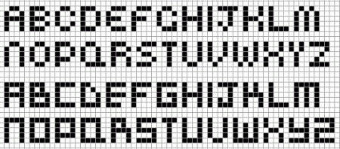
Quantizing Fonts to the Screen
We will be going over this in-depth next week.

Slide 26
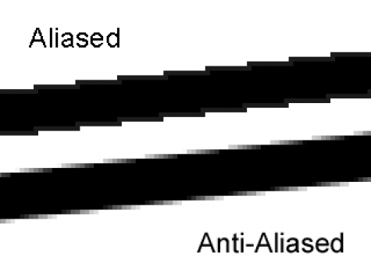
Antialiasing
http://i.stack.imgur.com/pA7uy.png

Slide 27
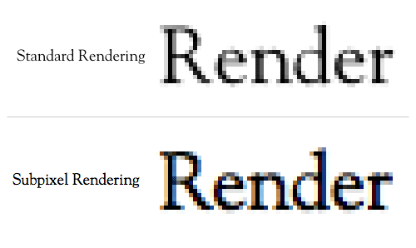
Sub-Pixel Antialiasing
http://media.mediatemple.netdna-cdn.com/wp-content/uploads/images/anti-aliasing/subpixel-side-by-side.gif

Slide 28
Text in Digital Multimedia
Choosing Fonts
Aesthetics for the project, laid down in the Planning Stage.
Platform differences & graceful degrading.
Less is more. “Minimalism.”
Serifs or no Serifs – the dawn of the e-Ink and “retina” displays.

Slide 29
Text in Digital Multimedia
Your audience’s attention span.
The way we read has changed dramatically.
Above the fold. Small chunks.
http://www.theguardian.com/world/interactive/2013/feb/12/state-of-the-union-reading-level
Animating text. (Subtle to obvious.)
Text as cues. Labels must call the user to action.
Symbols vs. text. (Think about the save icon.)
Hypertext (the founding principle of HTML)

Slide 30
ARE THERE ANY QUESTIONS?
It’s time to wake up and ask:

Slide 31
Lab Time!
Take a break, and be back here by:

Slide 32
Writing Demonstration

Slide 33
Lab #2 – Articulating Fonts
Lab 2 Instructions should be posted on the Group now… (or I should probably get to that…)

