Slide 1
The Internet & Multimedia
Vaughan Chapter 11
3 important things.

Slide 2
Where Did the Internet Begin?
ARPANET – The Advanced Research Projects Agency Network
Started at UCLA as a means for scientists to share their papers and the military to share “military stuff.”

Slide 3
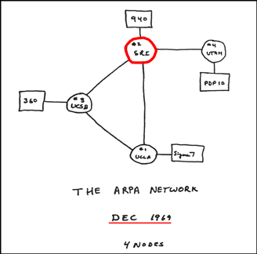
Where Did the Internet Begin?
Source: University of Manchester

Slide 4
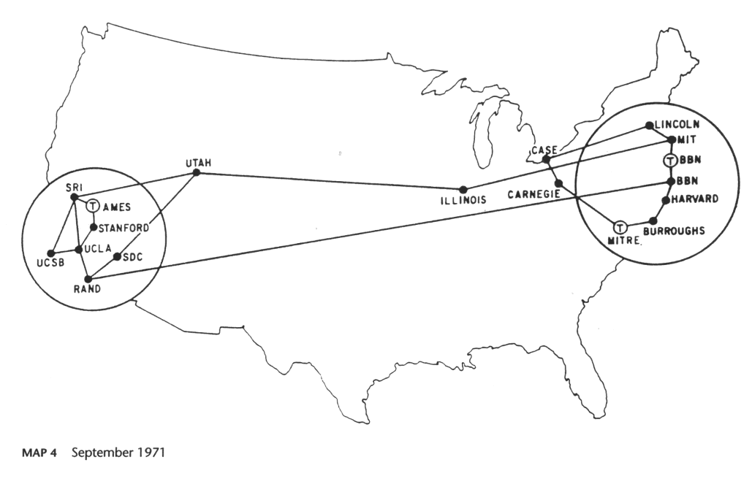
Where Did the Internet Begin?
Source: University of Manchester

Slide 5
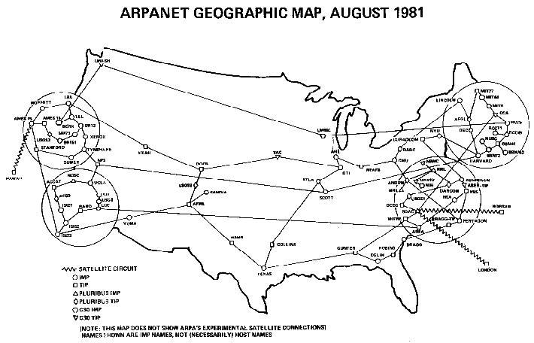
Where Did the Internet Begin?
Source: University of Manchester

Slide 6
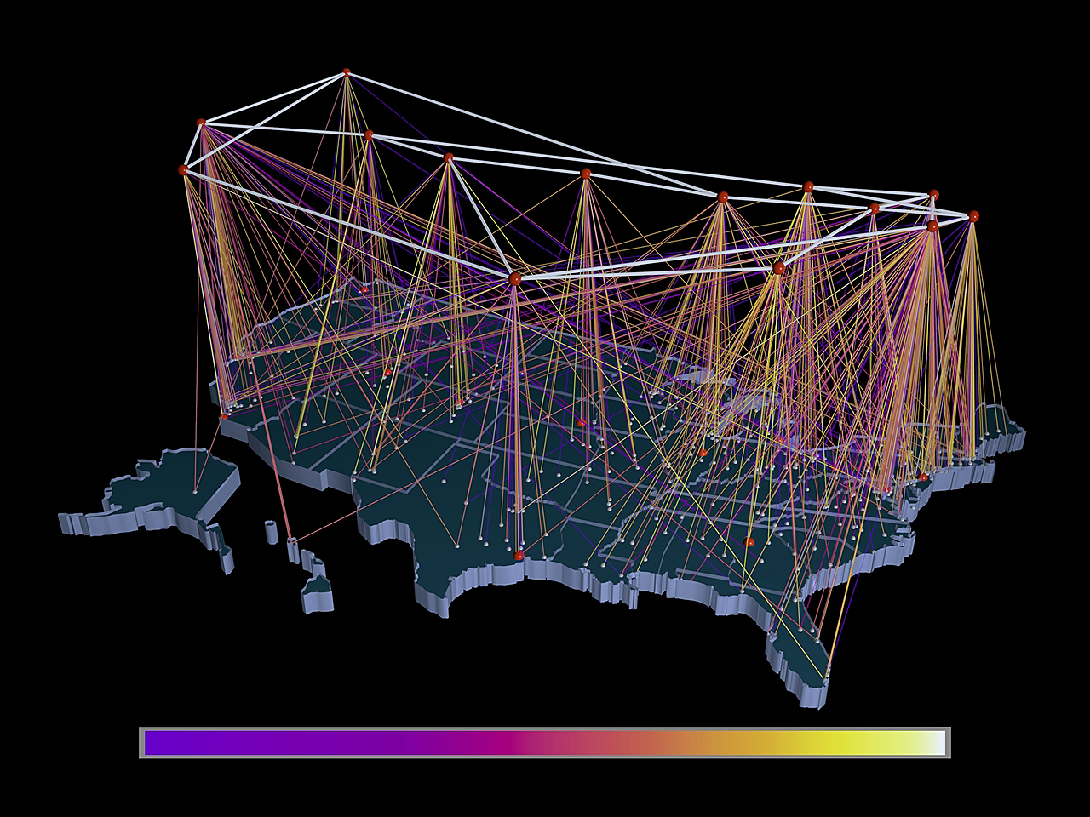
1991
NSFNET “Backbone”
(not NSFW-NET, although…)
The Internet
"NSFNET-traffic-visualization-1991" by Transferred from en.wikipedia to Commons by Fredlyfish4 using CommonsHelper.. Licensed under CC BY-SA 3.0 via Wikimedia
Commons - http://commons.wikimedia.org/wiki/File:NSFNET-traffic-visualization-1991.jpg#/media/File:NSFNET-traffic-visualization-1991.jpg

Slide 7
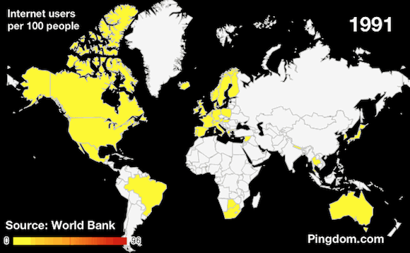
From there it exploded…

Slide 8
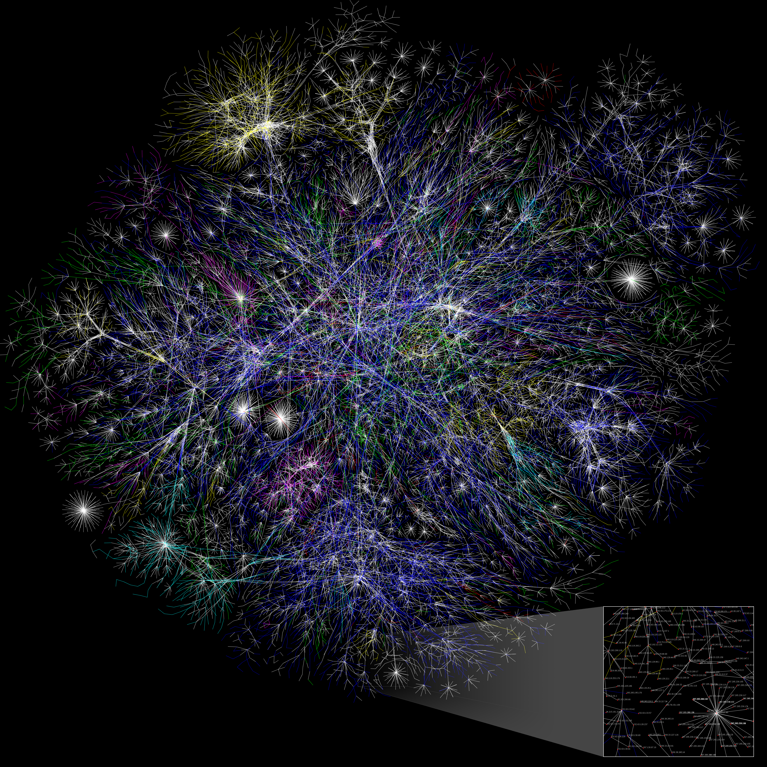

Slide 9
BANDWIDTH: A Big Deal to Multimedia Developers
How much data we can transfer through an Internet connection per second.

Slide 10
BANDWIDTH: A Big Deal to Multimedia Developers
56k modem = 56kB/sec
T1 = 1.544kB/sec
DSL & Cable = 1.5-400MB/sec
802.11n Wireless = 54MB/sec
OC-255 = 13.21GB/sec

Slide 11
BANDWIDTH: A Big Deal to Multimedia Developers
Let’s visualize it with pennies.
Because pennies make it absurd!
Imagine 1 penny = 1 bit (1 or 0, heads or tails).

Slide 12
BANDWIDTH: A Big Deal to Multimedia Developers
Penny Math:
1 penny (post 1982) weighs 2.5 grams.
Multiply the number of pennies by
0.0055115 to get the number of pounds.

Slide 13
BANDWIDTH: A Big Deal to Multimedia Developers
BITS x 0.0055115 = pounds of pennies
BITS x 0.00000275575 = tons of pennies
56k modem = 56,000 bits/sec = ~309 lbs
T1 = 1,544,000 bits/sec = ~4.25 tons
DSL & Cable = 400,000,000 bits/sec = ~1,100 tons
802.11n Wireless = 54,000,000 bits/sec = ~150 tons
OC-255 = 13,210,000,000 bits/sec = ~36,400 tons (about 7,000 school bus weights of pennies per second)

Slide 14
MIMES?

Slide 15
Multipurpose Internet Mail Extensions (MIMES)
Ways to identify
different file formats
via email and HTTP.
Ever click on a link
and want to view it in
your browser, but it
downloaded it instead?
Improper MIME type.

Slide 16
The Rest of the Chapter Goes Over…
HTML
CSS
JavaScript
In order for this part of the chapter and the next assigned reading to make sense, we need to have a basic grasp of HTML and CSS.
Notes:
I’m honestly not sure why we haven’t had a lab on HTML. If I could tinker with the curriculum I would have done so.

Slide 17
DEMONSTRATION!
It’s time for a…

Slide 18
Smashing Chapter 5: RED FLAGS
(Warning Signs)
in Web Development
Christian Hielmann

Slide 19
Source: Lost in Space

Slide 20
Hielmann & The Dalai Lama
“None of the things I am about to mention are actually surprising.”
Hielmann is Mozilla’s “Developer Evangelist.”
Tenzin Gyatso is the 14th Dalai Lama.

Slide 21
Most of this Chapter is about
“BEST PRACTICES”
Why?

Slide 22
Hielmann’s Points on Pitfalls
People not qualified to write code for the Web are asked to do so because “it is just software engineering.”
People not qualified to design an interface are asked to use an out- of-the-box system and “make it prettier and modern.”
Developers aren’t given enough time to build, clean up and docu- ment code-most of the time, they have to ship halfway through the building process.
Designers are asked to work with corporate colors and fonts and to add a photo of the CEO with an audio welcome message, rather than spend time making sure the product is easy to navigate and guiding the user as quickly and enjoyably as possible to their objective.

Slide 23
Hielmann’s Points on Pitfalls
Web development is part of a larger project plan, and when the plan goes wrong, the wrong parts get cut (testing, documentation, developing a maintenance and build infrastructure).
Developers themselves are bad at estimating the time and resources needed to build a product.
Developers are too proud to use existing solutions and prefer to build their own... over and over again. (prof: “Re-inventing the wheel as it turns.”)
For years, the market and particularly software companies have made us believe that handcrafted Web design and development are unnecessary: All you need are a set of great software tools and some templates, right? In the end, however, all WYSIWYG editors and clever IDEs have failed to deliver what we need.

Slide 24
We’ve Gone Over These Before:
Designers are not users.
Make every element count.
Don’t use gobs of text.
Remember cross-platform and cross-browser differences.

Slide 25
But then he gets to HTML Problems:
DO NOT:
‘Paint’ with HTML
Use classes everywhere
Use visual class and id names
Write unsemantic HTML
Write script-dependent mark-up.
Write invalid HTML because you can.

Slide 26
And CSS Problems:
DO NOT:
Allow browser defaults
Use convoluted syntax
Add CSS without analyzing
Be too specific
Use browser-specific hacks and technologies

Slide 27
And JavaScript & PHP Problems…
I cannot give a JavaScript and PHP primer with the amount of time we have. There is too much to learn.
However, the same sort of principles apply.
For more about this, I highly recommend taking the Web Design course.

Slide 28
In Summary
Pace yourself.
Don’t copy unknown code.
Don’t “please machines.”
Don’t be a fanboy/girl.

Slide 29
Questions?

