Slide 1
Interactive Multimedia 1
History & Overview

Slide 2
The
First
Medium

Slide 3
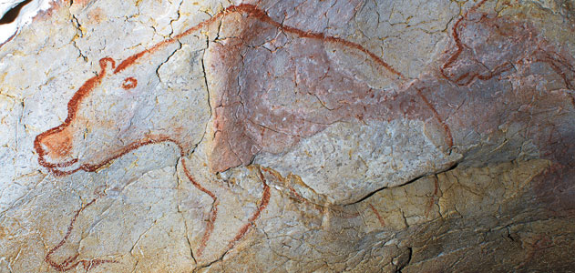

Slide 4
New
Medium

Slide 5
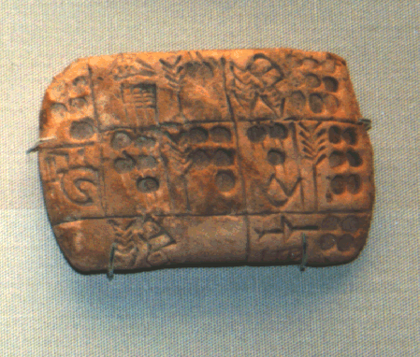

Slide 6
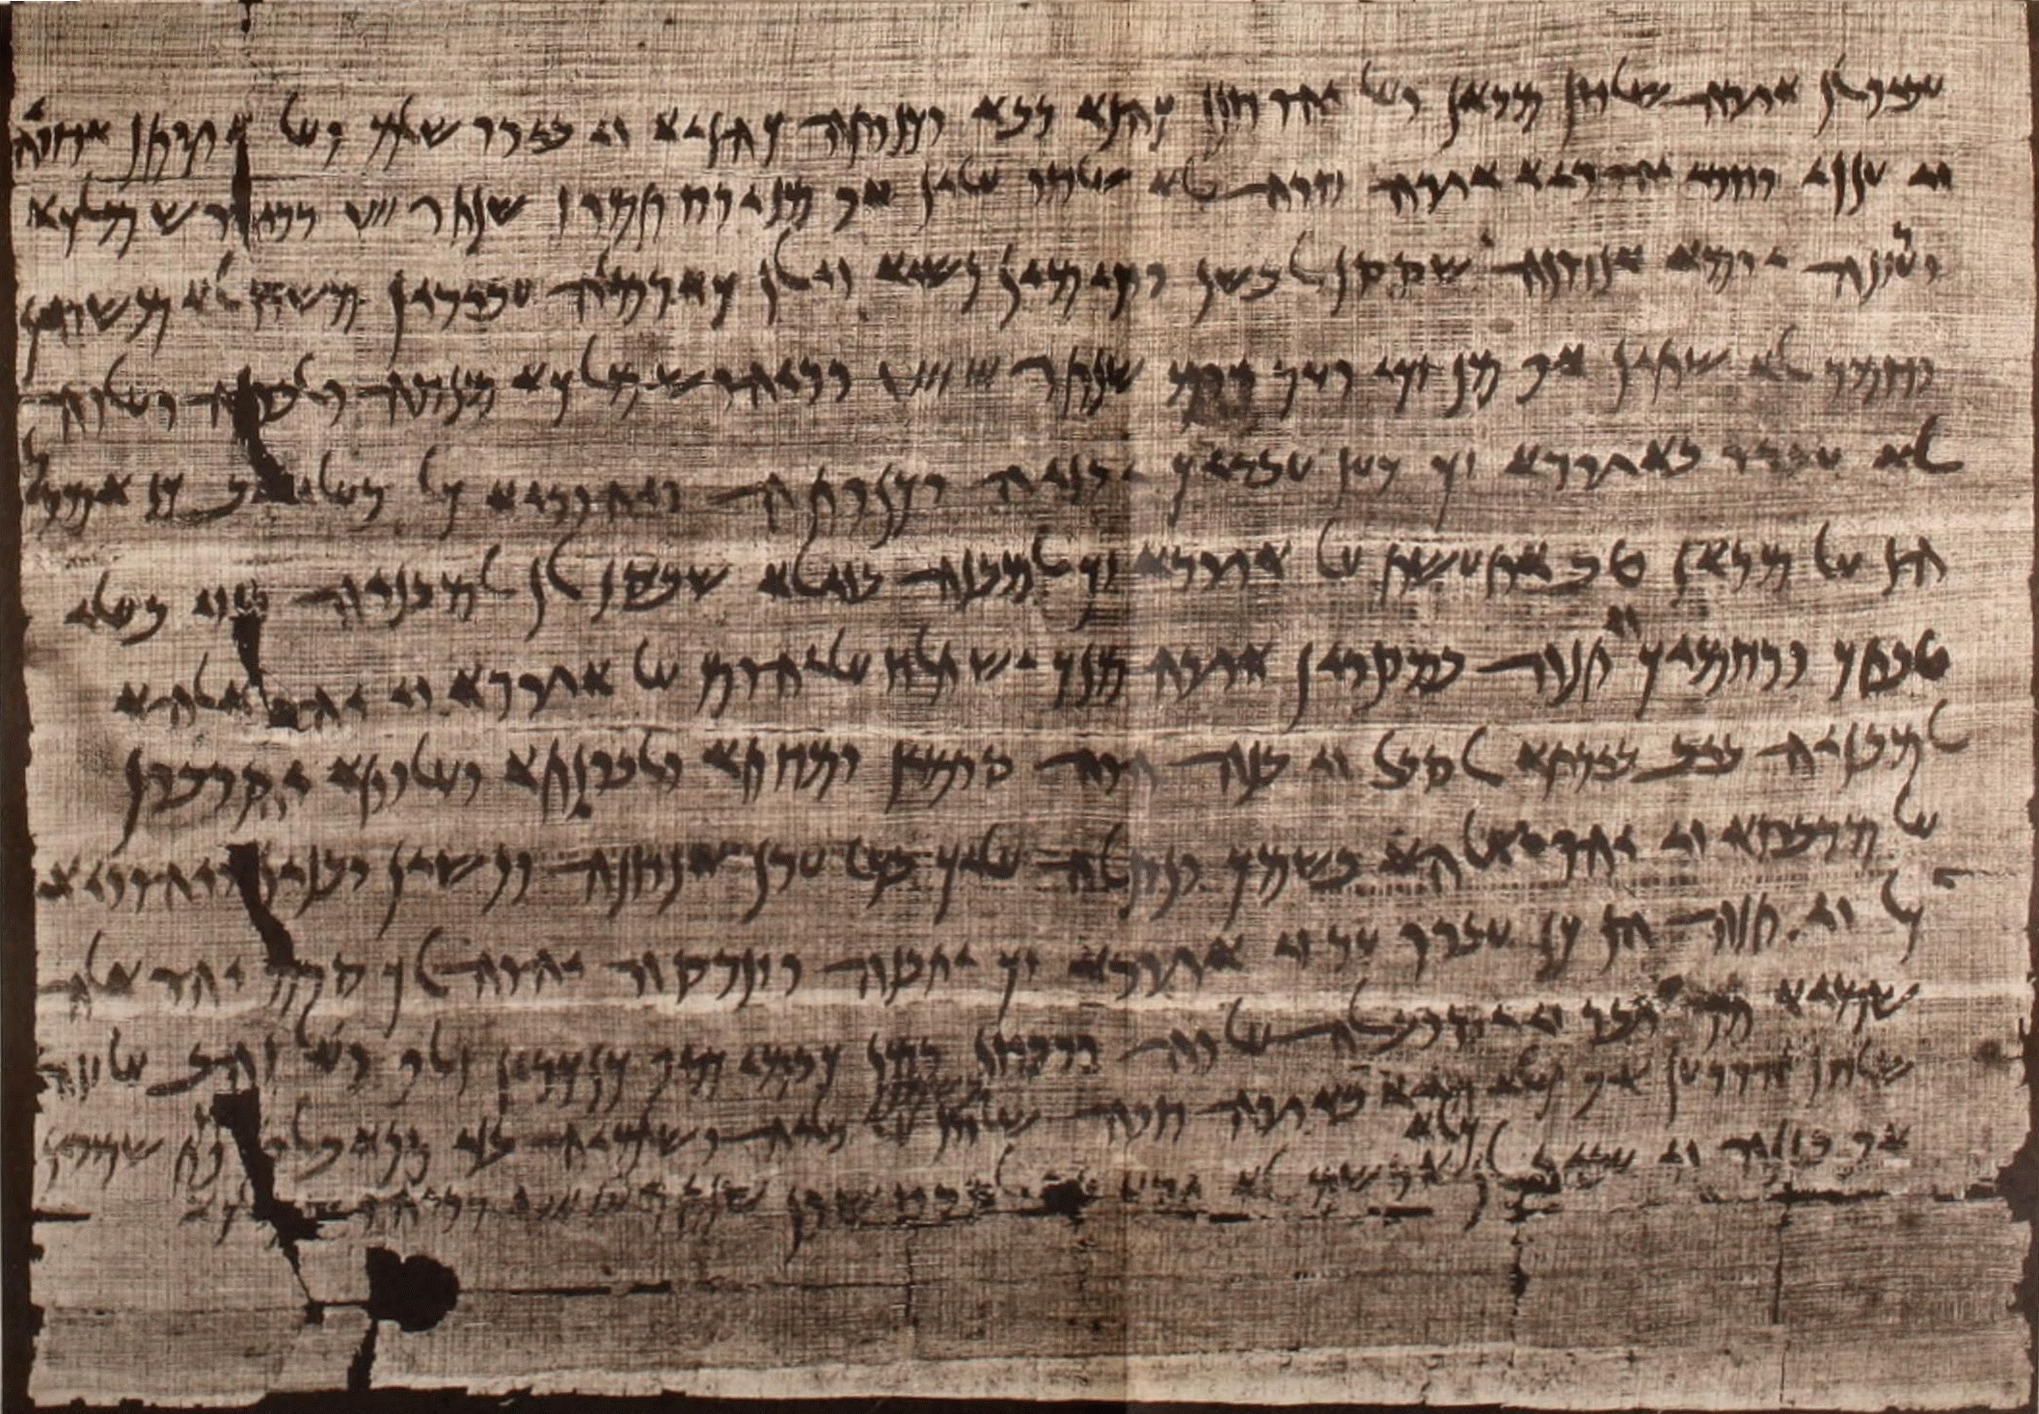

Slide 7
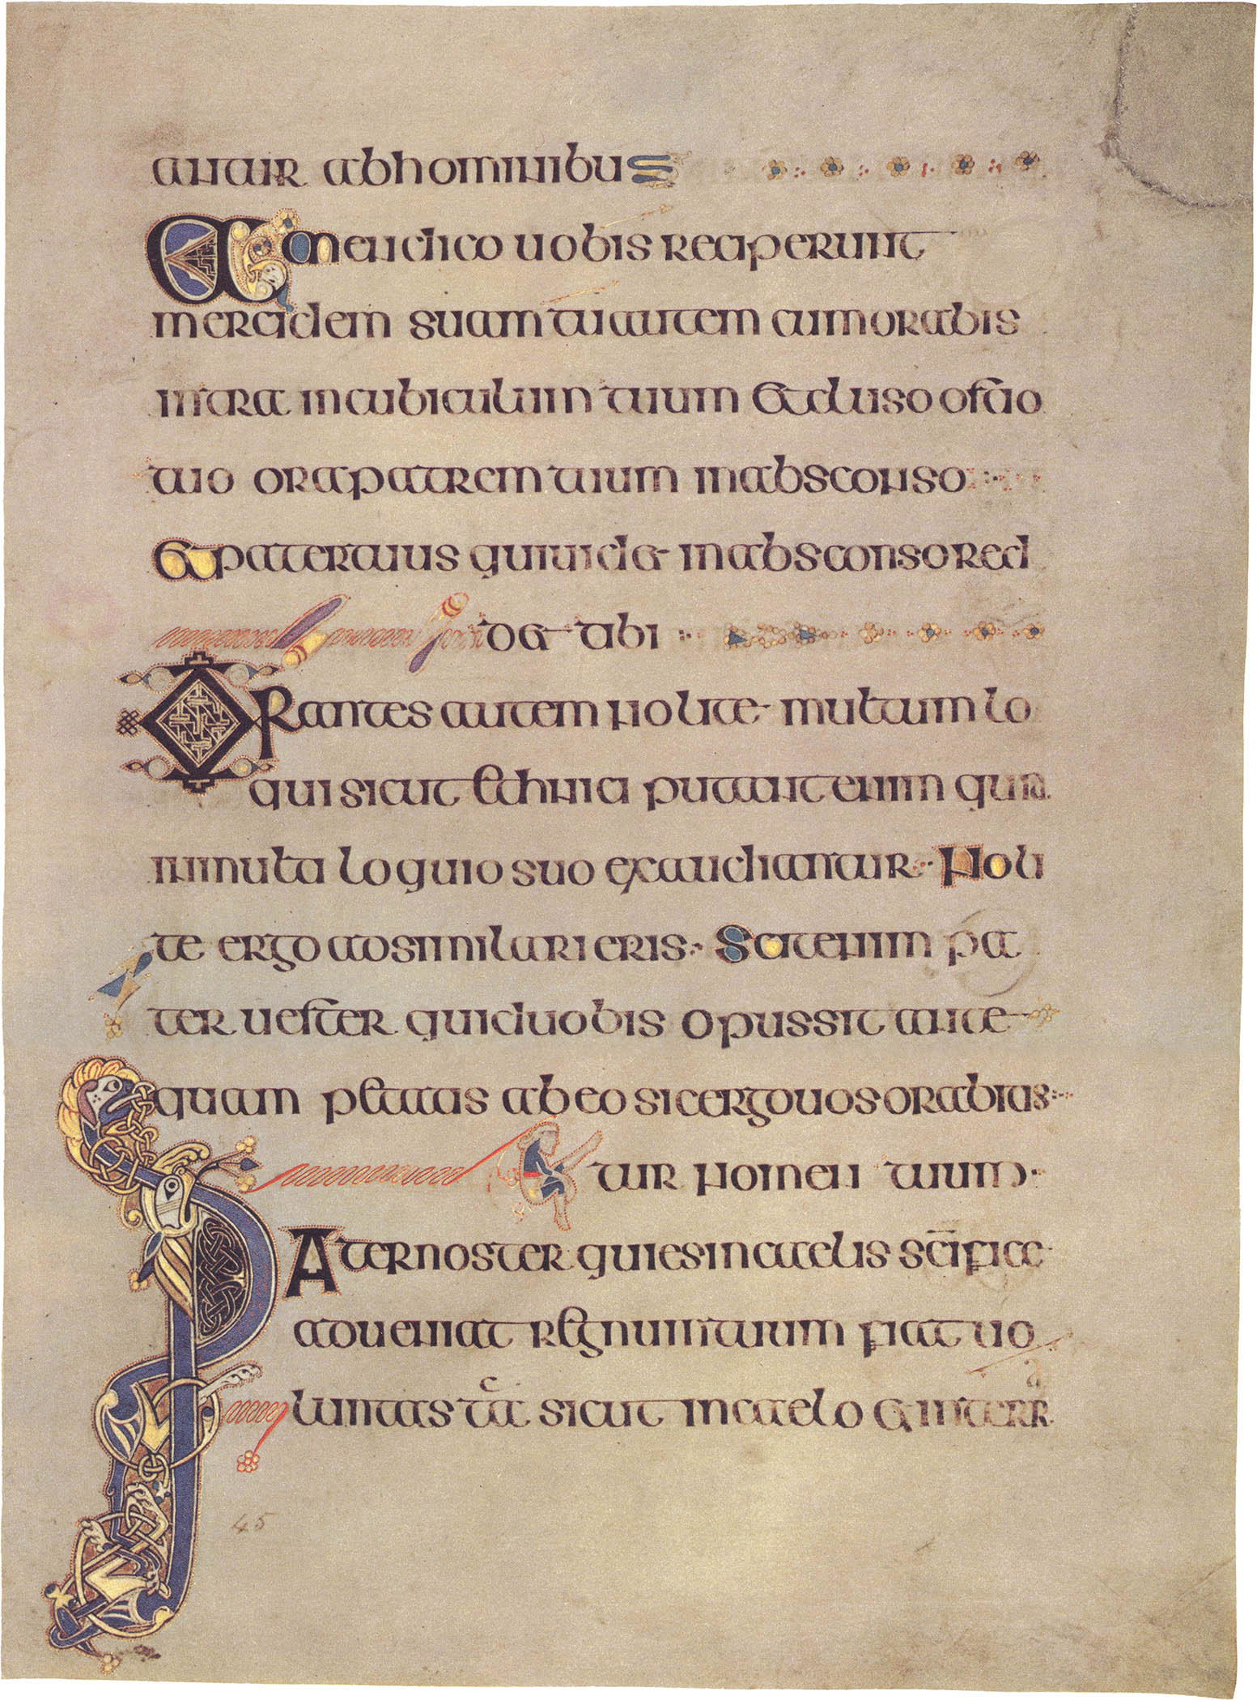

Slide 9
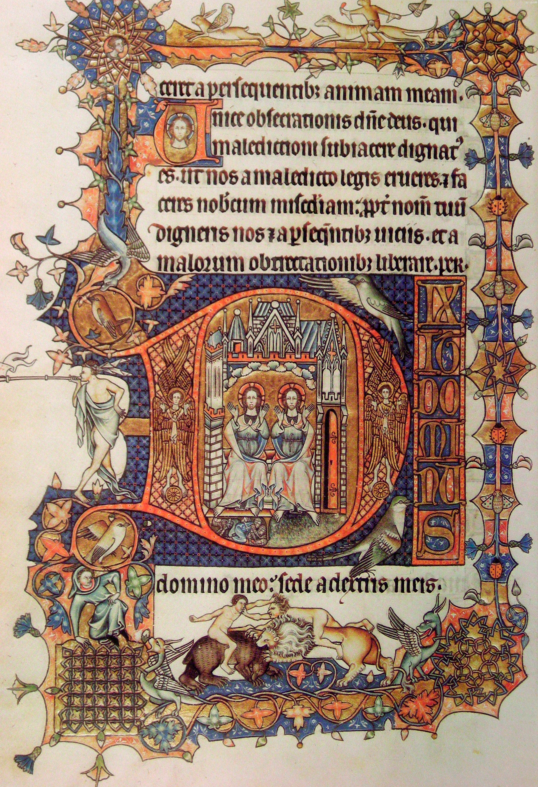

Slide 10
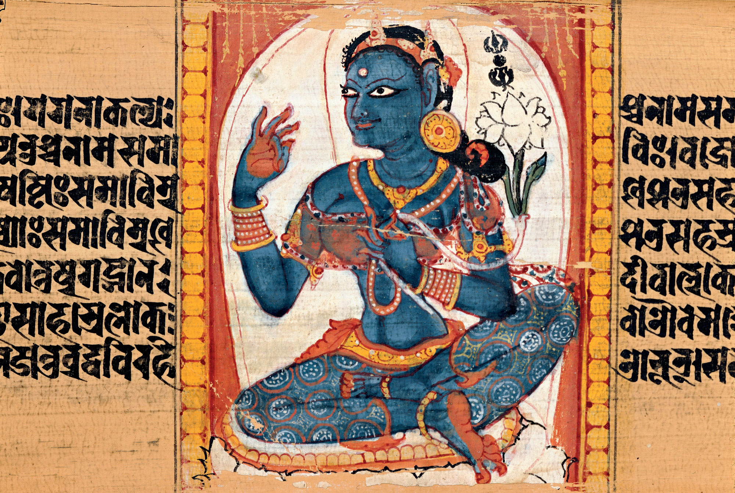

Slide 11
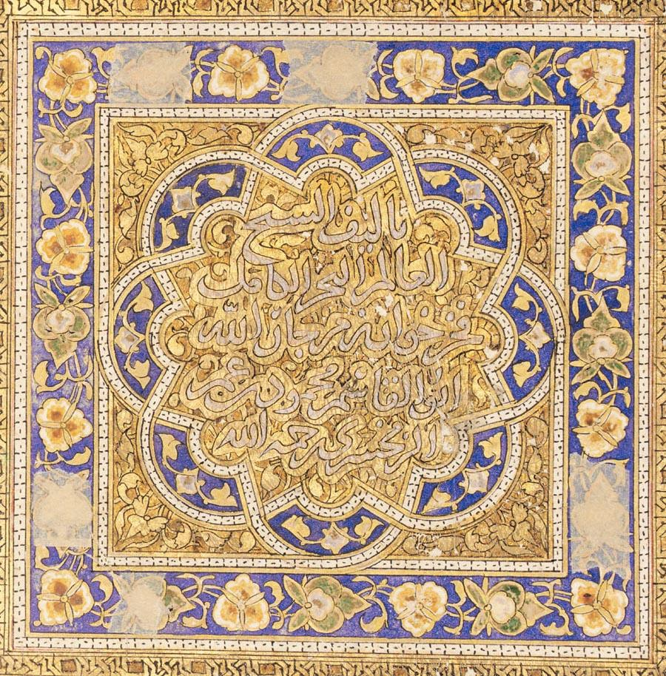

Slide 12
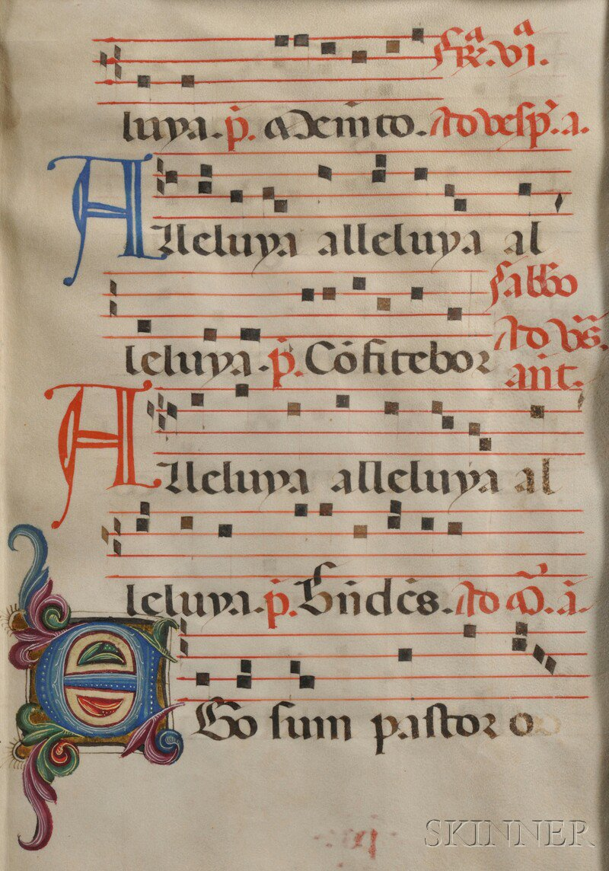
New
Medium

Slide 13
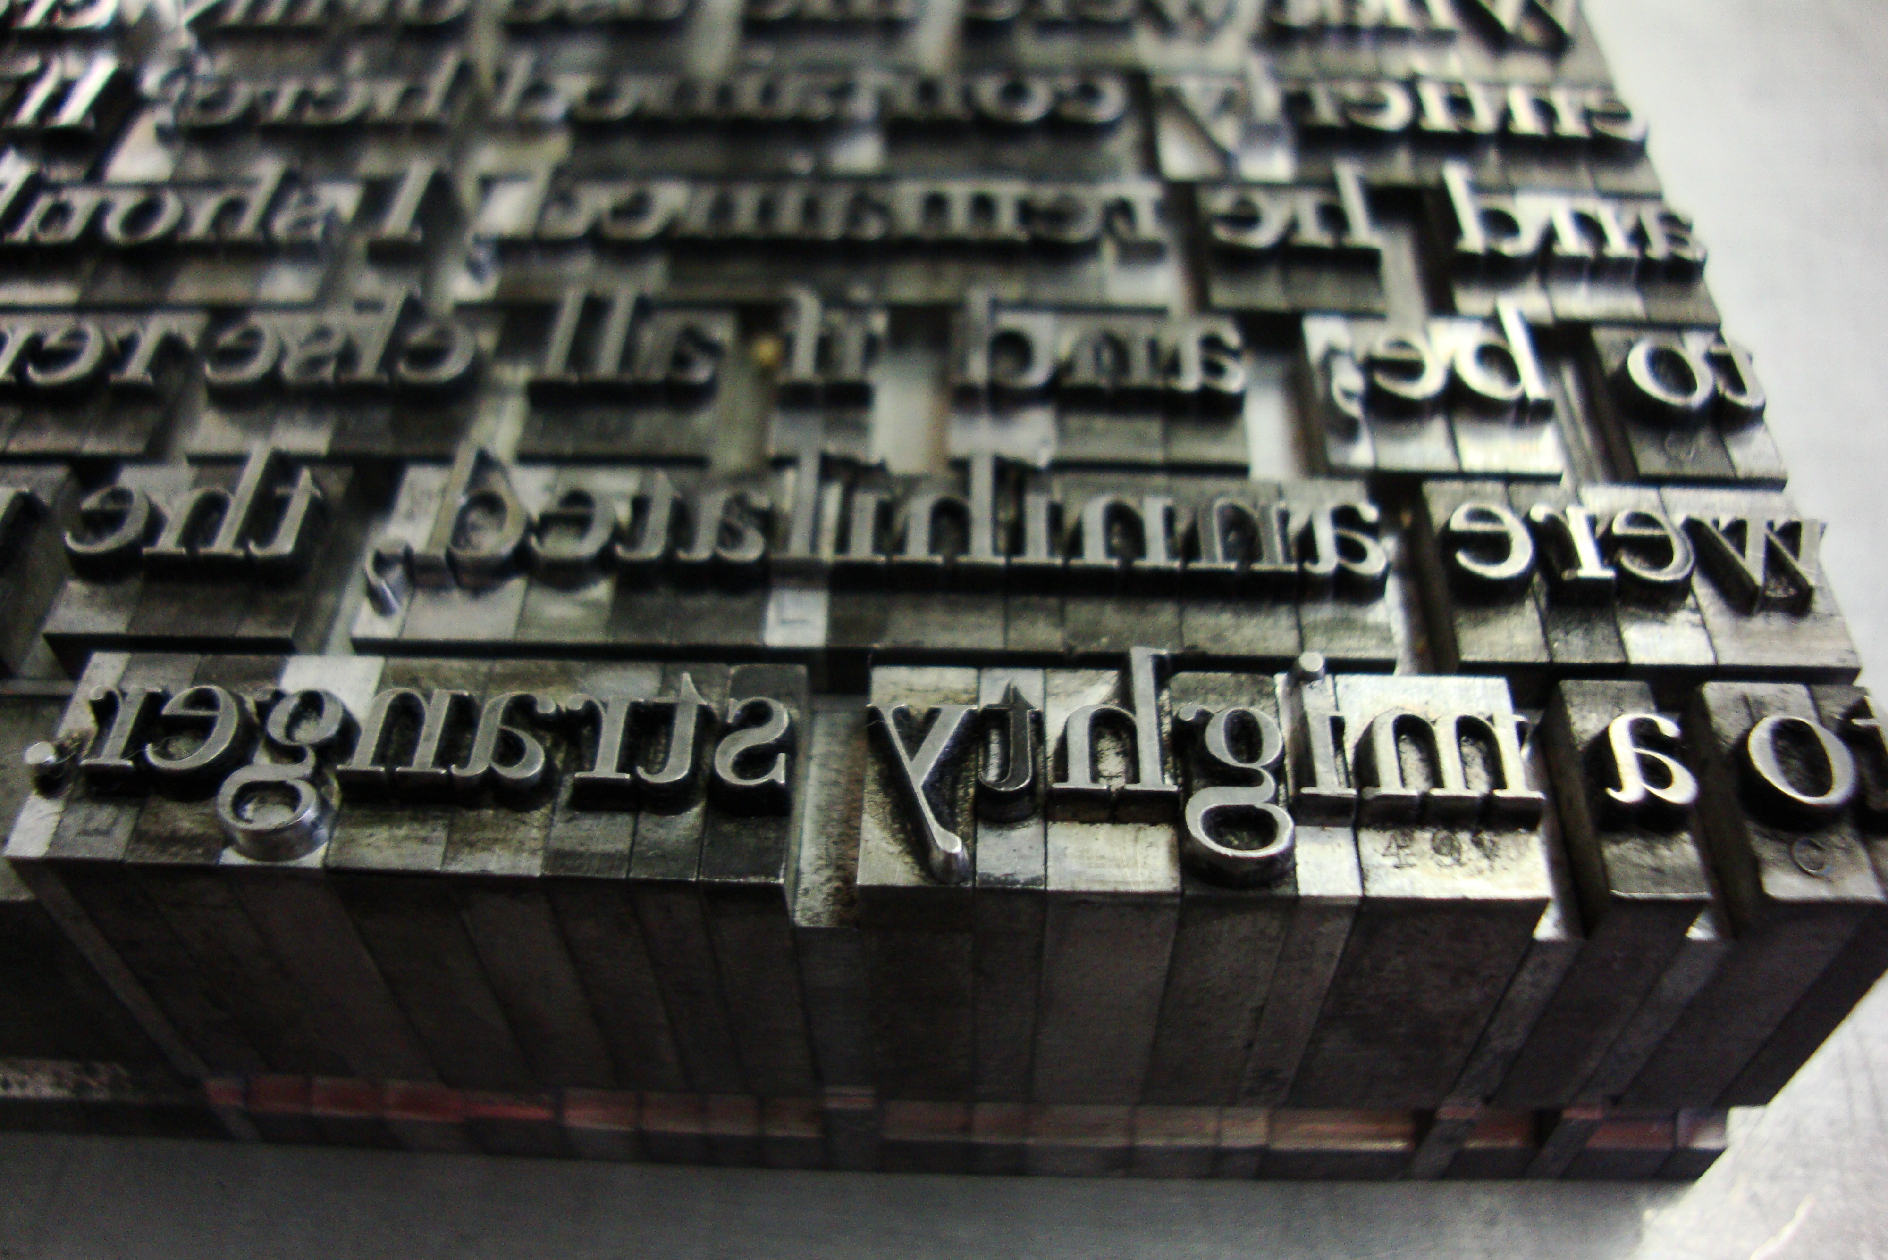
Game Changer

Slide 15
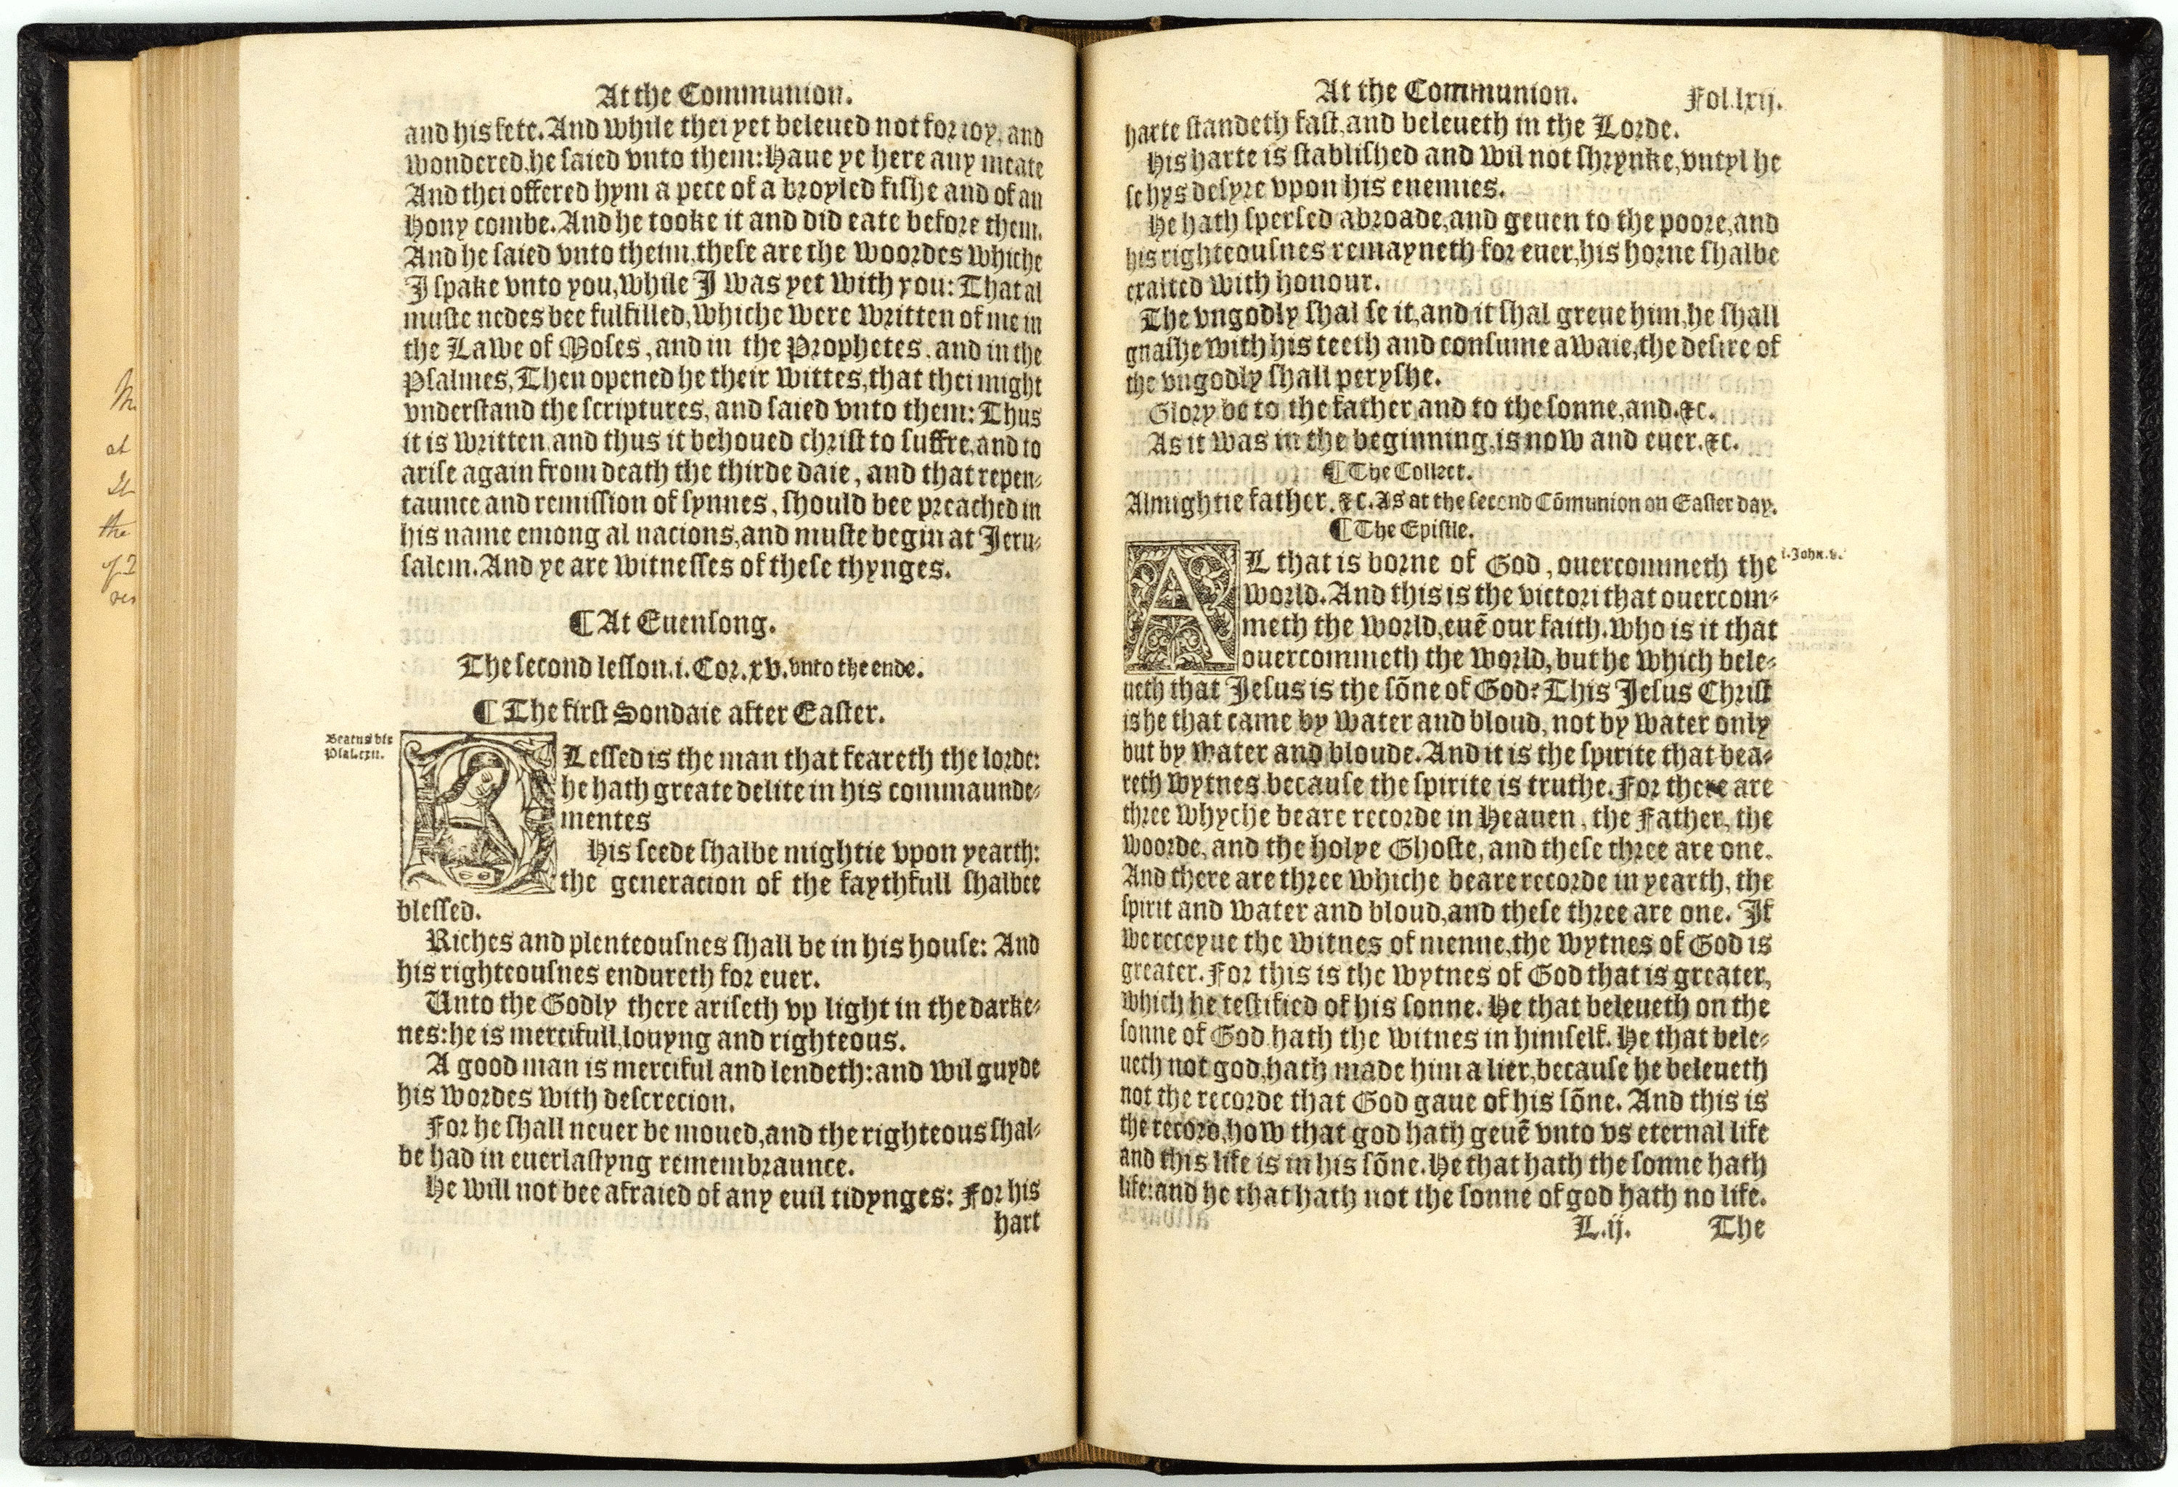

Slide 16
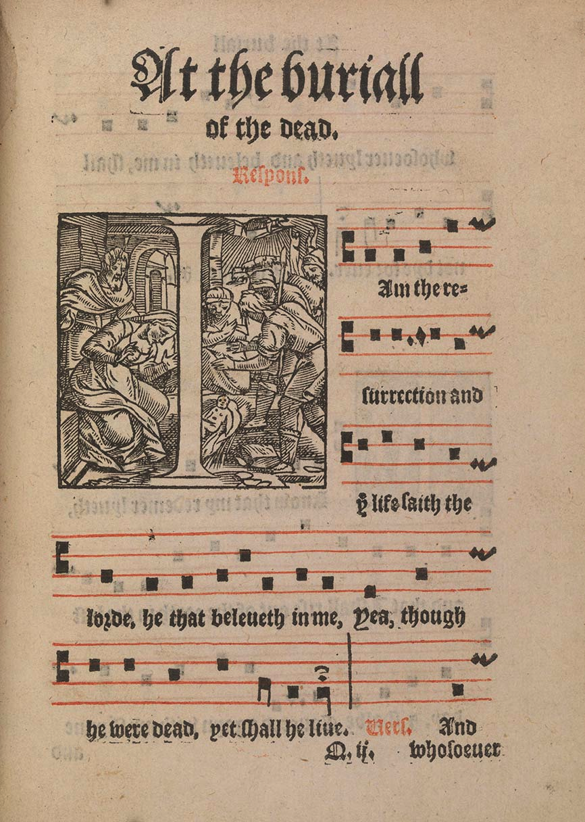

Slide 17
Game Changer: Mechanical Music

Slide 18
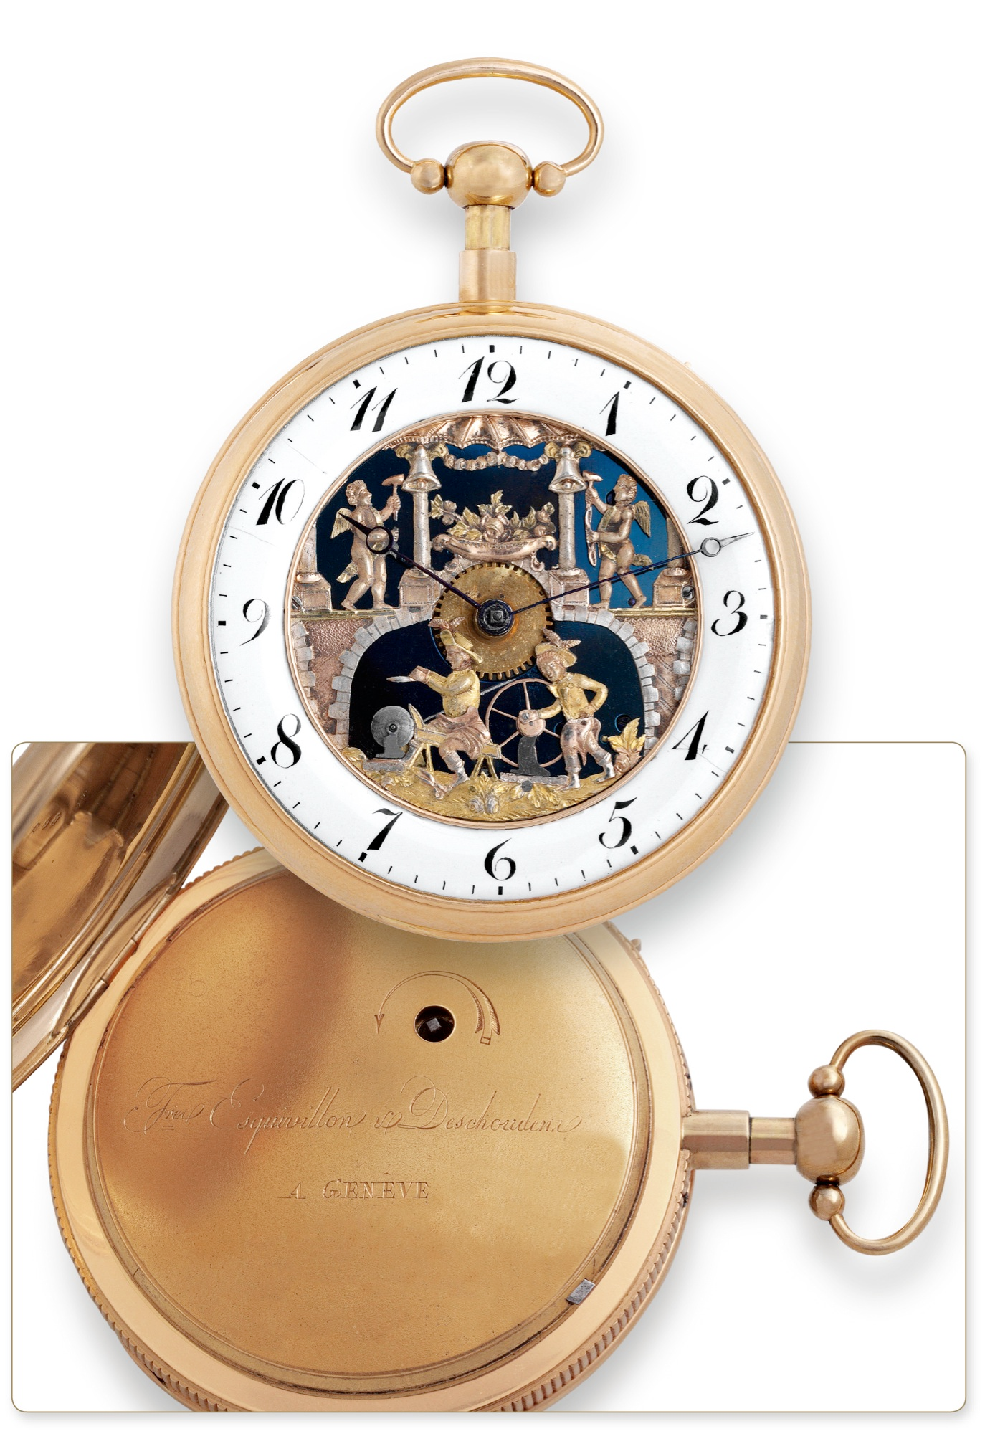

Slide 19
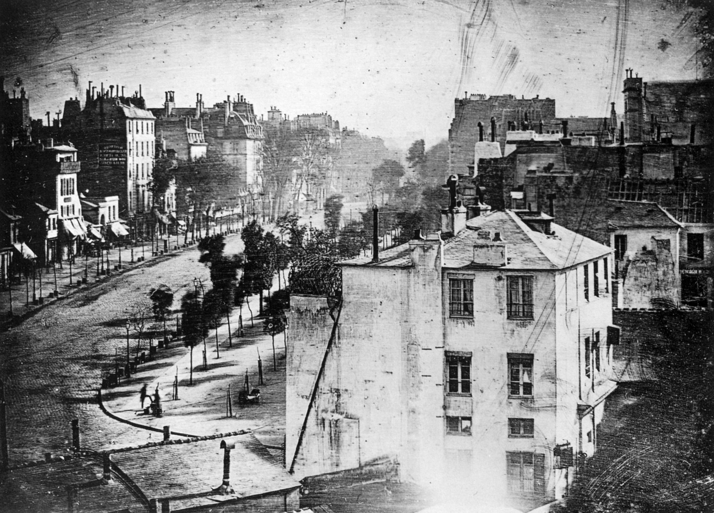
"Boulevard du Temple", taken by Daguerre in 1838 in Paris
New Medium

Slide 20
Game Changer
Henri de Toulouse-Lautrec

Slide 21
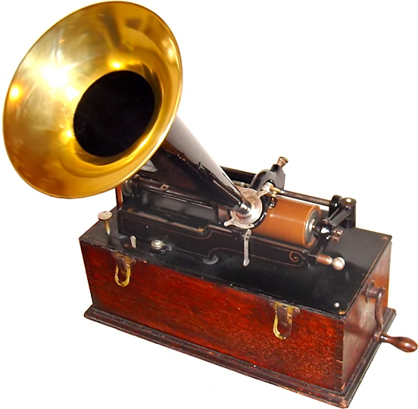
Game Changer

Slide 22
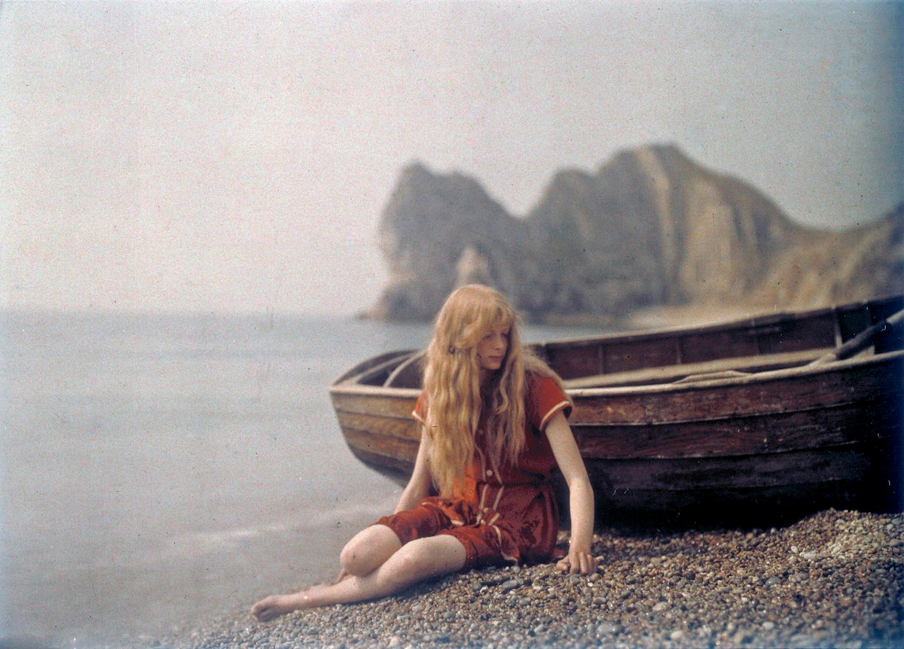
Taken in 1913 by Mervyn O’Gorman

Slide 23
20th Century Media
Gertie the Dinosaur
http://youtube.com/watch?v=UY40DHs9vc4
Steamboat Willie
Sound animated film
http://youtube.com/watch?v=AEEaT_UQnVM
Media combined in new and novel ways. True MULTI-media born.

Slide 24
Broadcast Media (Push)
Radio
Television
B&W
Color
Cable TV
Satellite TV

Slide 26
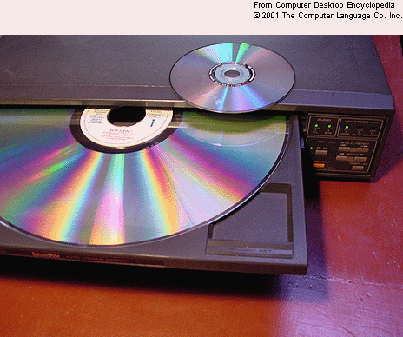
Interactive Multimedia
LaserDiscs

Slide 27
Interactive CD-ROM

Slide 28
Interactive CD-ROM

Slide 29
Networked computing and WWW

Slide 30
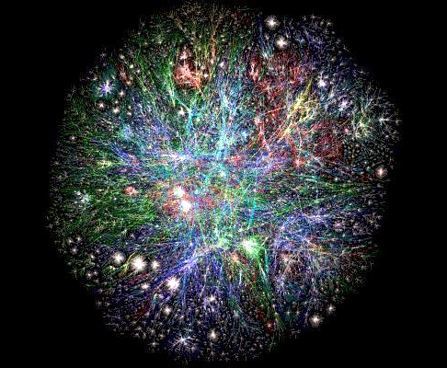

Slide 32
Game Changer: Broadband

Slide 33
Removable Media Slowly Dying

Slide 34
Social Media & Sharing Multimedia

Slide 35
Game Changer: The Smartphone

Slide 36
Where Will We Go Next?

